Slide 1

General Information about turbomachinery and Terminology
Associate professor of Department of Aircraft Engine Theory of Samara University,
Oleg V. Baturin
Of. 336 of 5 building, 34, Moskovskoye Shosse, Samara, Russia, 443086
Phone: (846)267-45-94
E-mail: oleg.v.baturin@gmail.com
Samara 2016

Slide 2
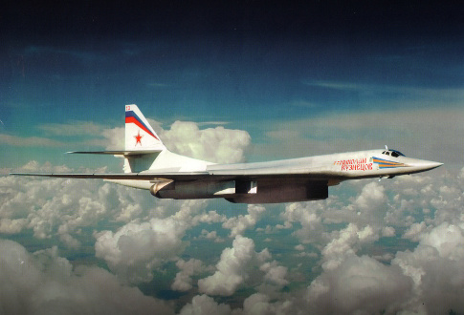
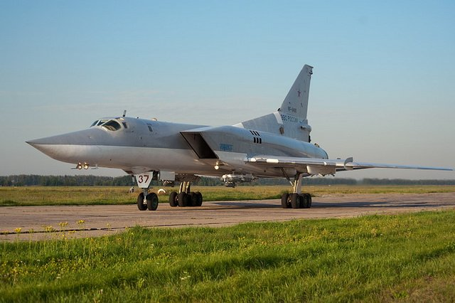




about me
5830km
2

Slide 3
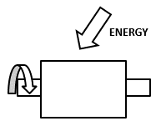
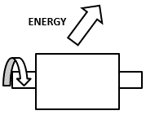
TURBOMACHINES DEFINITION
Turbomachinery (blade machine) is a device in which there is a conversion of energy due to the constant flow of the rotating rotor element by liquid or gas flow moving at high speed.
Distinguishing characteristics:
Continuous process
Interaction is carried out using the special elements – blades
Work is supplied to the flow
Work is extracted from the flow
Work is consumed on the momentum transfer to the flow and pressure increase
Kinetic and potential energies of the flow are transformed into the work
3
Notes:
Turbomachinery is a device in which there is a conversion of energy due to the constant flow of the moving rotor element by liquid or gas moving with a high speed.
Turbomachinery can also be called blade machines.
These two definitions – turbomachinery and blade machine – are synonymous.
In the turbomachinery, mechanical energy can be supplied to the liquid or gas flow or extracted from it.
In the first case, the supplied energy is expended on momentum transfer, forcing the flow to move in a prescribed direction (for example, through the pipeline), and/or on the increase of the working fluid pressure.
In the second case, existing kinetic and/or potential energy of the flow are converted to mechanical energy.

Slide 4
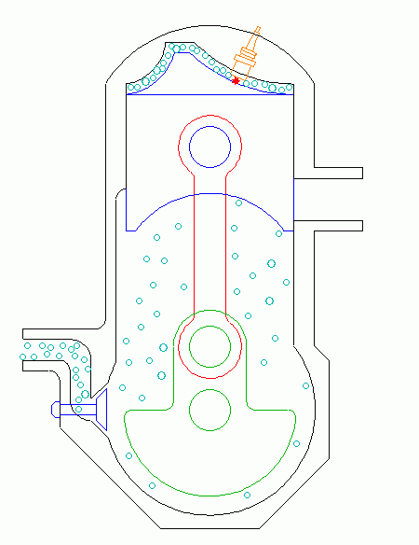
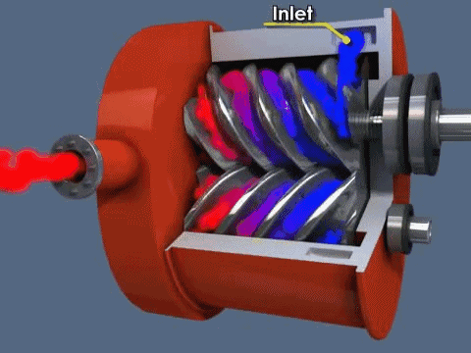
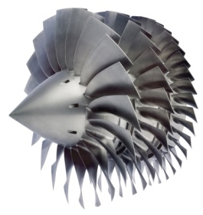
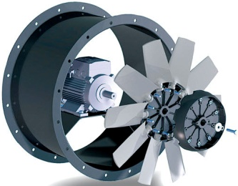
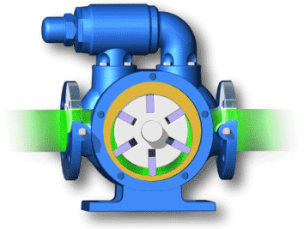
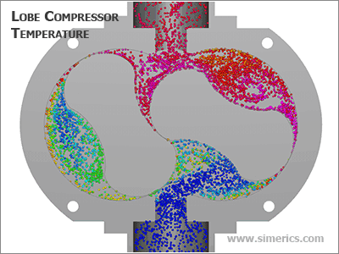
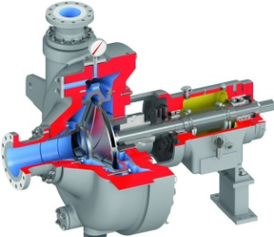
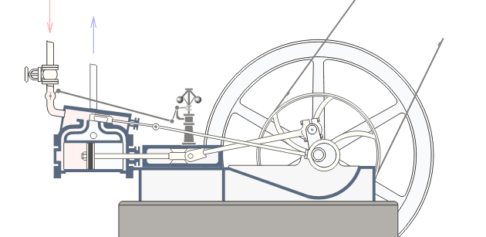
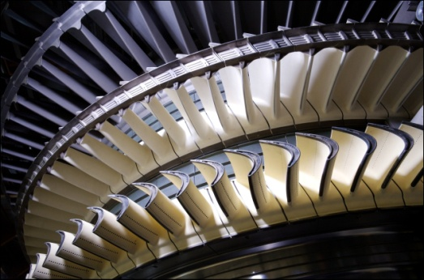



Turbomachinery competitors
Work is supplied to the flow
Volumetric machines |  | Blade machines
Piston | Screw | Compressor | Fan
Rotary-vane | «Roots» | Pump
Work is extracted from the flow
Steam engine |  | Turbine
4
Notes:
Many devices are known that perform similar functions.
In particular, piston, plunger, membrane, screw, rotary and other types of compressors and pumps can be applied for compressing and pushing the working fluid.
The mechanical energy can be obtained in the steam engine from the compressed steam or air.

Slide 5
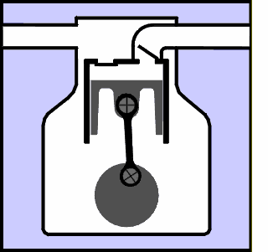
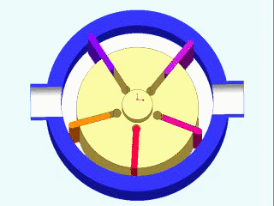
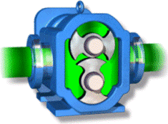
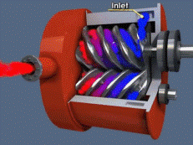
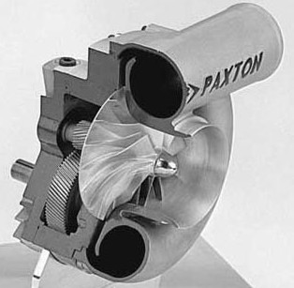
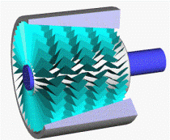
Turbomachinery advantages
Turbomachinery advantages:
Distinguished specific parameters
Possibility of obtaining more power
High efficiency of the stage
High velocity of the working element movement
Low vibration
High reliability
Easy of installation and operation
Uniform flow parameters at the outlet
Motor oil does not get into the working fluid
Good coordination with generators and other turbomachinery
type | Pressure ratio | Velocity M/c | Efficiency, %
 | 20 | 10 | 95
 | 4 | 30 | 60
 | 1.8 | 100 | 90
 | 5 | 150 | 82
 | 8 | 600 | 86
 | 2 | 500 | 94
5
Notes:
As can be seen, the main turbomachinery "competitors" are volumetric machines, operating principle of which is based on the changing the volume of the closed space with the working fluid.
Comparison of the main characteristics of different types of compressors is shown in Table
Energy exchange is carried out continuously in the turbomachinery (compared, for example, with volumetric machines, which work with insulated gas portions).
As a result, the mass flow rate of the working fluid is increased by several times, that significantly increases the machine power with the same specific work.
If the power increase is not required to solve the technical problem, it makes possible to reduce machine size significantly.
Due to substantial increase of the working fluid mass flow, turbomachinery have outstanding specific parameters (weight, volume, overall dimensions).
2. It is possible to achieve virtually unlimited value of the working fluid mass flow and power in one unit.
the working fluid mass flow rate in turbomachinery vary from fractions of grams to thousands of tons, and the power from a few Watts up to thousands of Megawatts.
3. Turbomachinery have high efficiency, which value can exceed 90%.
4. Turbomachinery working elements are balanced (mass unbalance will lead to their destruction).
A small residual unbalance associated with manufacture inaccuracy is eliminated during balancing.
The balance significantly reduces fluctuating loads on the construction and vibrations.
As a result, it simplifies reduces the price of machinery foundation and its installation.
5. Turbomachinery working elements move (rotate) with a large circumferential velocity.
This is possible because the elements of rotor and stator are not in contact unlike the volumetric machines.
This value is limited only by the rotor elements, experiencing the extension from the centrifugal forces
6. High reliability and ease of operation. Today, the operation of gas turbine engines is performed "according to the technical state".
For example, the lifetime of the "cold" part is over 30,000 flight cycles (FC) (over 75,000 hours) for a modern short-haul aircraft with a typical flight duration of 2.5 hours.
The lifetime of hot part is more than 15000 FC (over 35,000 hours).
For industrial gas turbines, the requirement of lifetime of 100,000 hours is typical.
7. The working fluid parameters are more uniform at the outlet, that makes it unnecessary to use receivers.
8. The working fluid at the turbomachinery outlet is isolated from friction units (e.g. bearings).
For this reason, motor oil virtually does not get into it. [3, 18, 21].
9. Good coordination of turbomachinery with generators, electric motors and each other.

Slide 6
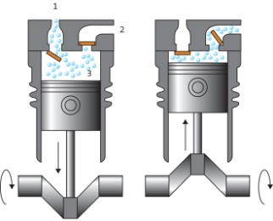
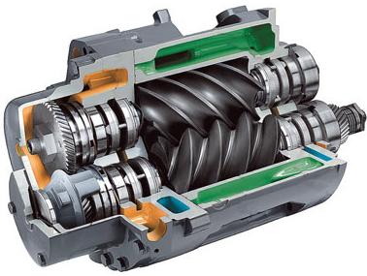
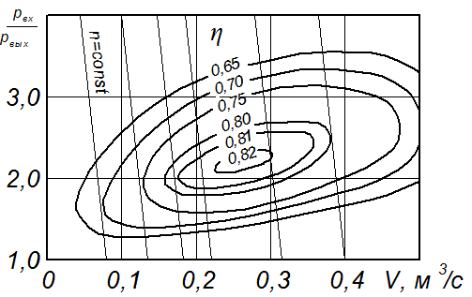
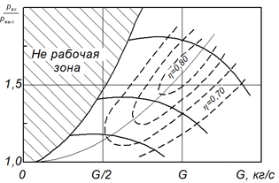



Turbomachinery drawbacks
Drawbacks:
Low efficiency at low mass flow rates
There are modes, where the turbomachinery are unable to work
Lower pressure ratio in one stage
Comparison of characteristics of different compressors
Piston | Screw | Centrifugal
Area, where operation is impossible
$$\frac{p_{in}}{p_{out}}$$
$$\frac{p_{in}}{p_{out}}$$
$$\frac{p_{in}}{p_{out}}$$
n, rpm
V, m³/s
G, kg/s
6
Notes:
Turbomachinery have a lot of important advantages.
However, they have are some drawbacks, including the following:
Turbomachinery efficiency is low at a low working fluid mass flow rate (less than 1 kg/s).
4. Vane compressors have the areas of unstable operation on its characteristic, where their work is impossible or very difficult
5. Volumetric machines allow to get a much greater pressure ratio in one stage.

Slide 7
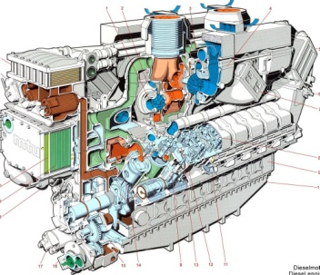
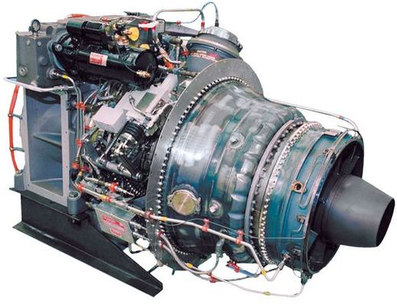
Comparison of gas turbine and piston engines
 | MTU 16V 595 TE70L | MTU TF50
Type | Diesel | Gas turbine
Power, kW | 3925 | 3800
Rotational speed, rpm | 1750 | 16000
Length, m | 3.98 | 1.39
Width, m | 1.66 | 1.89
Volume, m³ | 18.96 | 1.29
Weight, kg | 13000 | 710
7
Notes:
Turbomachinery characteristics mentioned above make it possible to significantly improve the quality of the products to which they are included.
As an example, Table shows a comparison between the diesel engine characteristics, based on the volumetric machines, and GTU, constructed on the turbomachinery.
Obviously, that GTU has much less volume and weight at equal outlet power.

Slide 8
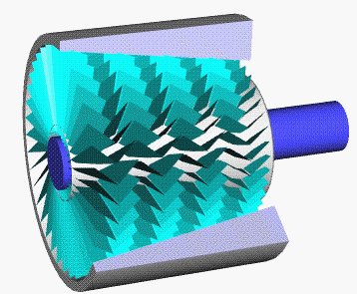
Comparison of dynamic and blade machines
 | Volume machines | Turbomachinery
Principle of operation | Change the size of the insulated volume | Flow of the blade
Rotational speed | < 20 000 rpm | < 500 000 rpm
Pressure ratio | High | Low
Working fluid mass flow rate | Low | High
Type of working fluid movement | Discontinuous | continuous
Cost of installation | High | Low
Application | High pressure ration Low mass flow rate | Low pressure ratio High mass flow rate
8
Notes:
Nevertheless, there is no need to take up the position that turbomachinery definitely leaves behind other types of machines.
In fact, each of them occupy its own niche.
Turbomachinery applications are devices, which are characterized by high power, working fluid mass flow rate and small degrees of pressure variation in one stage.
Volumetric machines are applied in case of low working fluid mass flow rate and significant pressure ratio.

Slide 9
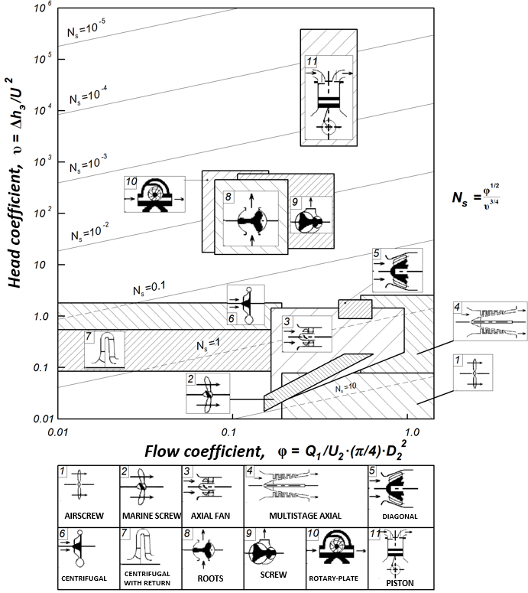
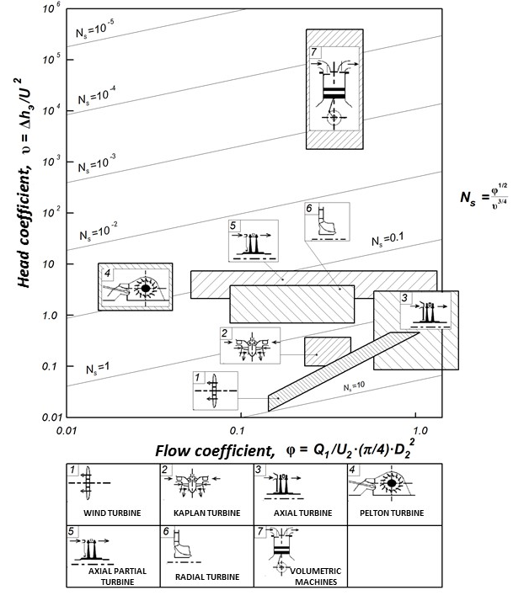
Application of different machines
Work is supplied to the flow
Work is extracted from the flow
9
Notes:
It is also true that different types of turbomachinery have different applications

Slide 10
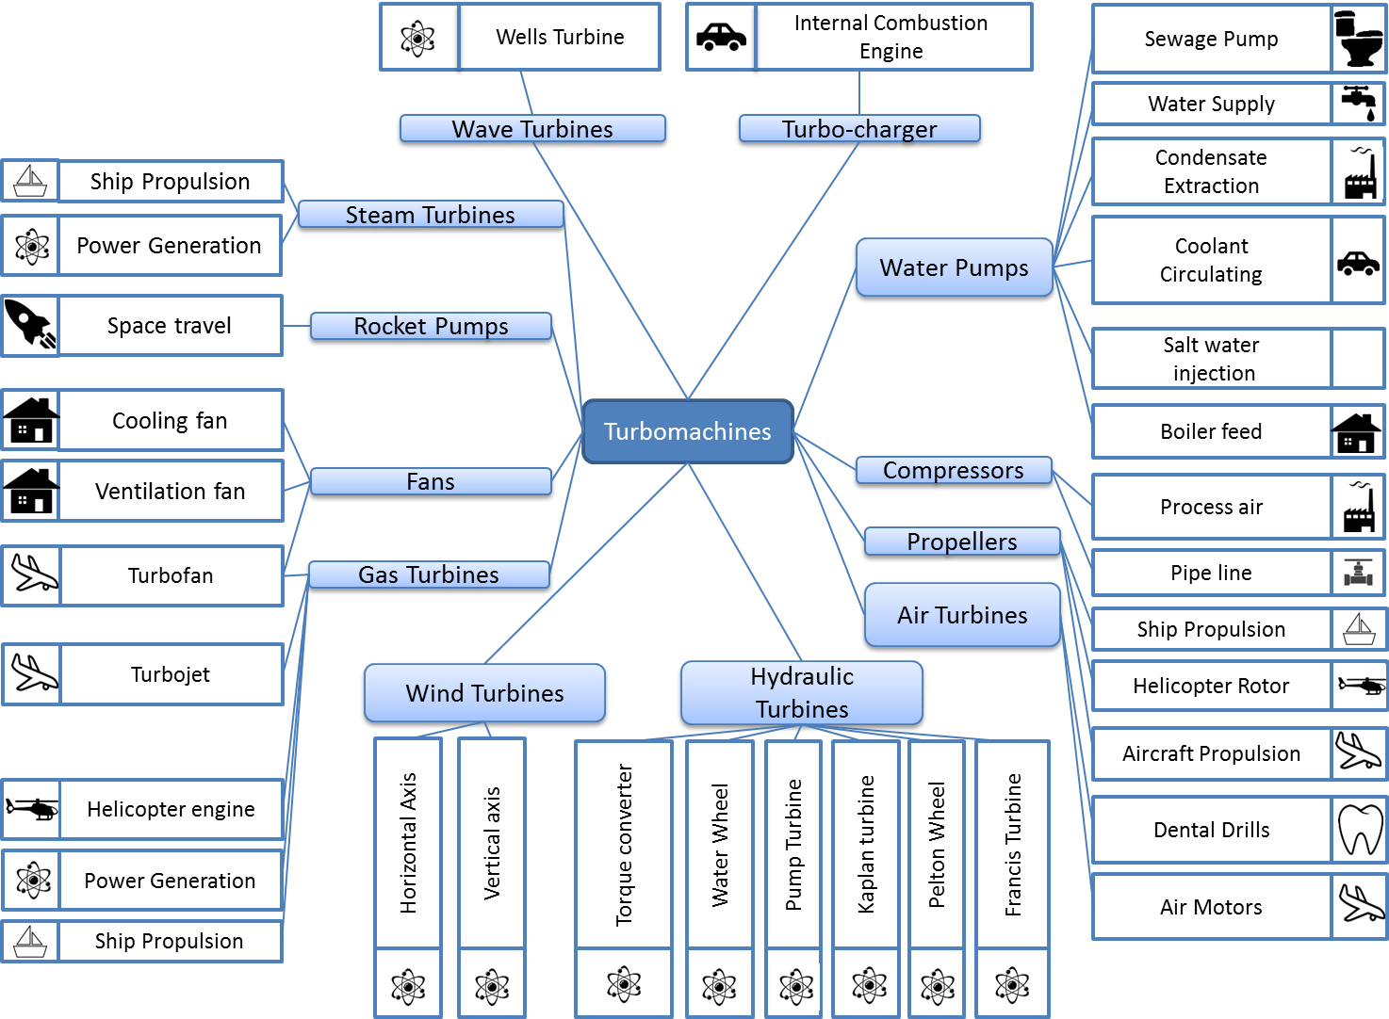
Turbomachinery application
10
Notes:
Figure shows the main turbomachinery applications.
It is seen that they are used in all areas of industry and everyday life.

Slide 11
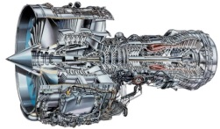
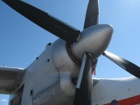
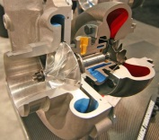
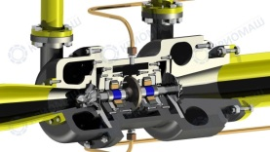
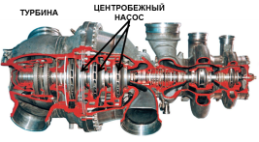
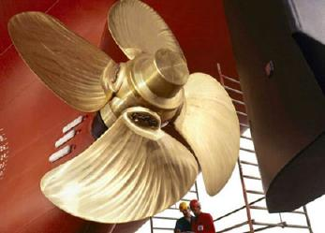
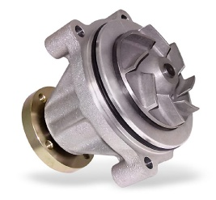
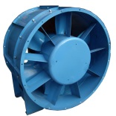
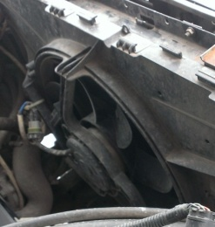
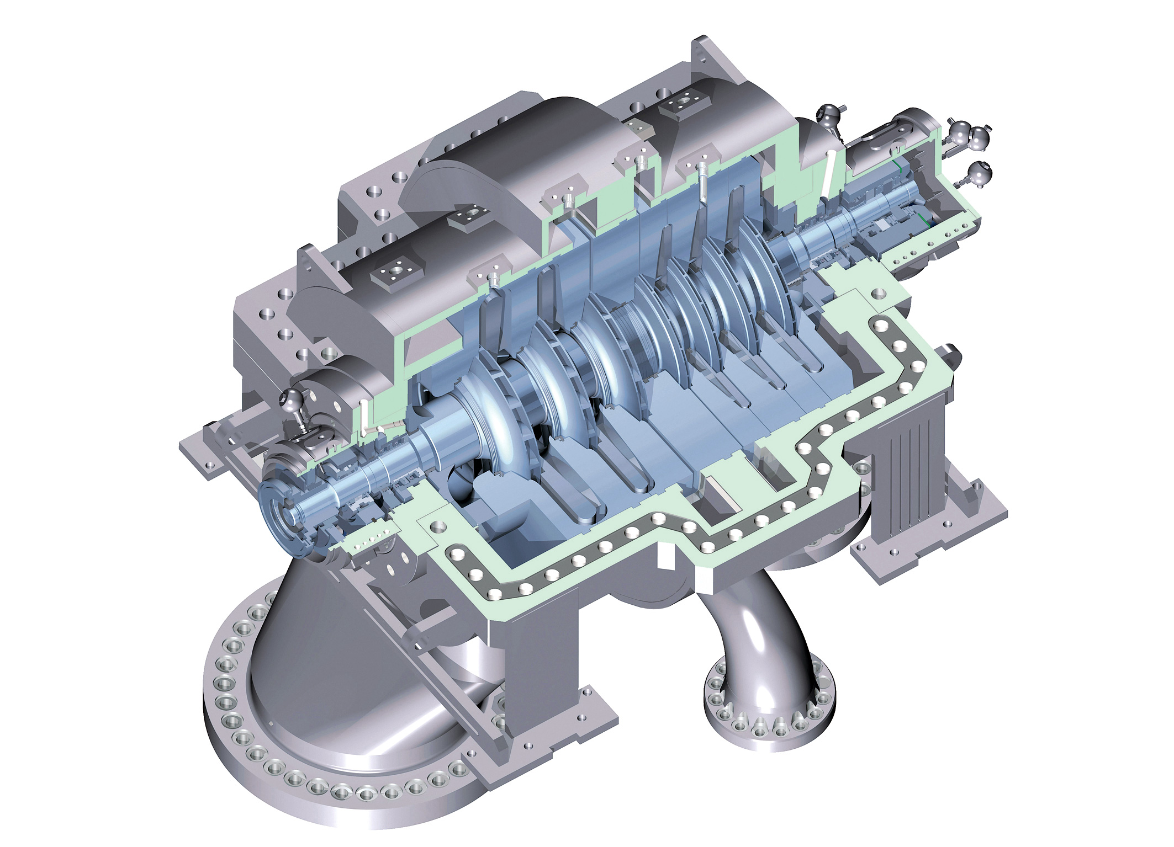
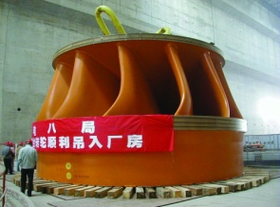
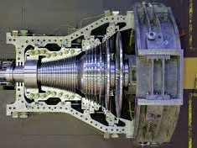
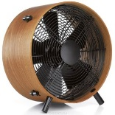
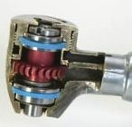
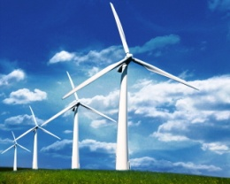
Turbomachinery application
What are the applications of turbomachinery in different areas?
Air transport
Rocket and space technology
Navy
Oil and gas industry
Motor transport (Cars)
Life and medicine
Machine-building enterprise
11
Notes:
if the turbomachinery would not be invented, mankind has now remained at the level of ancient time development.
The most typical examples of turbomachinery applications is given below.

Slide 12
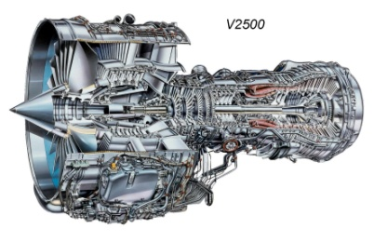
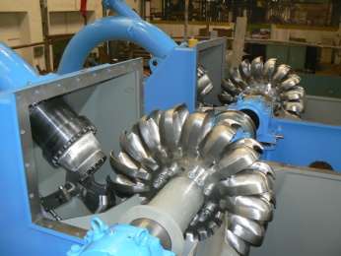
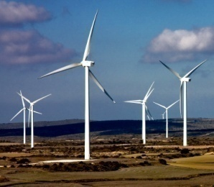

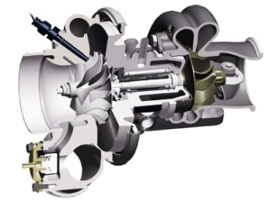
Economic Value of turbomachinery
Electricity is generated by steam, gas, hydraulic and wind turbines
Air transport operations are carried out by means of gas turbine engines
The ship's main propulsion plant is a screw
The ship's power plants are steam or gas turbines and diesel engines
90% of diesel engines are equipped with turbochargers
Pumps supply homes with water and drain the sewage run off
Fuel is supplied to the engines by vane pumps
Air circulation in ventilation and air conditioning systems of buildings and enterprises is organized by fans
12
Notes:
the blade machines is an important part of the modern world and widespread:
electricity is generated by steam, gas, hydraulic and wind turbines;
air transport operations are carried out by means of gas turbine engines;
the ship's main propulsion plant is screw;
the ship's power plants are steam or gas turbines and diesel engines with turbocharged;
90% of diesel engines are equipped with turbocharged;
in the cooling systems of the internal combustion engines there are pumps and fans;
pumps supply homes with water;
fuel is introduced in the rocket engine by vane pumps, which rotate using the turbine;
air circulation in ventilation and air conditioning systems of buildings is organized by fans;
modern electronics and computers require cooling, which is organized by the fans;
dental drill rotates using the turbine.

Slide 13

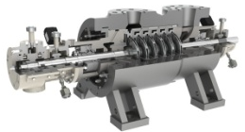
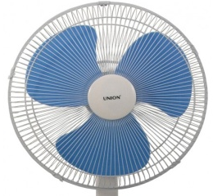

Variety of used turbomachineRY
Parameter | Minimum value |  | Maximum value
Size |  | 4 мм (dental handpiece) | 100 m (wind turbine)
Rotational speed |  | 6 rpm (wind turbine) | 450 000 rpm (dental handpiece)
Mass flow rate |  | 0.001 kg/s (dental handpiece) | 700 000 kg/s (Francis turbine)
Power |  | 3 W (dental handpiece) | 1200 MW (steam turbine)
Pump pressure ratio |  | 1000 Pa (coolant pump of internal combustion engine) | 30 000 MPa (boiler feed pump)
Pressure ration (gas) |  | 1.00 (fan) | 100 (Multistage centrifugal compressor)
13
Notes:
Table shows the possible ranges of the main turbomachinery parameters.

Slide 14







Turbomachinery blades
The main turbomachinery element - blade
blades
The main blade elements
Shroud element
Trailing edge
Suction side
Airfoil
Pressure side
Leading edge
Root
14
Notes:
Energy interaction between turbomachinery and working fluid flow is carried out by means of specially profiled elements, which are called blades .
They are the main elements of turbomachinery.
In general, the blade consists of three main parts: airfoil, root, and shroud segment.
Blade airfoil is the specially profiled aerodynamic surface through which the turbomachinery carries the energy exchange with the working fluid flow.
It is an indispensable element of the turbomachinery blades.
Other elements may present or absent depending on the type, application or size of the turbomachinery.
However, the airfoil will always present.
The airfoil has two lateral sides.
The convex side is called a suction side, and a concave side is a pressure side.
The blade edge which is first in downstream direction is called leading edge, the edge which is the last in downstream direction is called trailing edge.

Slide 15












Turbomachinery blades
What are blades?
1
2
3
4
Axial compressor
Axial turbine
Radial turbine
Axial turbine
5
6
7
8
Radial turbine
Axial compressor
Centrifugal compressor
Axial compressor
9
10
11
12
Centrifugal pump
Axial turbine
Centrifugal compressor
Centrifugal compressor
15

Slide 16









Blade fastening
"dovetail" root
TREE Root
Blades without root
Root of hinged type
Blade
Radial machines
BLISK
BLING
Comparison of masses of rotor wheels with different fastening methods
Weight%
Lug
Disk
Root axis
16
Notes:
Blade airfoil is attached to the disk or the casing.
If the blade is the separate part, its fastening and fixing is performed with the help of the root.
Root type "dovetail" with longitudinal and transverse grooves are most widely used in the axial compressor of GTE and GTU.
In the first case, a groove, into which the blade is inserted, is directed along the rotation axis at a small angle.
In the second case, the groove is cut along the disk in circumferential direction.
Sometimes, in the first compressor stages and in particular in fan stages of GTE, the strength of the "dovetail" root is not sufficient to hold the blades.
In this case, the "tree root" type is used.
The number of "tree" tiers is typically 2...3.
Similar roots are used in aircraft axial turbines or in turbines for power generation.
Number of "tree" tiers pairs can reach 5.
If the disc or casing have a complex configuration, or to reduce the rotor weight, the blades are made integrally with other structural elements.
Rotor blades, manufactured integrally with the disk, are called the blades of type "BLISK" (abbreviation from bladed disk).
These rotor wheels can be manufactured by powder metallurgy methods, investment casting, friction welding or machined from a single piece.
It is possible to reduce the weight of rotor wheels by more than 30% and increase the critical rotation frequency in axial turbomachinery due to the rejection of the root junction.
Further development of the technology "BLISK" are the wheels, made by "BLING" technology.
They represent a rotor wheel with blades made integrally with the disk. On the inner surface the disk is reinforced metalcomposite matrix, which improves its carrying capacity.
Reinforcement is carried out by the diffusion welding.
This design allows to reduce the rotor wheel weight to 70% (relative to the disk with separate blades) and again go back to the drum rotor (Figure 1.2.9), the use of which is limited by the strength characteristics.

Slide 17








Shroud segment
variant 1 – shroud segment in flow path
axial compressor
Axial Turbines
Rope
Shroud segment
rotor wheel of axial compressor with shroud segment
Compressor rotor blade with shroud segment
Steam turbine
Aircraft turbine
Top view of the shroud segment
rotor wheel of axial compressor with double-row shroud segment
Stage With shroud segment
Stage Without shroud segment
This type of shroud segment reduces the efficiency by 1...2%
17
Notes:
Shroud segment is not a mandatory element.
There are two approaches of the shroud segment implementation.
In the first case, shroud segment is located in the flow path of the turbomachinery, usually in the long blades.
When interacting with gas flow, such blades are prone to high oscillations, that can lead to their destruction.
The complete ring is formed in contact with adjacent blade shroud segments, which considerably increases the wheel rigidity.
The oscillation energy is consumed on the friction of shroud segments about each other, causing the significant reduction of the oscillation amplitude.
Such shroud segment performs only anti-vibration function.
Because such shroud segment is located in the flow path of the turbomachinery, its flow reduces the efficiency approximately by 1...2%.
Shroud segment of such type is usually applied in the GTE axial compressor and steam engine.
There are known designs of turbines of steam-turbine plant, industrial gas turbines and aviation GTE in which steel rope passed through the wheel blades can be applied as the shroud segment.

Slide 18








Shroud segment
variant 2 – shroud segment at the periphery
Axial Turbines
the connection of the blades of Axial turbines
Rotor wheel with shroud segment
Rotor wheel without shroud segment
Comparison of axial turbine blades
Closed rotor wheel
Without shroud segment
With shroud segment
Closed rotor wheel of centrifugal pump
This type of shroud segment increases the efficiency by 1...2%
18
Notes:
2. In the second case, shroud segment is located on the peripheral surface of the blades.
It performs anti-vibration function as well.
However, the installation of the shroud segment significantly changes the leakage into the radial gap, which improves the turbine efficiency by 1...2%.
Such shroud segment is widely used in axial turbomachinery.
It is almost a mandatory element for the blades of GTE axial turbines except for the first highly loaded stages, where their use is limited by strength criteria.
Sometimes, rotors wheels with a shroud segments are applied in radial turbomachinery (e.g. closed wheels), but their use is limited due to the difficulties production and in ensuring the sufficient safety margins

Slide 19




Definitions
Blade row is a set of blades mounted on the rim of the disk or in a ring casing
Type of rows:
movable – rotor wheel (RW);
fixed – guide vanes (GV)
[in compressor]
– nozzle blade (NB)
[in turbine]
Alternation of movable and fixed rows
19
Notes:
Set of blades mounted on the rim of the disk or in a ring casing is called blade row (BR).
The rows can be moving and fixed.
The blades installed in the disk, which is connected to the drive shaft, form a movable blade row which is called rotor wheel (RW).
Fixed blades, installed in the casing, form guide vanes (GV) in compressor, and nozzle blades (NB) in turbine.
Moving and fixed rows usually alternate in the turbomachinery.

Slide 20



Definitions
Jet Cat P200
Rotor
Rotor blades with disks and shafts
Stator
Fixed blades with casings
20
Notes:
Rotor – rotating turbomachinery shaft with details mounted on it (blades, disks, hubs, separators etc)
Stator –turbomachinery casing with fixed elements mounted on it

Slide 21




Compressor stage
Axial compressor
Select the individual stages
№1
№2
№3
№5
№6
№4
1. Stage: RW+GV (2 rows)
How many stages?
2. Stage: IGV+RW+GV (3 rows)
21
Notes:
Turbomachinery stage is the set of one rotor wheel and fixed elements of flow path, providing supply and extraction of the working fluid.
Axial compressor stage consists of moving rotor wheel (RW) and fixed guide vane (GV).
It is worth noting that RW is installed before GV in compressor. However, this rule has an exception.
Fixed row - inlet guide vane (IGV) - can be installed before RW of the first (or single) compressor stage. IGV is used for pre-twist creation to increase compressor efficiency and specific work.
In this case, compressor stage consists of three rows IGV+RW+GV .
In number of sources IGV does not belong to any stages, and it is considered as the part of the input device.

Slide 22





Compressor stage
Centrifugal compressor (Generalized stage)
Inlet
Compressor stage
Inlet guide vane (IGV)
Rotor wheel (RW)
(mandatory element)
Outlet system
Slot diffuser
Vane diffuser (GV)
Volute
Рабочее колесо
IGV
Vane diffuser
outlet
Supercharger
GTE
Volute
22
Notes:
Centrifugal compressor stage is the most general case of compressor stage.
The structure of the output system may include slot and vane diffuser as well as volute (spiral casing) .
Slot diffuser (SD) is used only in radial compressors.
It is intended for flow deceleration and static pressure increase.
SD has the form of radial or inclined slit, in which the flow moves from the center to the periphery.
The cross-sectional area and the pressure increase due to the rise of the cross section radius.
The main advantages of such diffuser are simplicity and the possibility of inhibition of supersonic flow with low losses.
Vane diffuser (VD) is a fixed blade row and performs the same function as the SD.
Guide vane is the specific case of vane diffuser.
In comparison with the slot diffuser, vane diffuser has a smaller radial length (at the same pressure ratio) and smaller energy losses at a subsonic flow of the blade.
If supersonic flow is got into vane diffuser inlet leading-edge shock waves is formed before blades, which results in higher losses. Therefore, vane diffusers do not apply separately in centrifugal compressors.
Slot diffusers is always preceded, in which the flow velocity is decelerated to subsonic speeds.
Volute or spiral casing is a specially shaped channel in which the flow deceleration and its collection occurs for the supply in single collecting canal (pipeline).
The latter directs the flow further, for example, in the cylinders of internal combustion engine (ICE). Volute may have one or more outlets.

Slide 23




Turbine stage
Axial turbine
How many stages?
Stage: NB+RW (2 rows)
Select the individual stages
№1
№2
№3
№4
23
Notes:
Turbine stage consists of the fixed nozzle blades and the moving rotor wheel. In turbine, the fixed row always precedes the moving row

Slide 24







Turbine stage
Generalized turbine stage
Purpose of the turbine diffuser
Centripetal turbine
Determine the elements of the stage
24
Notes:
In centripetal turbine input system can function as the NB.
The input system includes a volute (in case if the working fluid is supplied to the turbine via conduit) slotted channel and nozzle blades .
The volute of radial turbine is designed for uniform supply of the working fluid to the nozzle blades circumferentially from the manifold.
Furthermore, the flow in the turbine volute is accompanied by acceleration and expansion of the gas flow.
The slotted channel and NB are designed to accelerate the flow.
Slotted channel is a radial or inclined slit, in which the gas flows from the periphery toward the center of the turbomachinery.
Due to the reduction of the radius, the passage area decreases, leading to acceleration and expansion of the flow. NB perform the same function, but the expansion occurs in a fixed blade row with converging channels.
The usage of bladed NB reduces the diametrical dimensions of the turbine, in addition it is often installed after volute to align the flow at the RW inlet.
The input system does not necessarily have all the elements.
Often, the NB is not installed in the supercharging units to simplify the construction.
In radial turbine turbochargers this allows to reduce their costs by 15-20% [18].
Output diffuser is an expandable channel, and it is designed for the static pressure reduction at the outlet of the turbine RW.
This increases the pressure drop in turbine $π_{t}={р_{g}^{∗}}/{р_{t}}$, which in turn improves the work:

Slide 25


Numbering of control sections
Compressor
Turbine
inlet
Inlet
Outlet
Outlet
0 – Inlet to the IGV
1 – Inlet to the RW
2 – Outlet of the RW
3 – Outlet of the GV
0 – Inlet to the NB
1 – Inlet to the RW
2 – Outlet of the RW
The numbers are standardized !!! They are used to identify parameters principle: 1 – inlet to the rotor wheel
2 – outlet from the rotor wheel
25
Notes:
Flow parameters in turbomachinery often analyzed in the control sections, which are usually at the inlet and outlet of the blade rows.
The designations of these sections are standardized and common to all types of turbomachinery:
0 – inlet to the stationary blade row, located in front of the RW (turbine NB or compressor inlet guide vanes (IGV));
1 – inlet to the rotor row;
2 – outlet of the rotor row, the inlet to the next stationary row;
3 – outlet of the guide vane (GV).
These numbers are used as indexes to write a parameter and indicate belonging of the parameter to a specific section.
For example, р₁ - means the pressure in a section 1, i.e. at the RW inlet: с₀ - means the absolute velocity at the nozzle blades inlet.

Slide 26








Coordinate system
Coordinate system
Usable cross sections
Meridional
Vector projections
Normal
Cylindrical
26
Notes:
In turbomachinery theory, the gas flow is usually considered in the following coordinate system including 3 main axes:
a axis (axial direction) - coincide with the axis of turbomachinery rotation;
r axis (the radial direction) - directed along the radius;
u axis (circumferential (tangential) direction) - perpendicular to the first two.
Any velocity vector can be decomposed into the projection in the adopted coordinate system.
c_{a} – axial projection;
c_{r} – radial projection;
c_{u} – circumferential projection;
c_{m} – meridional projection.
1. Meridional cross-section - cross-section by the plane passing through the axis of rotation. It gives you a better understanding about the turbomachinery geometry and design. However, it does not provide comprehensive information about the geometry of the blade airfoil. Any turbomachinery drawing is actually its meridional cross section.
2. The cross-section by plane perpendicular to the axis of rotation
Cylindrical cross section - circular (constant along the axis of rotation of the radius) or conical (alternating along the axis of rotation of the radius) section, the axis of which coincides with the turbomachinery axis opened out in the plane.
This cross section gives the most complete information about the blades shape

Slide 27








Geometrical parameters of turbomachinery
Parameters of meridional
cross-section
Parameter of airfoil cascade
Nondimensional parameters
Angle measurement
Blade aspect ratio:
Relative hub diameter:
Relative blade height:
Cascade solidity
Relative pitch
Blade aspect ratio
relative coordinate of airfoil maximum thickness position
Compressor | Turbine
27
Notes:
The geometrical parameters of the turbomachinery can be divided into two groups.
The first group describes the flow path parameters, the second - the blade row and airfoil geometry.
The first group includes a number of dimensional parameters:
peripheral diameter of the flow path ;
hub diameter of the flow path ;
mid-diameter of the flow path:
height of the blade:
row width (axial chord) S.
Nondimensional parameters that describe the meridional cross-section are often used along with the dimensional parameters:
blade aspect ratio:
relative hub diameter:
when describing of the turbine geometry, the parameter close to the physical meaning of the parameter is often used.
The relative diameters are associated with both the level of losses in the BR and the stress level in the blades.
the blade row and airfoil geometry
The most important and commonly used ones are the following:
Camber line of airfoil- geometric locus of the center of the circles inscribed in the profile.
Cascade front - the line connecting the end points of the airfoil at the inlet and outlet of the blade row.
The line connecting the points of airfoil camber line intersection with the its contour is called a chord of airfoil and is denoted by the letter b.
Stagger angle (γ) - the angle between the chord of airfoil and the cascade front.
Blade angles at the inlet and outlet - the angles between the tangent to the camber line of airfoil and the front at the points of its intersection at the leading and trailing edges respectively.
Blade-camber angle ( θ) - the angle between the tangent to the camber line at the points of intersection with the profile line.
Maximum airfoil camber of camber line (f) - distance from the chord to the farthest point of the camber line.
The maximum thickness of the profile - the maximum diameter of the circle inscribed in the profile.
Coordinate of position of the maximum thickness - the distance along the chord from the leading edge to the point of the center of maximum thickness position.
Cascade pitch (t) - the distance between the corresponding points of two adjacent profiles.
Cascade throat - the minimum diameter of the circle inscribed in the channel between adjacent profiles.
Incidence angle (i) - the difference between the blade and the actual angle of the flow on the leading edge.
Angle of lag (deviation) (δ) - the difference between the blade and the actual angle of the outlet flow:
Nondimensional parameters are often used along with the dimensional parameters to describe the turbomachinery geometry:
cascade solidity ;
relative pitch ;
blade aspect ratio ;
relative cascade throat :
relative coordinate of airfoil maximum thickness position:

Slide 28








Turbomachinery classification
Classification criterion | Classification
Direction of the energy movement | Machines-engines | Machines-performers
Number of stages | One stage | Multistage
Number of cascades (shafts) | One cascade | Multicascade
Shaft position | Horizontal | Vertical
28
Notes:
Turbomachinery can be classified according to several criteria.
Table shows the possible variants of its classification.

Slide 29






Turbomachinery classification
Classification criterion | Classification
Number of inlets | Single-inlets | Two-inlets
Presence of casing | Open | Close
Pressure change | Active | Reactive
29

Slide 30









Turbomachinery classification
Type | Axial | Centrifugal | Centripetal | Diagonal
Compressors |  |  | Do not exist
Image
Turbines
30
Notes:
In practice, turbomachinery are most often classified according to the main direction of the working fluid movement.
On this basis, they are divided into axial, centrifugal, centripetal and diagonal.
Diagram illustrating the blade machines differences of different types is shown in Figure

Slide 31





Turbomachinery classification
Type | AXIAL | CENTRIFUGAL | CENTRIPETAL | DIAGONAL
Pressure ratio | < 2 | < 12 | < 6 | < 5
The highest efficiency | 0.92 | 0.85 | 0.88 | 0.9
Rotor
Stator
Examples of different turbomachinery
31
Notes:
In axial BM, the direction of the working fluid in the meridional plane coincides with the direction of the RW rotation axis or close to it.
The streamlines are arranged on a surface close to the cylindrical, and their axis coincides with the axis of BM.
Axial turbomachines are characterized by increased efficiency (0.9-0.92 - the largest value compared with other types), but moderate pressure ratios ($π_{c}^{∗}$ up to 2) and expansion.
In centrifugal BM the movement of the working fluid in the meridional plane is performed from the center to the periphery in a direction close to perpendicular to the axis of rotation.
The main advantage of the centrifugal compressor compared to the axial is possibility to obtain larger pressure ratio $π_{c}^{∗}$ in one stage.
Often, it exceeds the value of 5...6, and it can exceed 12 in advanced aircraft compressors [17].
The efficiency of centrifugal compressor stage $η_{c}^{∗}$ does not exceed the value of 0.85 [1,17], which is considerably less than in the axial.
The efficiency values, close to the specified value, are typical for compressors of aircraft GTE with relatively high capacity.
However, unlike the axial compressors, while reducing the dimension of the compressor in mass flow rates and, as a consequence, reducing the blade height, the reduction of the centrifugal compressor efficiency is not so significant.
For this reason, the centrifugal compressor usually exceeds the axial one in efficiency at low mass flow rates of the working fluid.

Slide 32




Turbomachinery classification
Type | AXIAL | CENTRIFUGAL | CENTRIPETAL | DIAGONAL
The level of efficiency at low working fluid consumptions | low | acceptable | acceptable | acceptable
Production of multistage machine | Simple construction There are no additional losses | Dimension increase Losses due to additional turns of the flow | Dimension increase Losses due to additional turns of the flow | Simple construction There are no additional losses Good matching with axial stages
Rotor
Stator
Influence of working fluid mass flow rates on efficiency
Multistage turbomachinery
32
Notes:
However, gas-dynamic efficiency of axial stages essentially depends on the size of the blade machine.
Axial turbomachines at small mass flow rates of the working fluid (less than 5 kg/s) have small blade heights.
This leads to an increase in the influence of the processes occurring in the boundary layers and radial clearance on the flow in the blade passages and significant reduction of the efficiency.
Therefore, the efficiency of axial turbomachinery decreases with the decrease of the mass flow rate of the working fluid, and they can be worse than other types of blade machines at mass flow rate less than 5 kg/s.
An important advantage of axial turbomachinery is the easy creation of multistage designs of the successive stages.
Indeed, the flow leaving one stage in axial machines usually falls into the next one without transitional channels and additional flow turns.
This is not accompanied by a significant drop in efficiency.
This quality allows to get higher total compression and expansion ratio with small losses in axial turbomachinery.
The advantages of centrifugal compressors are also relatively simple structure, fewer parts, more favorable flow characteristics and less sensitive to operating conditions.
The disadvantages of this turbomachinery type include the complexity of the organization of multistage compression process without substantially reducing the efficiency, increasing the diametric dimensions and weight.
Indeed, to direct the working fluid from the periphery of the first stage to the inlet of the second stage it is necessary to turn the flow through 90° three times, which will lead to additional losses.
In centripetal BM the movement of the working fluid in the meridional plane is also carried out in a direction close to perpendicular to the rotational axis, but in the direction from the periphery to the center.
Only turbine can be centripetal.
The efficiency of centripetal turbine (reaches 0.88) is higher than the efficiency of the centrifugal machine, but does not reach the value of the efficiency of axial turbines.
Due to the movement of the working fluid against the action inertial forces, the centrifugal turbines can obtain greater expansion ratio, or to implement a similar expansion rates at a lower velocities level and thus losses. Centripetal turbomachinery is similar to centrifugal in terms of technology and the possibility of organizing a multistage process.
Diagonal turbomachinery represents an intermediate type between the axial and radial (centrifugal and centripetal).
Their parameters are between the parameters of these types of turbomachinery.

Slide 33




Turbomachinery for gas turbine engine
 | Requirements
Working fluid mass flow rate | >10 kg/s
Pressure ratio | >30
Number of stages | min
Reduction of efficiency due to the number of stages | High
Structure complexity | Minimum
Axial | Radial
High efficiency | Low efficiency
<2 | <10
>1 | >1
Not so high | Considerable
Acceptable | Complex
axial-centrifugal compressor
RR Trent 900
PW 545
33
Notes:
By analyzing these data, we should not conclude that a particular type of blade machines is good or bad.
A comparison should be made with regard to the conditions in which the turbomachinery will be operated.
For example, the ground GTU and aircraft GTE have a relatively high mass flow rate of the working fluid (measured in tens of kilograms per second) and compression ratio (more than 30).
It is obvious that high efficiency at high mass flow rates and the ability to create highly efficient and compact multistage turbomachinery are important requirements for turbomachinery of such products, as no one of their type can get the required parameters in a single stage.
Such requirements are best met mainly by axial turbomachinery
In some cases, axial-centrifugal multistage compressors that are a combination of axial and centrifugal stages can be used in GTU with low thrust and low mass flow rates of the working fluid to enhance the efficiency of the compressor.
And centrifugal stage is always a closing.
It is installed instead of multiple axial stages having ultra-small heights of rotor blades, which particularly affects the influence of radial clearances and secondary flows
Such compressors, despite some loss of efficiency (compared with the axial compressor of the same degree of compression) have significantly smaller linear dimensions and weight

Slide 34



Turbomachinery for supercharger
 | Requirements
Working fluid mass flow rate | < 1 kg/s
Pressure ratio | < 3
Number of stages | min
Reduction of efficiency due to the number of stages | High
Structure complexity | Minimum
Axial | Radial
Low efficiency | High efficiency
<2 | <10
>1 | 1
Not so high | -
Complex | Simple
34
Notes:
The superchargers of ICE are characterized by a small working fluid mass flow (up to 1 kg/s) and a moderate compression/expansion ratio (up to 3 [12], and gasoline engines have no more than 1,8-2).
Furthermore, the ICE turbocharger must have simple construction to reduce the cost of mass production of car engines.
Centripetal and centrifugal machines satisfy these requirements.
They are superior to the axial blade machines in efficiency in the range of considered mass flow and allow to obtain the required degree of compression in one stage (as opposed to axial)

Slide 35




Blade machines in gas turbine engine
 | Aircraft GTE | Ground gtu
What it produces | Thrust | Torque on the output shaft
Key component | Nozzle | Turbine
What should be done for the operation of the key component? | To create an increased inlet pressure
Ideal Brayton cycle
Combustion chamber increases the energy of the flow
Turbine rotates compressor
Torque on the output shaft
high pressure gas is required
35
Notes:
Gas turbine engine is a heat engine operating according to a closed thermodynamic Brayton cycle, resulting in effective work generation.
Then it is converted into the movement of the aircraft (in the case of GTE, or useful work at the output shaft (in the case of ground GTU
The result of the gas turbine engines operation is the thrust (P) - the force that is applied to the aircraft and eventually makes it move.
The principle of its production, according to the Stechkin formula, is based on dropping the working fluid with high speed in the direction opposite to the motion:
High speed gas flow is created through the nozzle, which is a narrowing channel (confusor) at subsonic pressure differentials.
In the case of supersonic pressure drops, the nozzle is in the form of a de Laval nozzle.
To accelerate the flow the nozzle must create a pressure difference between its inlet and outlet.
In this case, the pressure at the inlet to the nozzle must be greater than the outlet pressure. Considering that during the aircraft flight, gas jet exits in the atmosphere, it is necessary to create high pressure at the nozzle inlet for receiving the high-speed flow.
The result of the ground GTU operating (as well as aircraft engines of indirect reaction) is the power and torque at the output shaft, which are then transmitted to the consumer (to drive a generator, gas pumping units (GPU), propeller, etc.). The useful power is generated by turbine in such engines. For its operation, as in the case of the GTE nozzle a pressure differential must be created between the inlet and the outlet.
Thus, the increased pressure at the сomponent inlet, which is key to the functioning of the system (compressor or turbine) must be created for the work, as gas turbine engines, and the ground GTU.
The increased pressure required to operate the engine can be obtained from a compressor. Strictly speaking, any compression device (volumetric, screw compressors etc.) can be used for such purposes. However, bladed compressors compress air continuously rather than by portions. This allows to implement processes in all engine nodes simultaneously rather than sequentially, such as in a piston engine. As a result, it increases the flow rate of the working fluid by several orders and proportionally increases the capacity of the power plant with its small sizes (see table 1.1.3).
For the operation of the compressor, the mechanical energy from an external source must be supplied to it necessarily. To drive the compressor any power generator (electric motor, ICE, etc.) can be used, but the gas turbine allows to receive high power at small own size, which is especially important for GTE.
Obviously, this equation is valid only in one case, when ${{{π_{c}}^{∗}=π}_{т}}^{∗}$. That is, in the turbocharger, consisting only of the compressor and turbine, pressure ratio of the compressor ${π_{c}}^{∗}$ equals to the degree of gas expansion in the turbine ${π_{т}}^{∗}$ and the outlet turbine pressure equals to the pressure at the system entrance. Thus, the device consisting only of the compressor and the turbine does not create high pressure at the outlet.
This can be confirmed by analyzing the p-v diagram of the working process of the engine (with the described assumptions G_{air}=const, Lr →0). For such engine, the Brayton cycle degenerates into a line, and its useful work will tend to zero.
For normal operation of the turbocharger turbine inlet gas is preheated using the combustion chamber. This allows us to increase the efficiency of gas and reach the work required to drive the compressor with a lower degree of expansion ${π_{т}}^{∗}$ (as can be seen from the equation of specific ideal turbine work (*)). As a result, a considerable residual pressure remains at the outlet of turbine, which can be used to obtain high-speed jet in the nozzle or for the operation of drive turbine in ground GTU.

Slide 36

Blade machines in gas turbine engine
Principle of operation of gas turbine engine
36

Slide 37



Blade machines in gas turbine engine
Aircraft GTE | Ground gtu
RR Trent 900
V-2500
PW 545
37
Notes:
Analyzing the above, we can finally create a scheme of GTE (GTU).
It consists of the following components:
Input device in the form of a subsonic or supersonic diffuser intended for pre-compression of the working fluid entering the engine and its direction to the compressor.
Compressor is designed to continuously compress the incoming working fluid to the required level of pressure ratio${{ π}_{c}}^{∗}$.
To carry out the compression, mechanical work $L_{c}$ from the outside is supplied to the compressor, whereby the total pressure and total temperature of the working fluid increases, reaching the output values ${p_{c}}^{∗}$ and ${T_{c}}^{∗}$.
Combustion chamber – a device in which the continuous combustion of fuel (kerosene) at p=const in a flow of compressed working fluid is performed, whereby required amount of the heat $Q_{1}$, is supplied to the gas, and the temperature increases to the calculated value ${T_{g}}^{∗}$.
Turbine is designed to generate the power required to drive the compressor. In ground GTU the portion of the power produced by turbine is transmitted to the output shaft. As a result of the work of the working fluid in the turbine, its pressure and the temperature decrease, reaching the output values $p_{т}^{∗}$ and $T_{т}^{∗}$.
Jet nozzle is intended to further expand of the heated and compressed working fluid, whereby the potential energy of the gas jet exiting the turbine is converted into kinetic energy of the jet, and is used for propulsion. In the ground GTU the nozzle serves to output of the exhaust outside of the engine.
The appearance of modern two-circuit turbojet engines is shown in Figure 1.3.4.
A device consisting of an input device, a compressor, a combustion chamber and a turbine is called gas generator and is destined to produce a high-pressure hot gas. It should be emphasized here that the gas generator of GTE is one of the most complex and tense in operation devices in modern technology. Great efforts of the world's leading concerns and scientific organization (such as Rolls Royse, Pratt & Whitney, Safran, General Electric, UEC-Saturn, etc.) are spent on the design and improvement of the device, which serves "just" to produce a heated high-pressure gas.

Slide 38








Steam turbine plant (STP)
Rankine cycle
Installation scheme
Application of STP
Nuclear power plant
Steam turbines
Marine turbines
38
Notes:
Steam turbine plant (STP) - a continuously operating system, the working fluid of which is water and water vapor.
Steam turbine plant is a thermal machine, operating according to Rankine cycle.
STP convert the potential energy of the warmed vapor of high pressure into the electric power.
It includes a steam turbine, boiler and auxiliary equipment.
Picture illustrates the scheme of the steam turbine plant to drive electric generator.
Overheated steam from the boiler unit is supplied to the turbine through the steam pipe.
While expanding, steam energy is converted into the mechanical energy of turbine rotor rotation, which is located on the same shaft with power generator.
Exhaust steam is directed from turbine to the condenser.
In condenser exhaust steam cools to the state of water by heat exchange with circulating through the pipeline water and directed back into the boiler unit using the pump.
It should be noted that not only boilers can function as the heat source for receiving overheated steam.
Cooling circuit (секут) of a nuclear reactor can perform this function.
That is, nuclear power plants are special cases of steam turbine plants.
Turbine rotor rotational speed of the STP is usually proportional to the frequency of the electric current of 50 Hertz (synchronous machine). That is, in the bipolar generators it is 3000 rpm, respectively in quadripole generators is 1500 rpm.
STP for ships are also performed according to the same scheme. In this case the turbine rotates the propeller screw.
Gear reducers are used to connect high-speed turbines with propeller screws that require a small (100 to 500 rpm) rotational speed.
Unlike stationary, ship turbines work with variable rotational speed, determined by the required speed of the ship.
The steam turbine is the key element of the steam turbine plant.
It converts the energy of the heated compressed steam to mechanical energy.

Slide 39



Blade machines in rocket engines
Carrier rockets sizes
Structure of carrier rocket
Stages parameters
 |  | 1 stage | 2 stage | 3 stage
Proton | M_{fuel},t | 428 | 157 | 43
 | τ, sec | 121 | 215 | 239
Soyuz | M_{fuel},t | 40 | 94 | 25
 | τ, sec | 118 | 278 | 240
Shuttle | M_{fuel},t | F – 103 О -616
 | τ, sec | 480
"Useful" volume of carrier rockets
How to submit a large volume of liquid fuel and oxidizer into the combustion chamber in a short time?
39
Notes:
Liquid rocket engine (LRE) is an engine operating on liquid propellant components located on board of flying vehicle (rocket).
Components of the propellant are oxidant (O) (liquid oxygen, nitric acid, nitrogen tetroxide, etc.) and fuel (F) (kerosene, liquid hydrogen, etc.).
Monopropellant fuel can also be applied (hydrogen peroxide, etc.).
The most important advantage of such engines is that they do not use ambient air as the oxidizer.
This feature allows the engine to run in the airless space (in space, underwater, etc.), and develop the necessary thrust.
Liquid rocket engine is intended for brief creation of thrust.
The value of LRE thrust is varied from the stakes of newton to thousand kilonewtons.
Figure shows a scheme of carrier rocket (CR) "Proton".
The useful load and engines are denoted on the scheme.
As you can see, tanks of fuel and oxidant take all the rest of the space inside the rocket.
Carrier rockets and spacecrafts are the main application of engines of this type.
The height of the carrier rocket "Proton" is 58 meters. T
o represent its size, Figure 1.4.12 shows the sizes of various carrier rockets. The mass of fuel and oxidizer of CR "Proton" is: for the first stage - 428 tons, the second – 157 tons, the third – 43 tons.
Whereas the work time of the stages is very small: 121, 215 and 239 seconds respectively.
These figures are not unusual and are typical for carrier rockets
Thus, one of the key problems in the rocket engine functioning is the question of how to submit a large number (tens of tons) of liquid fuel and oxidizer into the combustion chamber in a short time.

Slide 40








Blade machines in rocket engines
Scheme of exclusion | Open pumping scheme | close pumping scheme
A simple, reliable scheme, heavy tanks | Loss of momentum, light tanks | Complex scheme, economical, light tanks
Turbopump unit
Turbopump unit– mandatory element of rocket engine
40
Notes:
There are several ways to solve this problem.
The easiest way consists in fuel and oxidizer exclusion from the tanks into the chamber using the gas of high pressure.
Such feed scheme of LRE is called the scheme executed by exclusion. Its advantages are simplicity and reliability.
However, the pressure in the tanks should be more than pressure in the chamber (reaches 30 MPa) for successful operation, which requires to produce the tanks thick-walled and heavy, which is unacceptable for modern rocket technics.
The second way is that the fuel and oxidant are supplied by vane pumps.
It is necessary to supply mechanical energy for the pumps work.
Gas turbine is used as the energy source.
Combustion products are the working fluid in the turbine.
Combustion products are obtained in a small separate combustion chamber (gas generator), to which certain amount of fuel and oxidizer is supplied. Turbine exhaust gases remove through the separate nozzle or directed to the tanks pressurization.
This scheme is called an open pumping scheme or with the independent turbine.
Its drawback is that the part of the specific impulse of the engine is lost, since the part of the fuel consumed on the generator gas production which is not involved in thrust development
The closed pumping scheme (scheme with antechamber turbine) doesn't have the drawback of the open pumping scheme.
Exhaust gases from turbine outlet are supplied to the chamber for post-combustion, but not to the separate nozzle.
In this scheme, the entire weight of one propellant component passes through the gas generator and the other component mostly flows into the chamber.
At the same time, a small part (about 1% of total propellant) goes into gas generator for combustion and generation of gas, i.e. the working fluid to drive a turbine.
Since the gas after turbine passes directly into the LRE chamber, such turbine is called antechamber turbine

Slide 41





Blade machines in rocket engines
Turbopump units
TURBINE
Centrifugal pump
Screw centrifugal pump
TURBINE
Centrifugal pump
TURBINE
41
Notes:
The pump feed system is much more complicated then the system executed by exclusion, but at high mass flow rate and components pressure at the chamber inlet it provides a lower mass of the entire propulsion system – the combination of LRE and tanks.
Thus, to reduce the weight of the carrier rocket, LRE should consists of the fuel and oxidizer pumps, the turbine to drive them, gas generator and control units.
Usually all these elements are combined in a single unit, which is called the turbopump unit (TPU)
Currently TPU is the mandatory element of the modern LRE.
TPU is the most complicated and time-consuming unit in the LRE according to the cost of construction, production and testing, and the cost of debugging and the number of experiments for its implementation.

Slide 42





Water turbines
Hydroelectric power stations on the Volga (Russia)
Hydroelectric power stations on Yangtze (china)
42
Notes:
Water turbine are widely used for conversion of the energy of flowing or falling water into mechanical and then electric energy
Pelton, Francis and Kaplan water turbines are most widespread

Slide 43






Water turbines
Pelton turbine
Francis turbine
Kaplan turbine
Head: 100 – 2000 m;
Power: 0.08 – 400 MW
Head: 10 – 900 m;
Power: 0.03 – 500 MW
Stator adjustment
Head: 5 – 80 m;
Power: 0.1 – 150 MW
Rotor adjustment
43
Notes:
Impulse Pelton turbine was invented by Lester Pelton in 1889.
The water passing through the nozzle forms a flow, moving with great speed and impacting the turbine blade. After that the wheel rotates, doing the work. The speed of the water flow depends on the head and can reach considerable values of the order of 500-600 km/h.
The speed of rotation of the turbine is also very high, up to 3000 rpm.
After the deviation of one blade, another blade is substituted under the water flow.
Then the process is repeated.
Flow energy conversion takes place at atmospheric pressure, and energy production is only due to the kinetic energy of water. Turbine blades have a biconcave shape with a cutting edge in the middle. The purpose of the cutting edge is to divide the water flow for better energy using and to prevent rapid destruction of the blades. Up to 40 blades can be installed on the rotor wheel.
Rotor wheel of the Pelton turbine can be placed both vertically and horizontally.
Pelton turbines are used at heads of more than 200 metres (most of 300-500 meters or more), at mass flow rates up to 100 m³/s. The power of the largest Pelton turbines can reach up to 200-250 MW or more. Pelton turbines are often applied at small HPP constructed on small rivers with large level differences in mountainous areas.
Pelton turbine advantage is the ability to use very large heads and small mass flow rates. Disadvantages — ineffective at smaller heads, impossibility to use as pump, high quality requirements of supplied water because of different inclusions, such as sand, cause rapid wear of the turbine.
Reaction Francis turbine was invented by the American James Francis in 1848. In the turbine of this type, the flow moves radially first (from the centre to the periphery), and then in the axial direction (to the output). Such turbines are applied at gain the altitude more than 600 m and is able to provide power to 640 MW.
The main advantage of the Francis turbine is a high efficiency, the largest of all water turbines. The disadvantage of the turbine is less flat working characteristic than the Kaplan turbine.
Kaplan turbine (Figure 1.4.22) was patented by the Austrian engineer Viktor Kaplan in 1920. The flow is moving along the axis of rotation. The axis of the turbine can be placed both horizontally and vertically. Often, the Kaplan turbine can often change the angle of the blades, which allows to regulate the power.

Slide 44



Blade machines in pressure charger
turbocharging
Power of piston engine
Charging – increasing of the piston engine power due to the increase of the air density in the inlet
mechanical charging
turbocharger
With radial turbine
With axial turbine
44
Notes:
The development of internal combustion engines (ICE) is the way of increasing engine power while reducing its size and fuel mass flow rate.
From the theory of ICE, it is known that the engine power is determined by the following expression
However, the most promising way to increase power is to increase the density of the working fluid entering the cylinder $ρ_{c}$. It allows to significantly increase engine power without significant change in size and weight, while maintaining the inertial loads and stroke number. As a result, the cylinder charge of oxidant increases, enabling to proportionally increase the amount of fuel burned into the cylinder. This in turn gives more heat which is later converted into mechanical work [7, 18].
Except the power, the torque of the output shaft increases proportionally to the increase of the inlet pressure of the cylinders:
Initially, the boost conceived as a method of increasing power of ICE, however, over time it has been applied to improve the environmental performance and reduce fuel mass flow rate.
Currently, more than 90% of diesel and 6% of gasoline engines equipped with turbochargers. Almost all modern engines for powerful machinery (locomotives, trucks, military, construction and road machinery) have turbocharging system [18].
The engine with turbocharging is a combined internal combustion engine. This refers to the combination of a piston ICE, blade and piston machines of compression, combustion, and heat exchangers. Thermodynamically single working fluid commits the single operating cycle in such an engine. In the combined engine, heat generated by the combustion of the respective fuel (or fuels) is converted into mechanical work. Useful mechanical work can generally be removed from the crankshaft of piston engine, from the gas turbine shaft or both shafts. Compressor driven by turbine is called turbocharge, and compressor driven by the crankshaft - supercharge.
In terms of design, the boosted engine is different from atmospheric in the presence of compression device. The compressors of all known types are used for it. Currently, the most common is a boost with a centrifugal compressor driven by a gas turbine or engine crankshaft, because the centrifugal compressor is the only one type that provides a continuous supply of the working fluid (other types feds it in portions) and the only type to which drive a turbine can be used.
The basic idea of turbocharging is to use energy of turbine in which there is an expansion of exhaust gases from the cylinder to a pressure near atmospheric for driving the compressor.
This energy is "gratuitous". Usually this energy of the exhaust gases is emitted and scattered in the atmosphere without any use.
The most common scheme is a single-stage turbocharging. It looks as follows .
The atmospheric air, passing the air filter goes to the compressor as a part of one unit with the turbine and the associated with is with a shaft.
The unit, consisting of a compressor and turbine mounted in common casing, is called a turbocharger and comprises a bearing system of the rotor and the system of oil supply and removal.
The compressed air passes through a heat exchanger where it is cooled by the incident flow, or using a liquid coolant.
The heat exchanger is not mandatory part of turbocharged ICE, but often is set to reduce the air temperature of blowing air that increases the density of the oxidant at cylinder inlets.
Then, compressed working fluid enters the engine.
The exhaust gases from the cylinder are supplied to the turbine, where expanding, performing work that is spent on the rotation of the compressor.

Slide 45






Blade machines in pressure charger
Characteristics of engine with charging
Change in specific parameters
Advantages | disadvantages
Engine power increases | Physical fuel mass flow rate increases
Engine sizes reduce | Mechanical supercharger increase the specific fuel mass flow rate
Specific fuel mass flow rate reduces (for turbocharger) | Low effectivity at low modes
Mechanical and pumping losses reduce | High inertia
Ecological characteristics improve | Turbine makes resistance for the exhaust
Life cycle of cylinder block increases
Change in sizes
Ways to improve turbochargers
Comparison of profitability
Two-stage charging
Turbine regulation
45
Notes:
Increasing the charge of the cylinder obtained by boost using significantly increases the engine volume power.
Currently, the volume power of boost engine has reached the value of 110-20 hp/liter (Figure 1.4.26).
As an illustration, Figure 1.4.21 shows the dependence of ICE power from the compression ratio increasing.
Positive effect from increasing the volume power can be realized in two different ways.
Firstly, increasing in volume power can significantly increase the engine power at a substantially constant dimensions and weight of the power plant (growth less than 5-10%, and it is associated with the installation of the boost assembly [18]).
This fact is valuable in cases where the power of unit is required to increase by only slightly changing the design of the engine.
Currently, there are examples where the introduction of the boost increases the capacity by 4 times in almost identical dimensions and weight.
Secondly, growth of volume power provides engine with predetermined power with significantly smaller dimensions and weight.
Engine with volume of 1.5 liter and with boost up to 1kg/cm² is equivalent in power to three-liter engine [7].
More compact engines have lower pumping losses and friction losses [5]. As an illustration,
Figure 1.4.27 shows a comparison of the two diesel engines of equal power.
Reducing in the size of ICE saves space in the rooms of the vessel, locomotive, power plant, underhood space of the car, etc.
In addition, a significant change in the size of the engine leads to a decrease in its value.
Price of boost engine is lower than the price of a naturally aspirated engine of the same capacity.
The use of turbocharging increases the efficiency of the engine, resulting in a decrease in specific fuel mass flow rate. The main reasons for increasing the efficiency of a diesel engine with boost are as follows [18]:
a) selecting of optimal pressure ratio;
b) increase of the filling ratio of the cylinder $_{v}$;
c) more perfect combustion (large combustion efficiency $_{g}$), due to increased air excess factor α;
d) large proportion of the fuel burned at constant volume;
e) charging of cylinder occurs of pressurized air, so there is an additional positive work, and energy on pre-compressed of air is taken not from the engine, but from the exhaust gases.
This primarily relates to the engine with turbocharging on modes close to the maximum. Efficiency increase is over 7%. As an illustration, Figure 1.4.28 shows the load characteristics for the specific fuel mass flow rate of diesel engines with and without boost.
Equipment of ICE with boost units has positive effect on environmental performance. Firstly, the installation of the turbine significantly reduces exhaust noise. Secondly, smokiness and exhaust emissions are reduced. This is because the flow behind the compressor has an increased turbulence, which results in better mixing of fuel with an oxidant. This allows to organize the process of combustion at increased excess air ratio α (lean mixture). Also placing the carburetor before compression in gasoline engines contributes to the intensity of mixing fuel with an oxidant. As a result, the fuel burns more completely and the amount of unburned fuel is reduced. This reduces the concentration of pollutants in the exhaust.
Life circle of the with ICE boost exceeds a lifetime of similar naturally aspirated engine. This is due to the following factors [18]:
ignition delay period in boost engines usually decreases, since the fuel injection occurs in a high temperature environment. As a result, the factor of cycle dynamic is reduced, the combustion becomes softer, shock loads typical of diesel disappear;
increased excess air coefficient α makes it easier to cool the combustion chamber. Due to the increase in the coefficient of excess air, the exhaust gases are cooler and do not overload the exhaust valve by the thermal load. Due to the boost, mean effective pressure of diesel becomes higher, but the maximum pressure does not increase in the same extent, i.e. the load on the bearings and other parts do not increase, which increases their lifetime;
the use of exhaust gas in turbine reduces their temperature, reducing the calorific of exhaust manifolds, catalytic converter operating conditions are improved.
With all these advantages, the use of boost has several drawbacks. They depend primarily on the applied scheme of boost, the principle of its organization and application design.
The main disadvantage of mechanical boost is that the work required to drive the compressor is taken from the crankshaft, significantly reducing the useful work on the output shaft. The power loss is greater, the greater the degree of compression. Power fraction going to drive the compressor may be greater than 15% of the engine power [18].
Boost engine can give a significant increase in power and torque on modes close to the maximum, but at lower modes can be worse than aspirated engine in these indicators (Figure 1.4.28). With increasing in boost ratio, the engine power is reduced greater at lower modes. This is because the energy of exhaust is insufficient for achieving the desired degree of compression at low modes.
Turbine installed in the exhaust manifold, creating resistance to the exhaust gases. This loads the pistons of engine, so they must perform the increased pushing operation, thus increasing the load on the crank mechanism, and creating additional losses.
In diesel engines due to the high level of degree of compression, high boost leads to excessively high cylinder pressures, i.e. high mechanical loads. To reduce these loads, it is necessary to reduce the degree of compression. In this case there is a problem of starting the engine and work on small loads. At start, when the pressure of the air entering the cylinder is atmospheric, low compression ratio does not provide sufficient temperature of fuel to obtain auto-ignition. The same can be observed at low loads, while the engine is "cold" [18].
When changing the mode, turbocharged engine has the worst response (transition time from one stationary mode to another) compared with atmospheric engines and engines with mechanical compressors. This is due to the absence of a direct connection of the compressor and piston engine. As a result, the turbocharger rotor acceleration is slower than the acceleration of the crankshaft. This leads to delays of process of supply air to cylinders, because of which operational, economic performance and power are reduced.
The small degree of compression at lower modes, the worst starting characteristics and high inertia are major challenges of turbocharging, and many modifications of the classical scheme aimed at improving throttle response. Therefore, the main trend of the boost systems aimed at overcoming these disadvantages [7,18].
Analyzing modern turbochargers of boosters, it is easy to notice the basic tendencies of their development, dictated by necessity of minimization of the specified lacks [18]:
reducing the size of the turbocharger and reducing its inertia due to this;
application of a two-stage supercharging;
use of control elements in the turbine;
use of an additional combustion chamber;
application of electric twist of rotor.

Slide 46



Blade machines in industry
Blade machines are used in the following industries:
Chemical industry (working fluid circulation in technical processes and cooling)
Petrochemical industry (working fluid circulation in technical processes and production)
Metallurgy (air supply and cooling)
Pneumatic systems (source of compressed air and pneumatic tools)
Refrigerating appliances (turboexpander)
Turboexpander
Pneumatic tools
Oil refining
46
Notes:
The examples of turbomachinery applications in various industries are given below.
Centrifugal compressors are used in the chemical industry for the following purposes:
ammonia production
methanol production
oxygen production
polyethylene production
acetylene production from natural gas
Centrifugal compressors are used in the petrochemical industry in the following units of [3, 7, 12]:
catalytic cracking and reforming
oil dewaxing
ethylene production
synthetic rubber production
oil production of gas lift method. In this case, petroleum gas is compressed in the compressors and pumped into the well.
Compressors used in the metallurgy to supply air (or air enriched with oxygen) during the iron smelting in blast furnaces.
Combustion products are exhausted by centrifugal superchargers during the steel production in open-hearth furnaces.
The pneumatic systems. Modern enterprises of metalwork use to 40% of the input power in the form of energy compressed air.
An extensive system of pipelines supply the compressed air to the work stations where it is used in various pneumatic engines, dies, presses, fixtures hand tools.
Centrifugal compressors maintaining pneumatic systems have the pressure ratio up to 12.
Refrigerating appliances. Moderate cold production in air conditioning systems, freezing products, etc. based on the vapor compression cycle.
Special gases – refrigerants are compressed in a centrifugal compressor, cooled and throttled with a temperature decrease, resulting in their liquefaction.
The liquid refrigerant corresponding to temperature creates the desired temperature of the cooled objects, moving in the heat exchanger – evaporator.

Slide 47




Blade machines in industry
Blade machines are used in the following industries:
Gas industry (gas production and transportation)
The scheme of trunk gas pipelines of Russia
47
Notes:
Compressors in the gas industry provide with transportation of natural gas from the extraction spots to consumers through the main pipelines to compensate pressure losses in pipeline sections
centrifugal blowers with a power of 6.3, 10, 16 and 25 MW transport the gas through pipelines at a pressure of 56 and 76 bar and more at the pressure ratio of 1.35-1.5 (Figure 1.4.27).
They are located at compressor units along the pipeline at the distance of 100-120 km from each other.
Approximately 4000 gas compressor units work at Joint Stock Company Gazprom.
Centrifugal compressors are also used for filling the underground gas storages with pressure to 150 atm.[12].

Slide 48









Turbomachinery history
50 – Hero of Alexandria created the first steam reaction turbine
1629 - Giovanni Branca (Italy) suggested steam turbine
1705 - Papin (France) described a centrifugal water pump
1756 - Leonhard Euler published an application of Newton's second law to the turbomachinery
1791 - John Barber (England) received a patent for the first actual gas turbine
1822 - Claude Bourdin (France) called his machine the turbine
1875 - Osborne Reynolds (England) took out a patent for multistage centrifugal pump
1884 – Charles Parsons (England) created steam reaction turbine
1889 - Gustaf de Laval (Sweden) invented the impulse turbine
1894 - Ch. Curtis (USA) took out a patent for multistage turbine
1905 - Alfred Buchi (Switzerland) took out a patent for turbocharger.
1930 - Frank Whittle (England) took out a patent for gas turbine engine
1939 - The first flight of the aircraft with a jet engine (Germany)
1944 - Serial production of aircraft with jet engines
48

Slide 49

THANK YOU
FOR ATTETION
Oleg V. Baturin
Of. 336 of 5 building, 34, Moskovskoye Shosse, Samara, Russia, 443086
Phone: (846)267-45-94
E-mail: oleg.v.baturin@gmail.com
10

