Slide 1

PRINCIPLE OF TURBOMACHINERY OPERATION
Associate professor of department of aircraft engines theory of Samara University,
Oleg V. Baturin
Of. 336 of 5 building, 34, Moskovskoye Shosse, Samara, Russia, 443086
Phone: (846)267-45-94
E-mail: oleg.v.baturin@gmail.com
Samara 2017

Slide 2
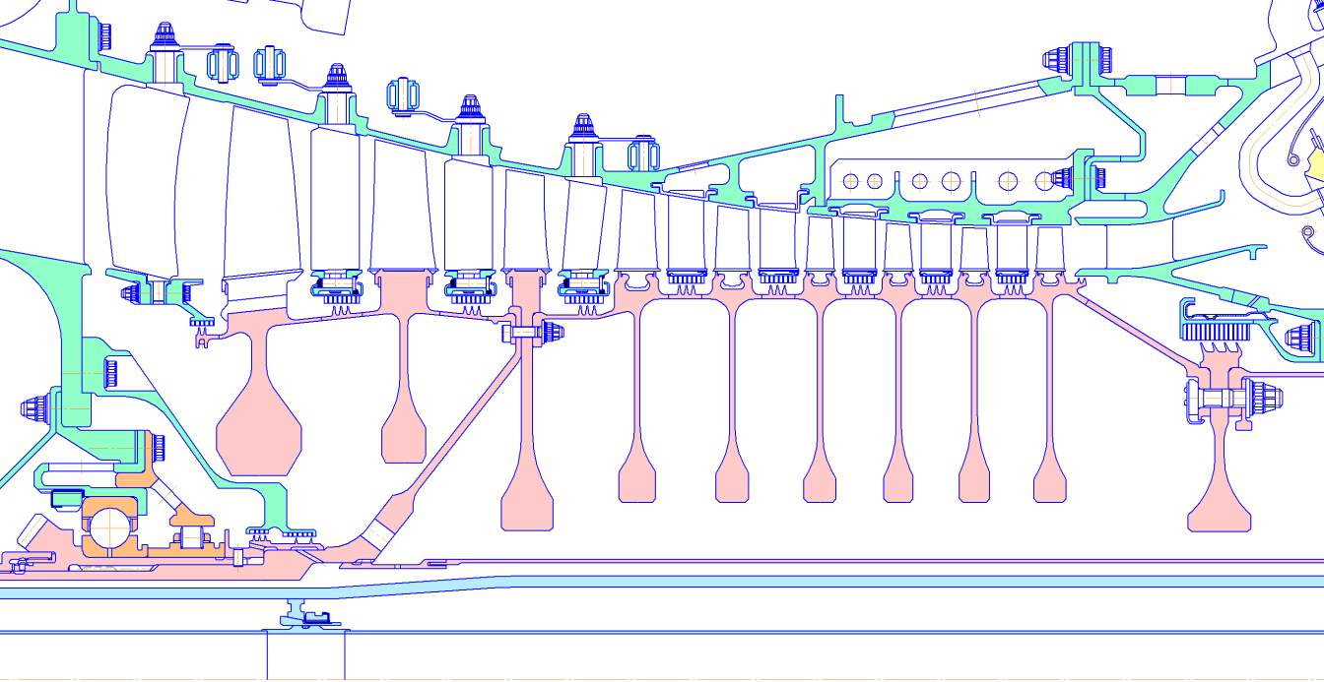
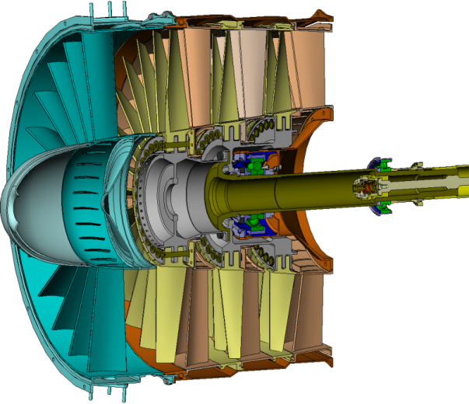
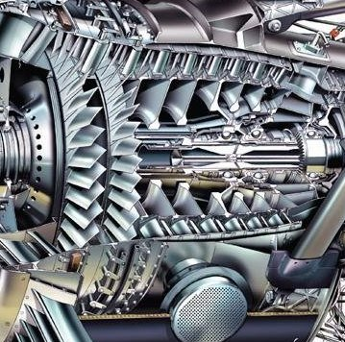
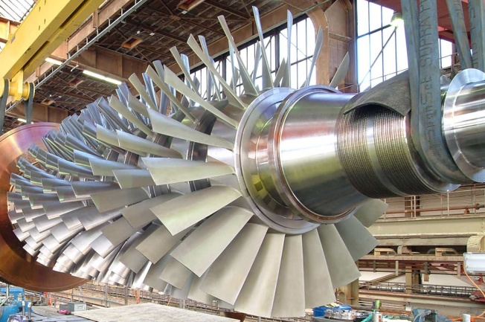
Compressor. General information
Compressor – is a device for the continuous compression of the working fluid to the desired level of pressure ratio due to the supply of mechanical energy to the working fluid flow
2
Notes:
Compressor – is a device for the continuous compression of the working fluid to the desired level of pressure ratio due to the supply of mechanical energy to the working fluid flow.
constant supply of mechanical work from the outside is necessary for compressor operation.
Gas turbines, electric motors are usually applied as the source of energy.
However, most often for this purpose turbines are used because they can produce more power at a relatively small size.
In the compressor, the input mechanical work is transformed into potential energy of the compressed gas.
As a result, total and static pressure (р, р*) and temperature (Т, Т*) of the working fluid, as well as its density ρ increase. Detail of this process will be discussed below.

Slide 3
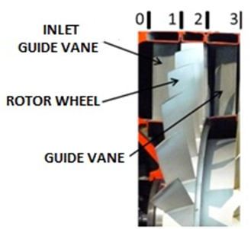
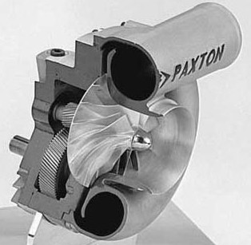
Classification of Compressors
Compressors classification:
By the number of stages: single-stage, multistage
By the direction of the working fluid: axial and centrifugal
Elements of axial compressor stage
Modern compressor should:
Have high efficiency
Work required resource
Have minimum dimensions and weight
Be technological and easy to use
Have wide range of stable work
Single-stage centrifugal compressor
Multistage axial compressor
3
Notes:
cross section at the inlet of RW denotes with the index 1, the outlet – 2 and at the outlet from the GV - 3.
For compressors that are applied as a part of GTE and GTU, the cross section of inlet may be referred to by the letter «in, and the output - "c".
All compressors may be classified according to the direction of the working fluid movement and the number of stages.
By the number of stages compressors are divided into single and multi-stage.
By the direction of the working fluid movement compressors can be divided into three groups: axial, centrifugal and diagonal.

Slide 4
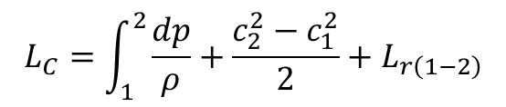


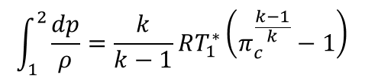
Principle of compressor operation
The work supplied to the compressor:
$$L_{C}=\int_{1}^{2}{\frac{dp}{ρ}}+\frac{c_{2}^{2}−c_{1}^{2}}{2}+L_{r\left(1−2\right)}$$
Bernoulli's equation
It is spent on:
- Increase in potential energy of the compressed gas
- Kinetic energy change in compressor
- Overcoming the hydraulic losses in the flow path
$$\int_{1}^{2}{\frac{dp}{ρ}}=\frac{k}{k−1}RT_{1}^{∗}\left(π_{c}^{\frac{k−1}{k}}−1\right)$$
$$\frac{c_{2}^{2}−c_{1}^{2}}{2}$$
$$L_{r\left(1−2\right)}$$
Where most of energy should be sent?
4
Notes:
Let us consider how there is an increase in pressure of the working fluid in compressor stage.
As noted above, the mechanical work from the external source is supplied to the compressor.
According to the Bernoulli's equation the work, supplied to the compressor, can be represented as follows:
– increase in the potential energy of the compressed gas;
– kinetic energy change in the compressor;
– the energy expended to overcome hydraulic losses in the flow path.
the main goal of the compressor - compression of the working fluid, the second and third terms of the equation 4.2.1 should be minimal.
It also follows that, in order to spend supplied work on increasing the pressure as much as possible, the energy losses in the compressor should be minimal.

Slide 5
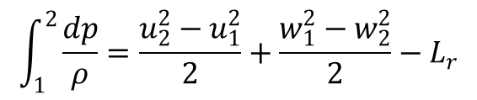


Principle of compressor operation
What should be done to increase the pressure?
$$\int_{1}^{2}{\frac{dp}{ρ}}=\frac{u_{2}^{2}−u_{1}^{2}}{2}+\frac{w_{1}^{2}−w_{2}^{2}}{2}−L_{r}$$
energy equation in the mechanical form in the relative motion
Pressure increases due to:
Working fluid movement in the field of centrifugal forces
Flow deceleration in the relative motion
$$\frac{u_{2}^{2}−u_{1}^{2}}{2}$$
$$\frac{w_{1}^{2}−w_{2}^{2}}{2}$$
How to implement it in the design?
5
Notes:
According to the energy equation in the mechanical form in the relative motion the change in potential energy of pressure forces in the compressor can be represented as follows:
- work to move a unit mass of the working fluid under the influence of inertial (centrifugal) forces;
- change in the kinetic energy of the flow in the relative motion.
As can be seen from equation increasing the pressure in the compressor RW is because of the working fluid movement in the field of action of inertial force and deceleration of the flow in the relative movement.

Slide 6
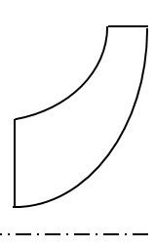
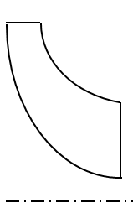
Principle of compressor operation
Working fluid movement in the field of action of centrifugal
$$\int_{1}^{2}{\frac{dp}{ρ}}=\frac{u_{2}^{2}−u_{1}^{2}}{2}+\frac{w_{1}^{2}−w_{2}^{2}}{2}−L_{r}$$
energy equation in the mechanical form in the relative motion
Circumferential velocity in compressor must increase : u₂>u₁
The flow must leave the compressor on the larger radius than it enter: r₂>r₁
Variant 1
Variant 2
c₂
c₁
r₂
r₁
c₁
c₂
r₁
r₂
6
Notes:
Consider how to apply the described above theoretical knowledge in the compressor design.
To increase pressure by using the centrifugal compressor it is necessary that the circumferential velocity of the flow at the RW inlet was less than at the outlet .
Since all the rotor elements rotate with the same angular velocity ω, it is possible to organize the change in circumferential velocity only by changing the radius of the flow r.
The flow should enter in the RW at small radius and leave at big radius.
This scheme of flow is implemented in a centrifugal compressor.
Since the flow in axial compressor moves in a direction parallel to the axis of RW rotation, the circumferential velocity in RW is changed slightly .
the influence of inertia forces in such compressors on the compression process is minimum, and it mainly occurs due to the flow deceleration in the relative movement.
For this reason, the axial compressor stage has a lesser compression ratio than the centrifugal one.

Slide 7
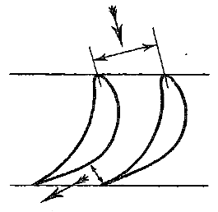
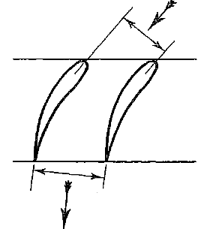
Principle of compressor operation
The flow deceleration in the relative motion
$$\int_{1}^{2}{\frac{dp}{ρ}}=\frac{u_{2}^{2}−u_{1}^{2}}{2}+\frac{w_{1}^{2}−w_{2}^{2}}{2}−L_{r}$$
energy equation in the mechanical form in the relative motion
Velocity in the relative motion must decrease: w₁>w₂
The channel between blades must diverge
Variant 1
Variant 2
Smaller angle (β₁)
Larger angel (β₂)
The flow angel at the inlet must be smaller than the angle at the outlet to obtain divergence form of the blade passage: β₂>β₁
7
Notes:
The rotor wheel of the compressor is designed in such a way that the blade inlet angle will be less than the blade outlet angle .
At the same time flow in the blade channel has divergence character.
With this channel configuration the flow is decelerated in the relative motion >and the velocity drop, according to the Bernoulli's equation 4.4.2, leads to an increase in static pressure and the density of the working fluid .
In the centrifugal compressor parameters growth is increase by the working fluid movement in the field of centrifugal forces from the center to the periphery.

Slide 8
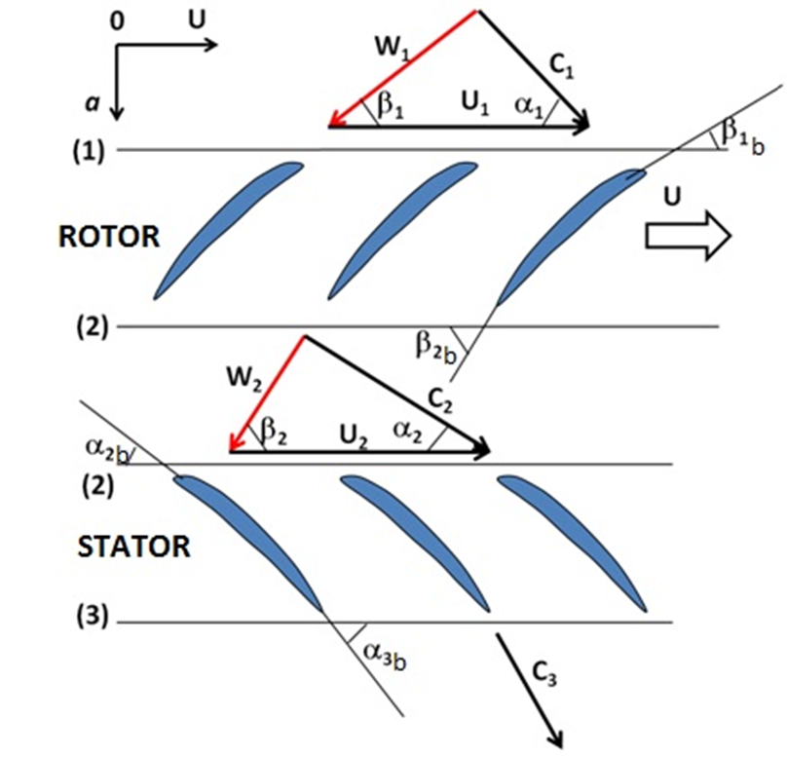
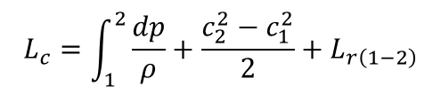
Principle of compressor operation
Scheme of flow in the compressor stage
Bernoulli's equation
Rotor blade is oriented by the vector w
$$L_{c}=\int_{1}^{2}{\frac{dp}{ρ}}+\frac{c_{2}^{2}−c_{1}^{2}}{2}+L_{r\left(1−2\right)}$$
Absolute velocity increases in the rotor wheel с₂>с₁
Absolute velocity increases in the rotor wheel
Increasing in pressure is not sufficient
Absolute velocity с due to the work supply
Blade is oriented by the vector с
How to increase the pressure?
To decelerate the flow behind the rotor wheel in the guide vane
8
Notes:
the process in RW is accompanied by growth of absolute velocity.
This, according to the equation 4.2.1, leads to the fact that considerable part of the supplied mechanical energy goes to the change in kinetic energy .
Therefore, after RW the working fluid flow is decelerated in the outlet system.
As a result, the kinetic energy of the flow is converted into the work of compression.
Deceleration of the flow in blade GV conceptually realized as in the RW due to the use of specially shaped blades.
Their blade inlet angle less than the blade outlet angle.
As a result, the blade channel turns to be divergent , the flow within it is accompanied by deceleration in absolute coordinate.
Deceleration is accompanied by increase in static pressure and density of the working fluid .

Slide 9
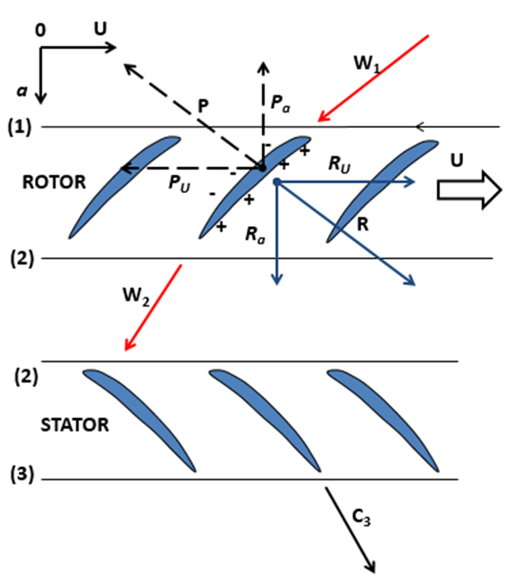

Principle of compressor operation
Forces, acting on the axial compressor rotor wheel
Compressor rotor wheel performs the following functions:
Supplies the work to the flow
Pushes the working fluid
Increases pressure
Force P_{u} prevents the flow movement
$$P_{u}=−R_{u}=G_{air}\left(c_{1u}−c_{2u}\right)$$
$$P_{а}=−R_{а}=G_{air}\left(c_{1а}−c_{2а}\right)+\left(р_{1}−р_{2}\right)th$$
Energy momentum equation
Force R_{а} pushes the working fluid through the compressor
Force R_{u} supplies the work to the flow
9
Notes:
The forces acting on flow from the blades R and from the flow on the blades P are depicted in Figure 4.2.3.
As seen from the figures, the direction of circumferential component of the force , acting in the circumferential direction on the blade is opposite to the direction of RW rotation.
That is, it has decelerate effect on the compressor blades.
Therefore, mechanical work should be supplied for the implementation of the compression process.
the circumferential component of the force, acting on the flow from the blade , supplies the work to the working fluid flow passing through the compressor.
The direction of the axial component of the force acting on the flow from the blade coincides with the direction of working fluid movement through the blade channel.
This leads to the conclusion that - is the force that causes the flow to move through the compressor from the smaller inlet pressure to a greater outlet.
Analyzing the above, we can conclude that compressor RW performs the following functions:
supplies the mechanical work to the working fluid flow;
pushes the working fluid through the compressor;
increases the pressure of the working fluid.

Slide 10
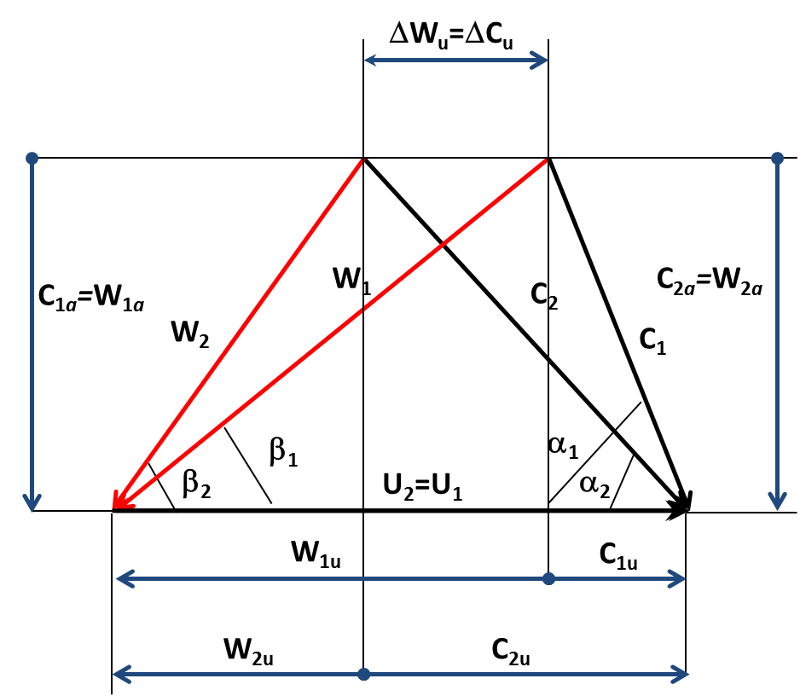
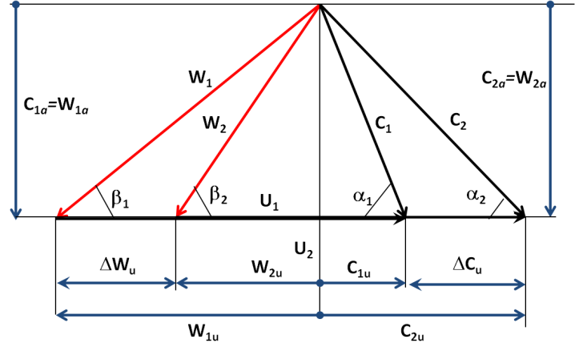
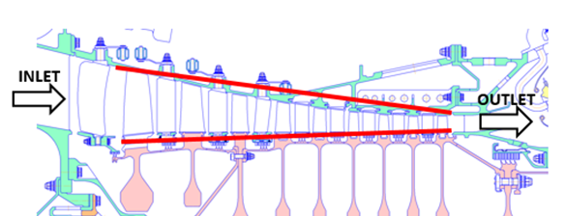
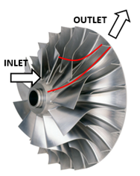
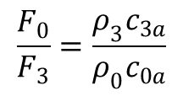
Principle of compressor operation
Velocity diagram of the compressor stage
Shape of the flow path
Working fluid density increases
Axial velocity changes a little
Axial area decreases towards the outlet
Blade height decreases towards the outlet
$$\frac{F_{0}}{F_{3}}=\frac{ρ_{3}c_{3a}}{ρ_{0}c_{0a}}$$
Continuity equation
10
Notes:
We write the equation of continuity for the compressor:
density increase due to the increase in pressure in the compressor leads to the need to reduce the cross sectional area and blade height to the outlet.
Figure 4.1.6 shows the velocity diagram of axial compressor stage.
You should pay attention to the fact that since the divergence process is accompanied by increased energy losses, flow turning angle in the row Δβ (Δα) is limited by the value of Δβ_{max} = 30° (for comparison, in the turbine Δβ = 100...120°).
Therefore, at equal mass flow rates of the working fluid and similar diametrical sizes, the stage work of the axial compressor less than the stage work of the axial turbine, and the required number of stages in compressor is greater than the number of turbine stages.

Slide 11
Change in parameters in compressor stage
Relative velocity in RW decreases due to the flow deceleration (w₁> w₂)
1
2
3
RW
GV
Absolute velocity in RW increases due to the work supply (c₂> c₁)
r
Absolute velocity in GV decreases due to the flow deceleration (с₂> с₃)
0
a
ω
Static pressure increases due to the flow deceleration in the blade channel of RW and GV
w
p
p
С
С
11
Notes:
Consider how the basic parameters of the flow along the compressor stage change.
As it has been noted, blade channels are divergent.
This leads to the flow deceleration in the relative motion, which in turn is the cause the increase in static pressure and density of the working fluid .
Its circumferential component deflects the flow in absolute movement in the direction of rotation, and supplies mechanical energy to it, as a result the absolute velocity increases (с₂> с₁).
In GV the channel is also expanding.
The flow in it is accompanied by the deceleration of the absolute CS that according to Bernoulli's equation 4.2.2 leads to an increase in static pressure and density .

Slide 12






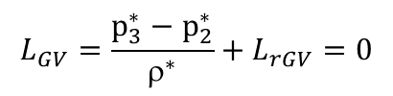
Variation of parameters in compressor stage
Energy equation for RW:
Energy equation for GV:
Energy equation for GV :
1
2
3
$$L_{RW}=\left(i_{2}−i_{1}\right)+\frac{c_{2}^{2}−c_{1}^{2}}{2}$$
$$L_{RW}≫0$$
Rw
GV
$$L_{RW}=i_{2}^{∗}−i_{1}^{∗}$$
r
0
a
ω
$$L_{GV}=\left(i_{3}−i_{2}\right)+\frac{c_{3}^{2}−c_{2}^{2}}{2}=0$$
Т*
The work is not supplied in the GV
$$L_{GV}=i_{3}^{∗}−i_{2}^{∗}=0$$
Т*
т
$$L_{RW}=\frac{р_{2}^{∗}−р_{1}^{∗}}{ρ^{∗}}+L_{rrw}$$
т
Total pressure increases in the rw
p*
$$L_{GV}=\frac{р_{3}^{∗}−р_{2}^{∗}}{ρ^{∗}}+L_{rGV}=0$$
Total pressure does not change in the GV (Decreases insignificantly)
p*
12
Notes:
Supply of mechanical work is carried out in RW.
It should be reminded that the external feature of work transmission/extraction in a thermodynamic process is the presence of physical movement.
On this basis, we can conclude that the work is supplied only to the RW.
There is no supply of work in GV.
Taking into account that and с₂> с₁, then from equations 4.2.8 and 4.2.9 it can be concluded that and Whence it follows that static and total temperatures in the rotor wheel and increase.
If we consider that the work supplied in RW, many times greater than the energy expended to overcome the losses, then from this equation it may be concluded that the total pressure is increasing in RW.
Taking into account that the work is not supplied in GV , reduction of the absolute velocity is compensated by an increase in enthalpy . This in turn leads to an increase in temperature.
The lack of work supply causes the equality of the total enthalpies and temperatures at the inlet and outlet of the RW: and.
Energy equation in mechanical form of GV can be as follows:
Taking into account that , the change in pressure is caused only by energy consumption to overcome losses. Considering that , then the total pressure drop will be negligible. Usually it does not exceed 5%. If the process in the outlet system is passed without losses, the total pressure there would be constant [1].
Figure 4.2.6 shows the qualitative picture of the change in the basic flow parameters along the length of the compressor resulting from analysis.

Slide 13
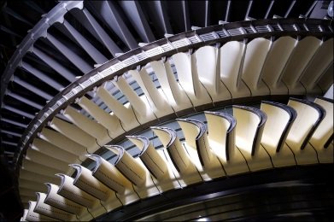
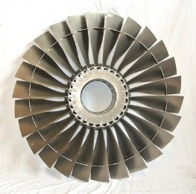
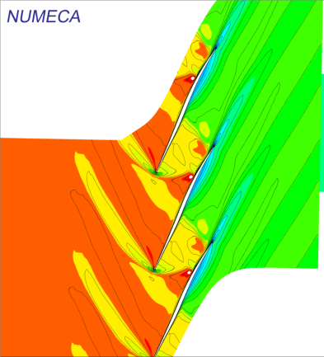


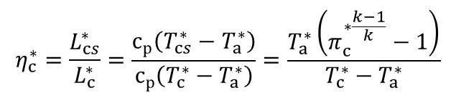

energy conversion in the compressor stage
Pressure ratio:
Shows how many times the pressure in the compressor increases
Compressor efficiency:
$$π_{c}^{∗}=\frac{р_{c}^{∗}}{р_{in}^{∗}}$$
$$η_{c}^{∗}=\frac{L_{cs}^{∗}}{L_{c}^{∗}}=\frac{с_{р}\left(T_{cs}^{∗}−T_{a}^{∗}\right)}{с_{р}\left(T_{c}^{∗}−T_{a}^{∗}\right)}=\frac{T_{a}^{∗}\left(π_{c}^{∗\frac{k−1}{k}}−1\right)}{T_{c}^{∗}−T_{a}^{∗}}$$
Energy balance in the compressor stage
$${L_{sts}}^{∗}=\frac{k}{k−1}R{T_{a}}^{∗}\left(π_{st}^{∗\frac{k−1}{k}}−1\right)$$
Isentropic head, L_{sts}
flow
blades
$$L_{u}=\left(u_{2}с_{2u}−u_{1}с_{1u}\right)$$
Head on the rotor wheel, L_{u}
Energy sources
Expanded head, L_{т}
Losses of Volumetric compression
Hydraulic losses
Disk losses
Losses in the radial gap
13
Notes:
The most important parameter of the compressor work process is the pressure ratio - is a value equals to the ratio of total pressure at the compressor outlet by the total pressure at the inlet:
Value shows how many times the pressure in the compressor increases.
The process of energy conversion in the compressor stage can be represented in the following form.
As has been noted the power from an external source is supplied for its operation.
The process of energy transfer can be divided into two stages.
At the first stage the energy is transferred from the drive through the shaft to the RW blades, and at the second stage it is transmitted to the flow from the blades.
Received energy on the shaft and disks moves to the rotor blades.
The part of the power is lost to overcome the friction of disk on gas.
Another part of the energy is lost with leakages of the working fluid .
Power which has come down to working blades is called the power on the wheel circumference.
Not all power transmitted to RW, is to increase its potential or kinetic energy.
The part of the power is consumed to overcome friction in the compressor flow path.
Another part of the energy is consumed because of the fact that it is necessary to compress a more heated owing to the losses gas
The remaining energy is supplied to the working fluid and spends for compression of the working fluid.
This is the power of isentropic compression
The perfection of the transformation process of mechanical energy into potential energy of the compressed gas in the compressor stage is estimated by efficiency.
It is the ratio of useful work to expanded.
Useful work of the compressor is the work spent on compression.
Expanded work - is the work supplied to the compressor from the power source
For stages of modern compressors the value of disk losses and leakages in the gaps usually do not exceed 2% [1].
Therefore, at the stage of preliminary calculations the work at wheel circumference is used as the expanded work that can significantly simplify the definition of efficiency.

Slide 14
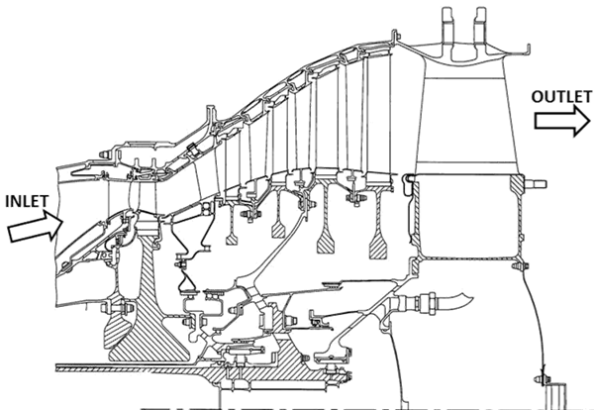
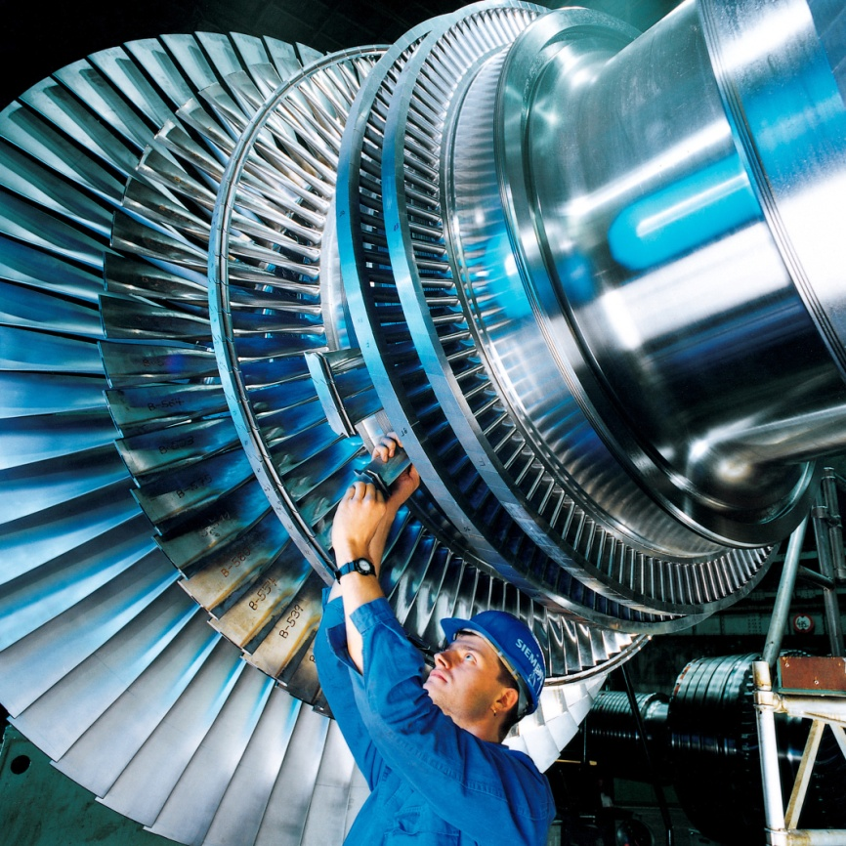
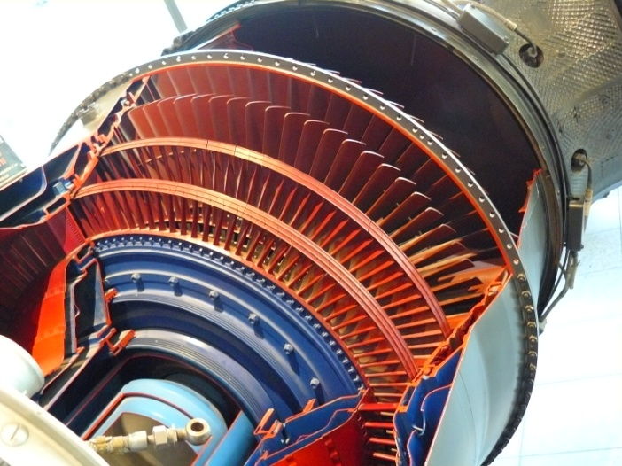


turbine. General information
Turbine is a blade machine in which the continuous extraction of energy from compressed and heated gas takes place, as well as its transformation into mechanical energy of rotor spinning
It is necessary to create a pressure difference between inlet and outlet for operation of the turbine
The expansion process is characterized by an expansion ratio of gas in a turbine:
By stagnated parameters
$$π_{т}^{∗}=\frac{р_{0}^{∗}}{р_{2}^{∗}}$$
By static parameters
$$π_{т}^{}=\frac{р_{0}^{∗}}{р_{2}^{}}$$
14
Notes:
Turbine is a blade machine in which the continuous extraction of energy from compressed and heated gas takes place, as well as its transformation into mechanical energy of rotor spinning [1, 7].

Slide 15
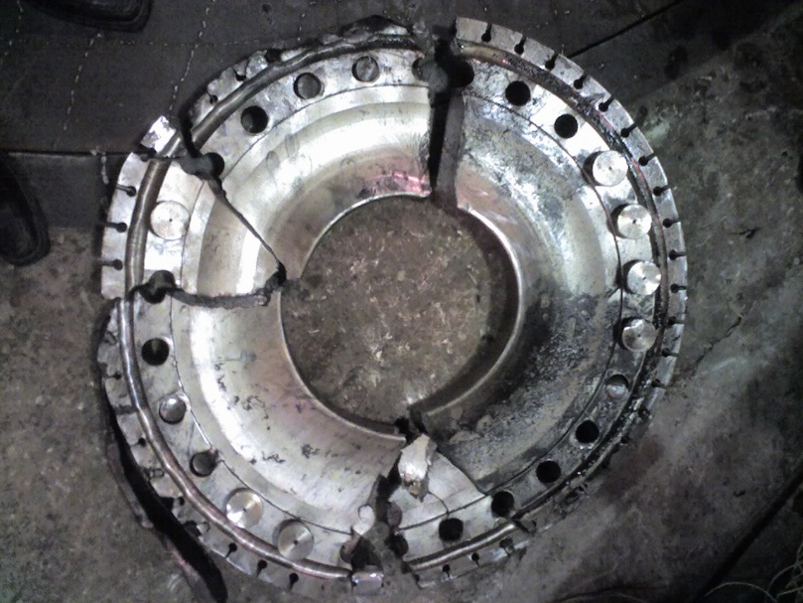
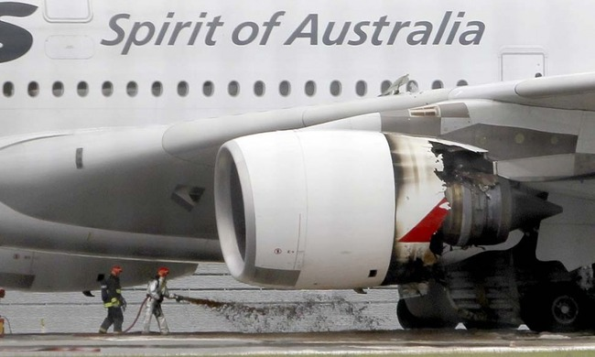
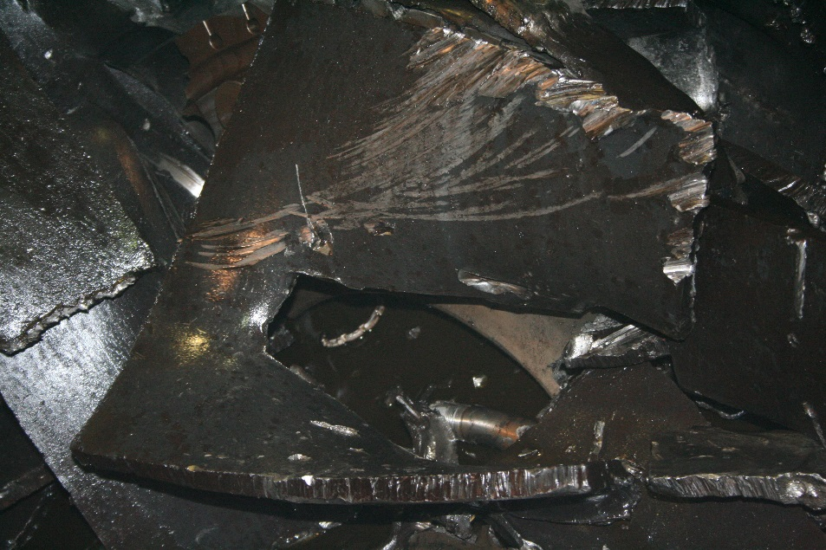
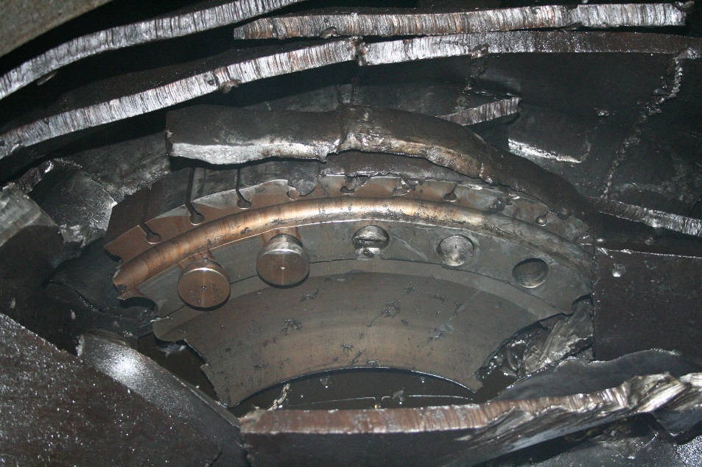
turbine. General information
It is important to dispose of the received power!!!
15
Notes:
Turbine is a blade machine in which the continuous extraction of energy from compressed and heated gas takes place, as well as its transformation into mechanical energy of rotor spinning [1, 7].

Slide 16
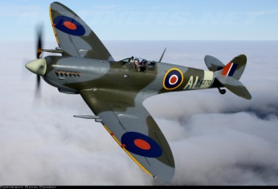
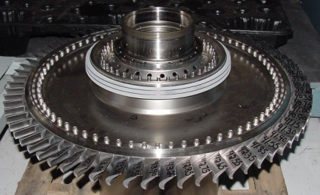
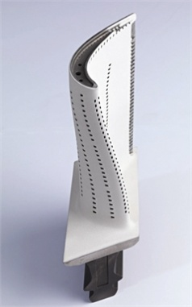
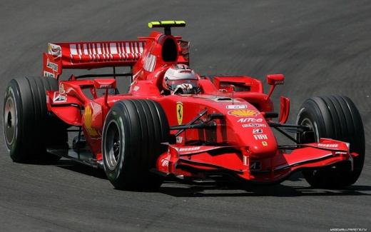
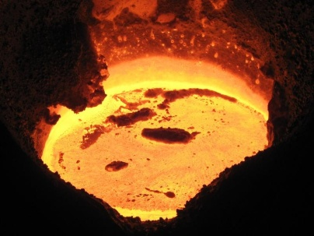
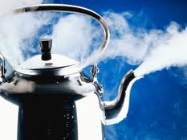
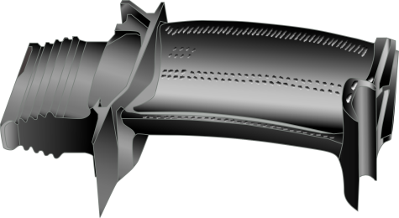
Some interesting facts about turbines
Power of HP turbine of bypass jet engine Trent 500 is 36.5 MW (this is equivalent to the power of 25 Spitfire aircrafts);
Each HPC blade produces 700 h.p, which corresponds to the power of Formula 1 car
Temperature of the gas flowing blade is by 700 degrees above the melting temperature of the material
Blade temperature is such that usual kettle would be boiled over 0.05 seconds
Force of 60000 g acts on the HPT blades at takeoff
= 25×
=
P=60000g
16
Notes:
Modern turbines operate under very difficult conditions:
power of single stage HP turbine of bypass jet engine Trent 500 - (Airbus 340-500) is 36.5 MW (this is equivalent to the power of 25 Spitfire aircrafts of the Second World War);
each blade of HPC produces 700 h.p., which corresponds to the power of a Formula 1 car;
temperature of the gas flowing around the blade is by 700 degrees above the melting temperature of the material;
blade temperature is such that the usual kettle in the same conditions would be boiled over 0.05 seconds;
force of 60000 g acts on the HPT blades at takeoff.

Slide 17
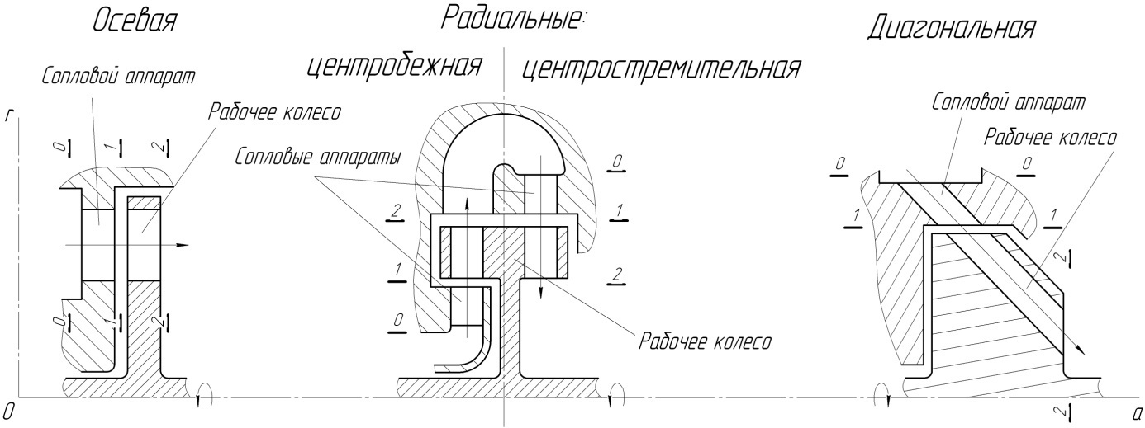
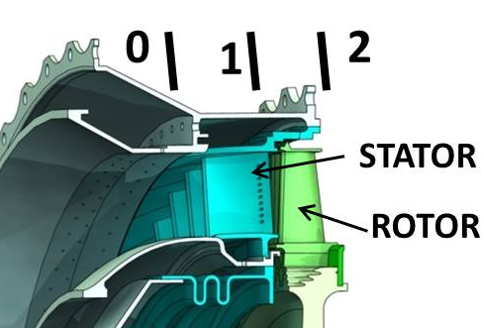
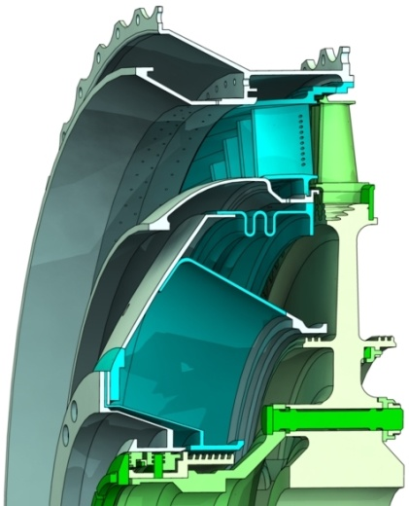
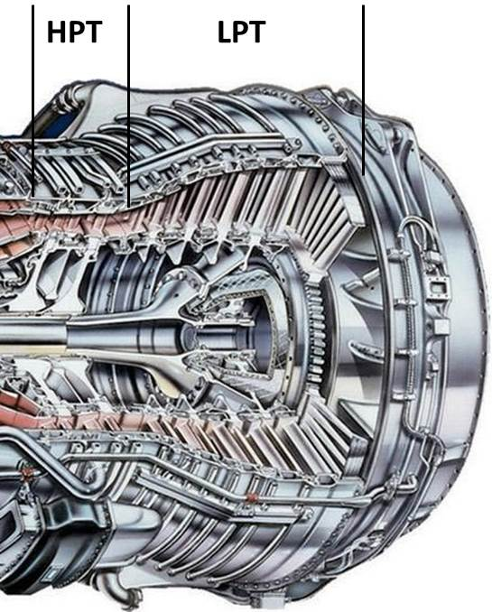
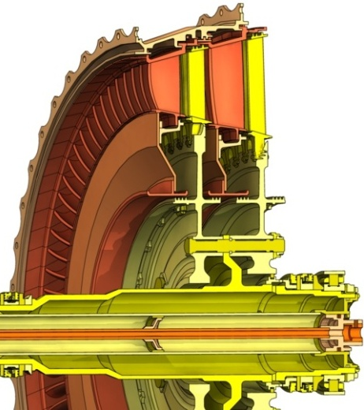
Classification of turbines
By the direction of movement of working fluid:
By the number of stages:
Elements of axial turbine stage
Single stage
Multistage (z=2…8)
Multispool
17
Notes:
The turbines can be single- and multi-stage. The maximum number of stages in the turbines of aircraft GTE is up to 7 pieces [1]. The number of stages of steam turbines can exceed this.
According to the direction of movement of the working fluid, turbines are divided into axial, centrifugal, centripetal and diagonal.
Turbine stage typically consists of two blade rows: a stationary nozzle blades (NB) and movable rotor wheel (RW).
In the stage of the turbine there are three specific sections:
section 0-0 at the inlet of NB;
section 1–1 at the outlet of NB (at the entrance of RW);
section 2-2 at the outlet of the RW.
The magnitude of expansion ratio of turbine stage is usually in the range from 1.5 to 5 [1, 7, 36]. Larger values correspond to the heavy loaded axial high pressure and centripetal turbines. Smaller value is typical to low pressure turbines. Currently, there is a tendency to reduce the number of stages in the turbomachinery of GTE. Because of this requirement, the degree of expansion of the gas in one stage of prospective axial stages may exceed 5.

Slide 18
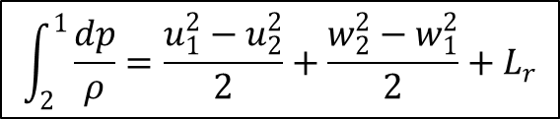


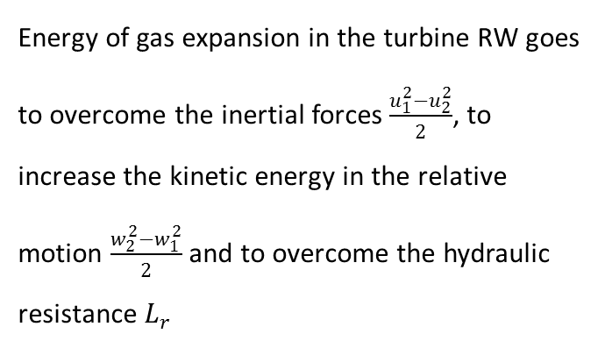
Principle of turbine operation. Process in the rotor wheel
W₁
С₁
$${\vec{c}}_{1}=\vec{w_{1}}+{\vec{u}}_{1}$$
$$\int_{2}^{1}{\frac{dp}{ρ}}=\frac{u_{1}^{2}−u_{2}^{2}}{2}+\frac{w_{2}^{2}−w_{1}^{2}}{2}+L_{r}$$
β₁
α₁
(1)
U₁
Energy of gas expansion in the turbine RW goes to overcome the inertial forces $\frac{u_{1}^{2}−u_{2}^{2}}{2}$, to increase the kinetic energy in the relative motion $\frac{w_{2}^{2}−w_{1}^{2}}{2}$ and to overcome the hydraulic resistance $L_{r}$
U
rotor
(2)
W₂
С₂
$${\vec{c}}_{2}=\vec{w_{2}}+{\vec{u}}_{2}$$
β₂
α₂
U₂
Acceleration of gas in the rotor
β_{1b} > β_{2b}
Blade passage convergence with such a ratio of angles
Gas accelerates in relative motion w₂> w₁
Acceleration is accompanied by a decrease in static pressure
18
Notes:
The main element of the turbine is RW. It converts the flow energy into mechanical work.
The process of gas expansion is in the RW, rotating with a constant circumferential velocity u.
The flow rides on the wheel with an absolute velocity c₁ at an angle α₁.
At the leading edges of the blades, the flow begins to participate in two movements.
It rotates together with the blades with a transient velocity u₁ and move relative to them with a velocity w₁.
These velocities are connected by the following vector relation: ${\vec{c}}_{1}=\vec{w_{1}}+{\vec{u}}_{1}$.
The flow runs rides on the rotor blades at an angle β₁.
To reduce the losses, the value of the inlet blade angle of RW $β_{1b}$ is selected in such a way that it is approximately equal to the angle $β_{1}$
From the energy equation in mechanical form in the relative motion 3.2.2, it follows that the energy of gas expansion in the turbine RW goes to overcome the inertial forces $\frac{u_{1}^{2}−u_{2}^{2}}{2}$, to increase the kinetic energy in the relative motion $\frac{w_{2}^{2}−w_{1}^{2}}{2}$ and to overcome the hydraulic resistance $L_{r}$:
In order that the process of expansion occurs with minimal energy losses, the design of the turbine is performed in such a way as to "maximize" the process of gas acceleration.
Rotor blades are designed as the outlet blade angle of cascade $β_{2b}$ is smaller than inlet blade angle of cascade $β_{1b}$ (Figure 3.2.3).
With such ratio of angles, blade passage area at the RW outlet is substantially less than at the inlet, i.e. passage is convergent (narrowing), resulting in an increase in the relative velocity $w_{2}>w_{1}$ and is accompanied by a reduction in static pressure $p_{1}>p_{2}$.

Slide 19
Principle of turbine operation
Pressure at pressure side is higher than at suction side because of flow deflection and wing-shaped blades
W₁
Stream line
β₁
(1)
U
-
+
-
p_{u}
+
Gas force P act on blade
+
-
p
+
-
p_{a}
-
(2)
Circumferential component of the force P_{u} creates torque on turbine shaft and forces it to rotate
rotor
β₂
W₂
Mechanical work is performed:
$$L_{т}={u_{1}c}_{1u}−{u_{2}∙c}_{2u}=\left(w_{2u}u_{2}−w_{1u}u_{1}\right)+\left(u_{2}^{2}−u_{1}^{2}\right)$$
19
Notes:
Passing through the blade passage of RW, gas flow turns (Figures 3.2.3 and 3.2.4).
As the result, gas flow is pressed towards the surface of the pressure side because of the action of centrifugal forces. Local increase in pressure occurs because of this (indicated by "+" in Figure 3.2.4).
On the other hand, the same forces "depress" the flow from the suction side forming a region of discharge (shown by "-" in Figure 3.2.4).
As a result, rotor blade experiences a pressure difference.
Wing-shape of the blade also contributes to the appearance of the pressure difference between the suction side and pressure side.
The resultant of pressure forces acting on the blade $\overline{P}$ is directed towards the suction side of blade in the direction roughly perpendicular to the chord.
It can be divided into two components: circumferential $\overline{P_{u}}$ and axial $\overline{P_{a}}$.
Circumferential component $\overline{P_{u}}$ creates a torque on the rotor blade and makes RW rotate.
In this case, it should be specially noted that, unlike the compressor, the rotation of the turbine proceeds independently without supply of external energy.
Axial component $\overline{P_{a}}$ is taken by thrust bearing of the turbine rotor (Figure 3.2.4).
The work extracted by the blades from flow can be found using the momentum equation (Euler equation):

Slide 20




Principle of turbine operation. Process in the rotor wheel
W₁
С₁
Kinetic energy of the gas leaving the turbine (с²₂/2) are residual velocity losses
This is the energy that was not extracted by the turbine from the flow
These losses can not be eliminated, but they can be reduced
$${\vec{c}}_{1}=\vec{w_{1}}+{\vec{u}}_{1}$$
β₁
α₁
(1)
U₁
U
rotor
(2)
W₂
С₂
$${\vec{c}}_{2}=\vec{w_{2}}+{\vec{u}}_{2}$$
β₂
α₂
U₂
The influence of inertial forces on the process
u₁> u₂ – Centripetal turbine
u₁= u₂ – Axial turbine
$$\int_{2}^{1}{\frac{dp}{ρ}}=\frac{u_{1}^{2}−u_{2}^{2}}{2}+\frac{w_{2}^{2}−w_{1}^{2}}{2}+L_{r}$$
$$\int_{2}^{1}{\frac{dp}{ρ}}=\frac{w_{2}^{2}−w_{1}^{2}}{2}+L_{r}$$
20
Notes:
The working fluid leaves the RW in relative motion with a velocity w₂ at an angle β₂, which is close in magnitude to the outlet blade angle β_{2b}.
Summing vectorially the relative velocity with the transient velocity u₂, an absolute flow velocity is obtained with which the working fluid leaves the RW c₂ and enters the next stage or outlet nozzle. Velocity triangles at the inlet and outlet of the RW are shown in Figures 3.2.4 and 3.2.5. It can be seen from them that the absolute flow velocity in the RW decreases $c_{1}>c_{2}$, which is due to the mechanical work done by the gas.
Working fluid leaves turbine with the velocity $с_{2}$ and it has kinetic energy of ${с_{2}^{2}}/2$, which is called residual velocity losses. Presence of this energy indicates that not all the energy of gas expansion was converted into useful power at the output shaft. Since the working fluid must leave the turbine, these losses are inevitable. The magnitude of the velocity $с_{2}$ varies widely, reaching the level of 300...400 m/s. But specific velocity at the RW outlet λ_{c2} is more characteristic quantity. Its value in the GTE turbines must be within λ_{c2}=0.4...0.6, and it can reach values of 0.65...0.75 in turbines of turboprop and turboshaft engines [1, 7, 36]. Apparently from Figure 3.2.6, minimum values of c₂ velocity and residual velocity losses will occur when α₂=90° (while maintaining the flow component of velocity$c_{a}$).
The presence of inertial forces, for example in a centripetal turbine ($u_{1}>u_{2}$), allows to reduce the level of relative velocities in the RW and, due to this, somewhat reduce losses.

Slide 21


Principle of turbine operation
$$L_{тт}=\int_{2}^{1}{\frac{dp}{ρ}}+\frac{с_{1}^{2}−с_{2}^{2}}{2}−L_{r}$$
Mechanical energy gained in the turbine is obtained because of the gas expansion $\int_{2}^{1}{\frac{dp}{ρ}}$ and the change in the kinetic energy of the flow $\frac{с_{1}^{2}−с_{2}^{2}}{2}$, despite the acting hydraulic losses $L_{r}$
In the rotor wheel, at first, the potential energy of the working fluid is converted into kinetic, then it becomes mechanical energy due to the flow rotation
$$L_{т}={u_{1}c}_{1u}−{u_{2}∙c}_{2u}=\left(w_{2u}u_{2}−w_{1u}u_{1}\right)+\left(u_{2}^{2}−u_{1}^{2}\right)$$
To increase the work of the turbine, it is necessary to increase the kinetic energy of the flow at the RW inlet and to create the swirl of the flow
Acceleration and rotation of the flow is performed by a nozzle Block
21
Notes:
It follows from this that the mechanical energy gained in the turbine is obtained because of the gas expansion $\int_{2}^{1}{\frac{dp}{ρ}}$ and the change in the kinetic energy of the flow $\frac{с_{1}^{2}−с_{2}^{2}}{2}$, despite the acting hydraulic losses $L_{r}$.
Relying on this conclusion and the process considered earlier in the RW, we can conclude that, despite its relative simplicity, a complex thermodynamic process occurs in it.
Initially, the potential energy of the working fluid is converted to kinetic, then it turns into a mechanical one due to the rotation of the flow.
As it follows from equation 3.2.4, it is necessary that the flow at its inlet has a large kinetic energy ${с_{1}^{2}}/2$ to obtain a significant amount of mechanical work in a turbine.
On the other hand, it follows from the Euler equation (3.2.3) that the mechanical work extracted by the turbine blades from the flow will be the greater, the larger its swirl at the inlet $c_{1u}$.
In other words, to obtain large values of the specific work in the turbine RW, a swirling flow with a large kinetic energy must be fed to its inlet.
This is done in an additional fixed BR, which is set before the RW and is called the nozzle block (NB).
It performs the function of accelerating the flow at the inlet to the RW and creating a swirl of the flow therein to increase the mechanical work of the turbine stage.

Slide 22
Principle of turbine operation
u
0
Process in the nozzle block
С₀
α_{0b} > α_{1b}
Blade passage convergence with such a ratio of angles
Gas accelerates in absolute motion с₁> с₀
Acceleration is accompanied by a decrease in static pressure
a
α_{0b}
(0)
stator
(1)
α_{1b}
W₁
С₁
β₁
α₁
β_{1b}
U₁
(1)
U
rotor
Nozzle block accelerates the flow and creates a preliminary swirl at the rotor inlet
(2)
W₂
β_{2b}
С₂
β₂
α₂
U₂
22
Notes:
Flow acceleration in NB is organized by the same principle as in the RW - due to the convergent form of blade passage.
For this purpose, the nozzle blades are performed in such a way that design blade angle of cascade at the outlet $_{1b}$ is smaller than the blade angle at the cascade inlet $_{0b}$ (Figure 3.2.4).
With such ratio of angles blade passage area at the NB outlet is substantially less than the inlet, i.e. blade passage is convergent, which leads to an increase in the absolute velocity $с_{1}>с_{0}$ and is accompanied by a reduction in static pressure $p_{0}>p_{1}$.
To reduce losses, the value of the inlet blade angle of NB $_{0b}$ is chosen such that it roughly equals the flow angle at the NB inlet in $_{0}$.
Velocity diagram of axial turbine stage is shown in Figure 3.2.5.

Slide 23




Principle of turbine operation
Velocity diagrams of turbine stage
Shape of flow passage
Density of the working fluid decreases
Axial velocity changes slightly
Axial area grows to the outlet
Blade height increases to the outlet
$$\frac{F_{0}}{F_{2}}=\frac{ρ_{2}c_{2a}}{ρ_{0}c_{0a}}$$
23
Notes:
Velocity diagram of axial turbine stage is shown in Figure 5.1.6.
It should be noted that since the convergent process is not accompanied by increased energy losses, Δβ (Δα) can reach values of 100...120° (for comparison, in compressor Δβ_{max} = 20...30°).
Therefore, the work of axial turbine stage is greater than work of axial compressor stage at equal mass flow rates of the working fluid and similar dimensions, and requirements number of turbine stages is always less than the number of compressor stages.
Let us write the equation of continuity with respect to the turbine:
density of the working fluid decreases during the gas expansion in the turbine, resulting in the need to increase the cross sectional area and height of the blades at the outlet (q.v. Figure 5.1.7). It should be emphasized that the expansion of the gas causes an increase in the height of the turbine blades, and not vice versa.
Working fluid leaves turbine with the velocity and it has kinetic energy of , which is called residual velocity losses.
Presence of this energy indicates that not all the energy of gas expansion was converted into useful power at the output shaft.
Since the working fluid must leave the turbine, these losses are inevitable.
Its value in the GTE turbines must be within λ_{c2}=0.4...0.6, and it can reach values of 0.65...0.75 in turbines of turboprop and turboshaft engines.
Apparently from Figure 5.1.6, minimum values of c₂ velocity and residual velocity losses will occur when α₂=90° (while maintaining the flow component of velocity).

Slide 24

Variation of parameters in turbine stage
Gas in NB accelerates due to the convergent blade passage (с₁> с₀)
Flow in relative motion in RW accelerates due to the convergent blade passage (w₂> w₁)
Flow in absolute motion in RW decelerates because of work extraction from the flow (с₁> с₂)
w
С
С
Static pressure decreases because of flow acceleration in blade passages of RW and NB
p
p
24
Notes:
Let us consider how and why the main flow parameters vary along the flow passage of the turbine stage.
As it was noted in explaining of operation process, blade passages of RW and NB of turbines have convergent shape.
Flow in such passages accelerates: in relative motion in RW and in absolute motion in NB .
Since the absolute motion in NB and relative motion in RW are isoenergetic, then velocity increase leads to a decrease in static pressure and density of the working fluid according to Bernoulli equation.
Absolute velocity in the RW reduces due to the energy extraction from the flow of working fluid с₁> с₂.

Slide 25








Изменение параметров в ступени турбины
Energy equation for NB:
$$L_{NB}=\left(i_{0}−i_{1}\right)+\frac{c_{0}^{2}−c_{1}^{2}}{2}$$
$$L_{NB}=0$$
Work in NB is not performed
$$L_{NB}=i_{0}^{∗}−i_{1}^{∗}$$
Energy equation for RW:
$$L_{RW}=\left(i_{1}−i_{2}\right)+\frac{c_{1}^{2}−c_{2}^{2}}{2}$$
$$L_{RW}>>0$$
Т*
$$L_{RW}=i_{1}^{∗}−i_{2}^{∗}$$
Energy equation in mechanical form:
$$\frac{р_{1}^{∗}−р_{2}^{∗}}{ρ}=L_{RW}−L_{rRW}$$
т
Т*
Total pressure decreases in RW
p*
т
$$\frac{р_{0}^{∗}−р_{1}^{∗}}{ρ}=−L_{rNB}$$
Total pressure slightly decreases (does not change) in NB
p*
25
Notes:
Let us write the energy equation in the heat form in the absolute motion for the RW cascade [1]:
In the RW work extraction is performed.
It should be recalled that the outward sign of the work supply/extraction in the thermodynamic process is the availability of physical movement.
On this basis, it can be concluded that the work is extracted only in the RW.
There is no energy transfer in NB.
Taking into account that and с₁> с₂, it can be concluded from above equations that and
Which implies that static and total temperature rise and in the RW.
Energy equation in the mechanical form in the absolute motion for the RW can be written:
Considering that the work extracted by RW is many times greater than the energy expended to overcome the losses, it can be concluded from this equation that total pressure in RW reduces .
Similarly, let us write the energy equation in the heat form in absolute motion for NB:
Given that the work is not extracted in NB the growth of the absolute velocity is compensated by decrease in enthalpy . This leads to a decrease in the static temperature.
Absence of energy exchange causes the equality of the total enthalpy and temperatures at the inlet and outlet of NB ( and ).
Energy equation in the mechanical form in the absolute motion for the NB has the following form [1]:
Since changing of total pressure is caused only by the energy cost for overcoming losses. Taking into account that , the total pressure drop is negligible. Usually, it does not exceed 5%. If the process in the output system occurred without losses, the total pressure would be there constant [1].

Slide 26



energy conversion in turbine stage
Work on the output shaft
Effective work of the turbine, L_{е}
consumer
blades
Internal work, L_{t}
Work on the rotor wheel, L_{u}
Available turbine work, L_{ts}
flow
Mechanical losses
Losses in radial gap
Disk losses
residual velocity losses
Hydraulic
losses
Energy balance in turbine stage
Return
heat
26
Notes:
Let us consider the energy conversion process in the turbine stage.
There is a process of energy extraction from the heated compressed gas in the turbine.
the process of energy transfer can be split into two stages.
At the first step, energy is transferred from the gas to the turbine blades, and then it is transmitted to the consumer via the disks and shafts.
As the result of gas expansion in the turbine, power is produced.
Dividing it by the air mass flow rate through the turbine specific work produced during the gas expansion with the initial temperature from the pressure to pressure is obtained:
This work is an ideal turbine work - maximum possible work, which can be implemented in it.
When transferring the produced power from gas to the blades, a part of the energy is lost for overcoming losses in the flow passage of the RW and NB .
These losses are converted into the heat and they further heat up the working fluid which allows providing additional power in the turbine .
The gas leaves the turbine with the velocity, which means that the part of expansion energy equal to the kinetic energy was not converted into the useful work at the shaft and it is losses for turbine.
Power which reached rotor blades is called power on the circumference of the wheel
Energy received by the blades is subsequently transferred to the consumer.
Part of the power is lost with the leaks of working fluid in radial gap (RG), which passes from the inlet to the outlet of the turbine bypassing blades and not making useful work.
Another part of energy is lost for overcoming friction of turbine disks on gas .
Obtained power considering losses and is called internal power of turbine .
Further, the part of power is spent on overcoming friction in the bearings and deformation of rotor elements when the energy is transferred via discs and shafts.
The remaining power is transmitted to the consumer.
The described process of energy conversion can be depicted schematically.
Energy balance in the turbine stage is shown in Figures 5.1.9 and 5.1.10.

Slide 27








Turbine efficiency
Turbine efficiency is the ratio of useful work to available work
Efficiency | Available (Expended) work | Useful turbine work | When applicable
Adiabatic |  |  | To assess the perfection of the flow part
Circumferential |  |  | In CFD calculations
Internal (power) |  | $L_{т}$ - work on the shaft | When assessing the perfection of the turbine as the part of GTE
Total efficiency |  | $L_{е}$ - work transferred to the consumer
$$η_{s}=\frac{L_{тs}−(L_{rRW}+L_{rNB})}{L_{тs}}$$
$$L_{тs}−(L_{rRW}+L_{rNB})$$
$$η_{u}=\frac{L_{u}}{L_{тs}}$$
$$L_{тs}=\frac{kR}{k−1}Т_{0}^{∗}\left(1−{\left(\frac{р_{2}}{р_{0}^{∗}}\right)}^{\frac{k−1}{k}}\right)$$
$L_{u}$=$\left(u_{1}с_{1u}+u_{2}с_{2u}\right)$
It is used most often in GTE turbines
$$η_{т}=\frac{L_{т}}{L_{тs}}$$
$$η_{е}=\frac{L_{е}}{L_{тs}}$$
27
Notes:
The above analysis makes it possible to obtain the concept of turbine efficiency, which characterizes its energy effectiveness.
Turbine efficiency is the ratio of useful work to expended work.
Useful work is the work transferred to the consumer .
Expended work is the energy produced during gas expansion with the initial temperature from the pressure to pressure
Unlike the compressor, several types of efficiency are distinguished in turbine:
Adiabatic efficiency - evaluates hydraulic turbine perfection:
Circumferential efficiency characterizes the efficiency of the turbine by the amount of energy transmitted to the blades of RW.
It characterizes the perfection of the hydraulic system and takes into account residual velocity losses:
Internal (power) efficiency characterizes the turbine efficiency by the amount of energy transmitted to the output shaft of the turbine:
This type of efficiency is most commonly used to assess turbine perfection, because it is the one used in the thermodynamic design of gas turbine units.
Total efficiency characterizes the efficiency of the turbine by the value of energy given to the consumer:

Slide 28

Design calculation of a turbomachinery
The purpose of the turbomachinery stage design is the search for such its geometry (shape of the meridian section and blade profiles in several sections along the radius) that will provide the achievement of the power N (for turbine), pressure ration $π_{c}^{∗}$ (for compressor) and mass flow rate of the working fluid G required in technical assignment at the preset parameters of the flow at the inlet with minimum overall dimensions, weight, cost, as well as providing high efficiency and reliability during preset life cycle
Initial data for calculation
They are accepted based on the results of thermodynamic calculation of GTE
Groups of initial data:
Inlet flow parameters and the work (р₀₍₁₎*, Т₀₍₁₎*, G_{i}, n, L_{T})
Parameters of turbomachinery process (L/u², c_{a}/u, ρ_{st} etc.)
Properties of the working fluid (k, R, c_{p})
28
Notes:
The purpose of the turbomachinery stage design is the search for such its geometry (shape of the meridian section and blade profiles in several sections along the radius) that will provide the achievement of the power N (for turbine), pressure ration $π_{c}^{∗}$ (for compressor) and mass flow rate of the working fluid G required in technical assignment at the preset parameters of the flow at the inlet with minimum overall dimensions, weight, cost, as well as providing high efficiency and reliability during preset life cycle.
As noted in Section 2.11.2, the key issue of turbomachinery design is determination of rational form of velocity diagram, since it is the one which identifies the shape of blades, the shape of meridional section, work, pressure ratio and its effectiveness under preset input parameters.
In this case, as will be shown below the sequence of turbomachinery design of different types (compressors and turbines) are largely similar.
The first stage of gas-dynamic design of the turbomachinery is the choice of initial data for the calculation. Usually, they are accepted based on the results of the design thermodynamic calculations of the whole unite, gas-dynamic calculations of the previous stages (if there is such). Initial data can be divided into three groups [57].
The first group is basic initial data. Total temperature $Т_{1(0)}^{∗}$ and total pressure $р_{1(0)}^{∗}$ at the inlet of designing turbomachinery stage, total pressure $р_{2}^{∗}$ at its outlet, rotor speed n, mass flow rate of the working fluid G₁, and/or other similar and derived parameters.
The second group is the parameters determining operation directly in the turbomachinery and its velocity diagram. As it was noted in Section 2.11.2, to define the dimensionless velocity diagram it is needed to know the five independent variables:
$ψ=\frac{L_{u}}{u_{mid}^{2}}$ – head coefficient;
$φ=\frac{с_{аmid}}{u_{mid}}$ - flow coefficient;
$ρ_{st}$ – kinematic degree of reaction;
$ ={с_{1а}}/{с_{2а}}$ - coefficient of meridional acceleration;
${D_{1ave}}/{D_{2ave}}$ – coefficient of meridional section of RW.
Exactly these parameters determine the velocity diagram, the velocity level, the flow angles (which determines the shape of the blade), the mass flow rate of the working fluid G, the specific theoretical work (head) $L_{т}$, and the stage efficiency η.
The third group of initial data is the properties of the working fluid. Gas constant R, heat capacity at constant pressure с_{р} and isentropic index k are mainly related to them.
When choosing the initial data at designing turbomachinery stage of GTE, it should be remembered that this choice is very rough and is not final in the first approximation. They can be repeatedly updated by the results of design, aerodynamic, hydraulic, strength, economic calculations, design and technology of elements definition. For this reason, gas-dynamic calculation of the turbomachinery can be multiply refined considering the results of performed calculations and limitations.

Slide 29

Statement of design problem
Available
Assumptions
Inlet flow parameters and the work (р₀*, Т₀*, G_{i}, n, L_{T})
Properties of the working fluid (k, R, c_{p})
blades are uncooled
heat transfer between the blades and the flow is not considered
properties of the working are considered as constant
mean diameter in the RW is unchanged $D_{1mid}=D_{2mid}$
axial velocity is considered as constant $c_{1a}=c_{2a}=c_{a}$
Need to find
shape of meridional section
blade profiles in several control sections
efficiency of the stage
values of the main flow parameters
29
Notes:
Let us consider the sequence of design methodology of turbine stags on the example of single-stage axial turbine.
The following parameters are known:
It is necessary to find the form of the meridian section and blade profiles in several control sections along the radius, to calculate its efficiency and values of the main flow parameters at the inlet and outlet in each blade row.
A generalized methodology for designing the stage of an axial turbomachine considering the following assumptions and simplifications is given below:
turbomachinery blades are uncooled (changing of the mass flow rate of the working fluid occurs only between rows);
heat transfer between the blades and the flow is not considered;
properties of the working fluid (heat capacity с_{р} and isentropic index k) are considered as constant, independent from temperature;
mean diameter in the RW is unchanged $D_{1mid}=D_{2mid}$ (it follows from this that $u_{1mid}=u_{2mid}=u_{mid}$);
axial velocity in RW is considered as constant $c_{1a}=c_{2a}=c_{a}$.

Slide 30

sequence of turbomachinery design
30
Notes:
In principle, the sequence of designing the turbomachinery stage consists of three main stages (Figure 3.3.1):
calculation at the mean diameter, in which the selection of the basic parameters of the turbomachinery operation is carried, which provide the achievement/supply of the required power $N_{т}$ with maximum efficiency;
calculation along the height of flow passage, in which calculation of parameters of the flow in turbomachinery in several control sections along the blade height is performed;
profiling, in which, shaping of the profiles of stator and rotor blades in several control sections is performed based on the calculations of the previous stages.

Slide 31





















sequence of turbomachinery design
Calculation of dimensionless velocity diagram
$$\frac{с_{1u}}{u_{mid}}=1−\frac{1}{2}\frac{L_{т}}{u_{mid}^{2}}−ρ_{st}$$
$$\frac{с_{1u}}{u_{mid}}=1+\frac{1}{2}\frac{L_{т}}{u_{mid}^{2}}−ρ_{st}$$
Compressor
$$\frac{с_{2u}}{u_{mid}}={1−ρ}_{st}+\frac{1}{2}\frac{L_{т}}{u_{mid}^{2}}$$
Turbine
$$\frac{с_{2u}}{u_{mid}}=ρ_{st}−1+\frac{1}{2}\frac{L_{т}}{u_{mid}^{2}}$$
$$β_{1}=arctg\left(\frac{\frac{c_{а}}{u_{mid}}}{\left(1−\frac{c_{1u}}{u_{mid}}\right)}\right)$$
Common for both types of turbomachinery
$$β_{2}=arctg\left(\frac{\frac{c_{а}}{u_{mid}}}{\left(\frac{c_{2U}}{u_{mid}}+1\right)}\right)$$
$$α_{1}=arctg\left(\frac{c_{а}}{u_{mid}}/\frac{c_{1u}}{u_{mid}}\right)$$
$$β_{2}=arctg\left(\frac{\frac{c_{а}}{u_{mid}}}{\left(1−\frac{c_{2U}}{u_{mid}}\right)}\right)$$
$$α_{2}=arctg\left(\frac{c_{а}}{u_{mid}}/\frac{c_{2u}}{u_{mid}}\right)$$
$$β_{1}=arctg\left(\frac{\frac{c_{а}}{u_{mid}}}{\left(\frac{c_{1u}}{u_{mid}}−1\right)}\right)$$
$$\frac{с_{1}}{u_{mid}}=\sqrt{{\left(\frac{c_{а}}{u_{mid}}\right)}^{2}+{\left(\frac{c_{1U}}{u_{mid}}\right)}^{2}}$$
$$\frac{w_{1}}{u_{mid}}=\sqrt{{\left(\frac{c_{а}}{u_{mid}}\right)}^{2}+{\left(1−\frac{c_{1u}}{u_{mid}}\right)}^{2}}$$
$$\frac{w_{1}}{u_{mid}}=\sqrt{{\left(\frac{c_{а}}{u_{mid}}\right)}^{2}+{\left(\frac{c_{1u}}{u_{mid}}−1\right)}^{2}}$$
$$\frac{c_{2}}{u_{mid}}=\sqrt{{\left(\frac{c_{а}}{u_{mid}}\right)}^{2}+{\left(\frac{c_{2u}}{u_{mid}}\right)}^{2}}$$
$$\frac{w_{2}}{u_{mid}}=\sqrt{{\left(\frac{c_{а}}{u_{mid}}\right)}^{2}+{\left(1−\frac{c_{2u}}{u_{mid}}\right)}^{2}}$$
$$\frac{w_{2}}{u_{mid}}=\sqrt{{\left(\frac{c_{а}}{u_{mid}}\right)}^{2}+{\left(\frac{c_{а}}{u_{mid}}+1\right)}^{2}}$$
$$∆β=β_{1}−β_{2}$$
$$∆β=180−\left(β_{1}+β_{2}\right)$$
31
Notes:
At the first stage, the designer sets the parameters characterizing the turbomachinery operation based on the calculation by mean diameter. The same parameters, as shown in Section 2.11.2, determine the shape of the dimensionless velocity diagram. The appearance of the dimensionless velocity diagrams of the axial compressor and turbine stages with accepted assumptions is shown in Figure 3.3.2.
For the assumptions described above, the form of the dimensionless velocity diagrams of the turbomachinery, and, consequently, their working process is described by three independent variables ($\frac{L_{т}}{u_{mid}^{2}}$, $\frac{с_{а}}{u_{mid}}$, $ρ_{st}$). They are enough to fully describe the shape of the velocity diagram (Table 3.3.1) with the help of obvious geometric relationships. The recommended ranges for these parameters are given in Sections 2.8 and 2.11.

Slide 32



















sequence of turbomachinery design
Calculation of circumferential velocity
$$u_{ave}=\sqrt{\frac{L_{т}^{∗}}{\left(L_{т}/u_{ave}^{2}\right)}}$$
Common for both types of turbomachinery
Calculation of velocity values
$c_{а}=\frac{c_{а}}{u}·u_{ave}$;
$c_{1u}=\frac{c_{1u}}{u}·u_{ave}$;
$c_{2u}=\frac{c_{2u}}{u}·u_{ave}$;
$$w_{2}=\frac{w_{2}}{u_{ave}}·u_{ave};$$
$w_{1}=\frac{w_{1}}{u_{ave}}·u_{ave}$;
$c_{2}=\frac{с_{2}}{u_{ave}}·u_{ave}$;
$$c_{1}=\frac{с_{1}}{u_{ave}}·u_{ave}$$
Calculation of flow temperatures
$$Т_{1}^{∗}=Т_{0}^{∗}$$
$$T_{1}=T_{1}^{∗}−\frac{c_{1}^{2}}{\frac{2kR}{(k−1)}}$$
$$Т_{1w}^{∗}=T_{1}+\frac{w_{1}^{2}}{\frac{2kR}{(k−1)}}$$
$$T_{2w}^{∗}=T_{1w}^{∗}−\frac{u_{1}^{2}−u_{2}^{2}}{\frac{2kR}{(k−1)}}$$
$$T_{2}=T_{2w}^{∗}−\frac{w_{2}^{2}}{\frac{2kR}{(k−1)}}$$
$$T_{2}^{∗}=T_{2}+\frac{c_{2}^{2}}{\frac{2kR}{(k−1)}}$$
Calculation of specific velocities and gas dynamic functions
$$λ_{сi}=\frac{с_{i}}{\sqrt{\frac{2k}{(k+1)}RТ_{i}^{∗}}}$$
$$π\left(λ_{i}\right)={\left(1−\frac{k−1}{k+1}{λ_{i}}^{2}\right)}^{\frac{k}{k−1}}$$
$$q\left(λ_{ci}\right)={\left(\frac{k+1}{2}\right)}^{\frac{1}{k−1}}{\left(1−\frac{k−1}{k+1}{λ_{ci}}^{2}\right)}^{\frac{k}{k−1}}λ_{ci}$$
$$λ_{wi}=\frac{w_{i}}{\sqrt{\frac{2k}{(k+1)}RТ_{iw}^{∗}}}$$
32
Notes:
At the next stage, it is possible to calculate the value of circumferential velocity $u_{mid}$ based on the preset in initial data stage work $L_{т}$ and accepted value of pressure coefficient $\frac{L_{т}}{u_{mid}^{2}}$, and then to dimension velocity diagram.
The obtained information together with the flow characteristics at the inlet allows calculating the flow parameters in the control sections of the turbomachinery (at the inlet and outlet of each row).
Initially, the temperature is calculated in the control sections:
Knowing the temperature and flow velocities (c and w), it is easy to determine the value of specific velocities and gas dynamic functions:

Slide 33










sequence of turbomachinery design
Selection of the total pressure losses
Recovery coefficient σ depends on losses in the row
Losses are calculated using the loss models
Diagram may be used in the first approximation for turbine
Common for both types of turbomachinery
Calculation of pressure and density
$$р_{1}^{∗}=р_{0}^{∗}∙σ_{NB}$$
$$р_{1w}^{∗}=р_{1}^{∗}∙π\left(λ_{w1}\right)$$
$$р_{2}=р_{2w}^{∗}∙π\left(λ_{w2}\right)$$
$$ρ_{i}=\frac{p_{i}}{RT_{i}}$$
$$р_{1}=р_{1}^{∗}∙π\left(λ_{с1}\right)$$
$$р_{2w}^{∗}=р_{1w}^{∗}∙σ_{RW}$$
$$р_{2}^{∗}=\frac{p_{2}}{π\left(λ_{с2}\right)}$$
Calculation of axial areas
$$F_{ai}=\frac{G_{i}·\sqrt{T_{i}^{∗}}}{m·p_{i}^{∗}·q\left(λ_{ci}\right)·sinα_{i}}$$
Dependence for determination of σ
33
Notes:
At this stage of the calculation by mean diameter, all velocities (dimensional and dimensionless) and flow temperature in all sections became known.
From the flow parameters only pressures (p and $p^{∗}$) and density ρ remain unknown among flow parameters.
The problem of determining total pressure is in the fact that its value depends on the energy losses in the blade row, and this value is unknown.
There are techniques that allow estimating the amount of losses by empirical formulas, but it is generally necessary to have complete information about the flow parameters and basic geometric parameters of the turbomachinery for their use.
At this stage, such information is not known completely.
Therefore, firstly it is necessary to preset the value of total pressure recovery coefficient σ in RW and NB (GV). For example, it is possible to use the graph in Figure 3.3.3 [63] for turbines
Then, after finishing calculations by mean diameter, the value σ should be clarified using losses models, and it is necessary to repeat this calculation until accepted and calculated loss value will coincide with the desired accuracy.
Knowing the value of total pressure recovery coefficient σ, it is easy to find the values of pressure and density of the working fluid.
Knowing flow parameters in control sections and mass flow rate of the working fluid $G_{i}$, cross-section area is calculated in these sections.

Slide 34













sequence of turbomachinery design
Calculation of dimensions of flow part
compressor
turbine
$$\frac{D_{midi}}{h_{bi}}$$
Selection of blade numbers
$$D_{mid}=\frac{60u_{mid}}{πn}$$
$$h_{i}=\frac{F_{ai}}{πD_{mid}}$$
compressor
turbine
$${\left(\frac{b}{t}\right)}_{rw}=\frac{1}{\frac{1.03}{(ctgβ_{1}−ctgβ_{2})}−2/3}$$
$$z_{i}^{′}=\frac{2πD_{iср}\sin^{2}β_{2}∙\left(\frac{1}{tgβ_{2}}+\frac{1}{tgβ_{1}}\right)}{S_{i}С_{Li}}$$
$$D_{hi}=D_{midi}−h_{bi}$$
$$\overline{d_{i}}=\frac{D_{hi}}{D_{shi}}$$
$$D_{shi}=D_{midi}+h_{bi}$$
$$S_{i}=\frac{h_{bi}}{{\left(h/S\right)}_{i}}$$
34
Notes:
Dimensions of meridional section of turbomachinery flow path (diameters, height and width of the blades) should be calculated at the next stage.
To do this, rotor speed n must be preset.
Then the number of blades in each blade row is calculated.
For compressor blades, the number of blades is usually calculated through the optimal cascade solidity, which can be calculated from the following formulas [17]:
For turbine blades, the calculation of the blade number with the help of the Zweifel number is widely used:
Based on the obtained value of $z$, final blade number $z_{i }$is selected. It obviously must be a whole number. It is necessary to strive for simple and odd numbers when selecting blade number.
If possible, it should not be equal to or a multiple of the blade number of other rows, especially neighboring ones. This is necessary to reduce vibration loads.

Slide 35










sequence of turbomachinery design
Calculation of the main turbomachinery parameters
compressor
turbine
$$L_{sts}=с_{p}T_{1}^{∗}({π_{st}^{∗}}^{\frac{k−1}{k}}−1)$$
$${L_{тs}}^{∗}=\frac{kR}{k−1}T_{0}^{∗}\left(1−{\left(\frac{p_{2}^{∗}}{p_{0}^{∗}}\right)}^{\frac{k−1}{k}}\right)$$
$π_{rw}^{∗}=\frac{{ p}_{2}^{∗}}{{ p}_{1}^{∗}};$ $π_{st}^{∗}=\frac{{ p}_{3}^{∗}}{{ p}_{1}^{∗}}$
$$L_{тs}=\frac{kR}{k−1}T_{0}^{∗}\left(1−{\left(\frac{p_{2}}{p_{0}^{∗}}\right)}^{\frac{k−1}{k}}\right)$$
$${η_{u}}^{∗}=\frac{L_{sts}}{c_{2u}u_{2}−c_{1u}u_{1}}$$
$$π_{st}^{∗}=\frac{p_{0}^{∗}}{p_{2}^{∗}};{ π}_{st}=\frac{p_{0}^{∗}}{p_{2}}$$
$$η_{st}=\frac{L_{sts}}{L_{st}}$$
$${η_{u}}^{∗}=\frac{c_{1u}u_{1}+c_{2u}u_{2}}{{L_{Ts}}^{∗}}$$
$${η_{Т}}^{∗}={η_{u}}^{∗}−{Δη}_{rg}−{Δη}_{d}$$
Limitations in design
compressor
turbine
Inlet flow angle must be less than outlet flow angle
Flow deflection angle is no more than 30°
Inlet flow angle of cascade is greater than 25°
Value of specific velocities in no more than 1.1
Blade height is no more than 15 mm
Outlet flow angle must be less than inlet flow angle
circumferential velocity is no more than 550 m/s (strength)
Expansion angle of flow path is no more than 15°
Value of specific velocities in no more than 1.1
Blade height is no more than 15 mm
35
Notes:
Finally, calculation of work, power and efficiency of stage is performed in the following sequence (Table 3.3.2).
The above technique allows calculating turbomachinery parameters at middle diameter. Calculation by height of flow path is based on the above algorithm.
Some assumptions indicated in Section 3.3.2 were made in the development of this technique. If these assumptions are omitted, the sequence of calculation and basic design approaches will not be changed.
Projectable turbomachinery must satisfy the strength and technological constraints.
In addition, when presetting the parameters for reducing design time, it is necessary to avoid the selection of parameters obviously resulting in low efficiency.
It is necessary to pay attention following restrictions during design calculation of turbine stage:

Slide 36

sequence of turbomachinery design
Key issues of design
How to distribute the work between stages of multi-stage turbomachinery?
Which combination of main parameters of turbomachinery operation will allow achieving the highest efficiency?
How to calculate energy losses and total pressure recovery coefficients $σ_{i}$ in blade rows?
How to calculate variation in flow parameters along the blade height?
How to select rotor speed n?
How to select blade number of stsges z?
How to profile the blade in order it turns the flow with minimal losses?
Which form of the meridional section of the flow part should be chosen?
How to choose the incidence angles ?
How to ensure the stable operation of the compressor?
How to match the workflow of stages in a multistage turbomachinery?
How to reduce the number of stages of a turbomachinery?
How to connect the working process of a turbine and a compressor operating in a single GTE?
36
Notes:
As it is clear from Section 3.3.3, a technique of turbomachinery stage design is logical and is relatively not difficult.
However, despite the apparent simplicity, there are several key issues that are needed for understanding to effectively solve design problem.
Among the issues, understanding of which will allow designing efficient turbomachinery the most important can be distinguished:
How to distribute the work between stages of multi-stage turbomachinery?
Which combination of main parameters of turbomachinery operation ($\frac{L_{т}}{u_{mid}^{2}}$, $\frac{с_{а}}{u_{mid}}$, $ρ_{st}$) will allow achieving the highest efficiency?
How to calculate energy losses and total pressure recovery coefficients $σ_{i}$ in blade rows?
How to calculate variation in flow parameters along the blade height?
How to select rotor speed n?
How to select blade number in rows z?
How to profile the blade in order it turns the flow by preset angle Δβ with minimal losses?
Which form of the meridional section of the flow part should be chosen?
How to choose the incidence angles ensuring high performance with minimal energy losses?
How to ensure the stable operation of the compressor?
How to match the workflow of stages in a multistage turbomachinery?
How to reduce the number of stages of a turbomachinery?
How to match the working process of a turbine and a compressor operating in a single GTE?
Answers to these questions will be given in subsequent sections of this chapter.

Slide 37



sequence of turbomachinery design
37
Notes:
The search for the geometry of the flow part of a turbomachinery described above is an important part of its creation, which in many ways determines the success of the solution of the posed tasks. However, as mentioned above, in addition to the requirement of high efficiency, many additional requirements are imposed on the stage of the turbomachinery. It must:
carry the current loads during the required resource τ;
have a minimum mass m;
require low costs in production and operation;
work in coordination with adjacent components in the unit;
have low cost, etc.
In this case, the geometry of the blade alone is described by several tens of independent variables. The complete geometry of the stage (including disks, casing parts and other elements) is described by hundreds of parameters.
Therefore, the process of searching for the best configuration of a turbomachinery is a complex multidisciplinary task that requires the involvement of mathematical models, specialists and software products of different complexity levels and related to various fields of physics. In other words, the process of designing a turbomachinery is a task of multicriteria, multilevel, multidisciplinary optimization with many variables and constraints. Solving this problem is extremely difficult. Below there is a brief algorithm for designing a GTE turbomachinery used by leading engine-building companies to date. The block diagram of the process of designing a turbomachine is shown in Figure 3.3.6.
When investigating the block diagram of the design process, you can pay attention to the following pattern - the design stages. At transition from one stage to another stage, the used mathematical models gradually become complicated, smoothly passing from "virtual" to "metal" constructions and prototypes. This is because the more complex model describing a process with minimal assumptions uses many variables and requires large expenditures of computational resources, time of obtaining the result and material costs. On the other hand, they allow you to get results that are closest to reality. Combination of the simplest "fast and cheap" models allow solving the problem of finding the final configuration of a turbomachinery consistently, gradually limiting search range. As a result, the search using the most perfect model is carried out in a narrow range of variables, significantly reducing the time of obtaining the result and material costs (Figure 3.3.7).
As the turbomachinery functions as part of the engine, the process of their design begins with thermogasdynamic design. At this stage, we use the simplest thermodynamic model (0D), which allows us to find the main parameters of the turbomachinery (power N, degree of expansion and compression π, mass flow rate of the working fluid G, its temperature at the outlet T) based on well-known thermodynamic relationships. In this case, the losses in the component are not calculated, but taken in accordance with the experience of the designer or recommendations from the literature. This calculation is the source of the initial data for the further design of all GTE elements. Even though the time of the design thermodynamic calculation is small, and it requires little computing power (enough for a normal personal computer), the decisions made at this stage are very important and will have an impact on the engine throughout its life cycle.
At the next stage, the flow part of the GTE is designed. The design uses a more complex 1D model based on the continuity equation, the material resistance formulas, the expressions for the pressure (load) and flow rates, and simplified correlations for determining losses (for example, the Smith diagram). As a result of this calculation, the number of stages of all turbomachines is selected, the approximate values of the diameters of the flow part $D_{i}$and the blade heights $h_{b}$, the rotor speed n, etc. At this stage, the strength of the engine elements can be estimated from the simplest formulas of the resistance, which makes it possible to filter out obviously unsuitable variants when searching for the variant. Carrying out the calculation takes a lot of time, but the time of obtaining the solution is slightly increased in comparison with the thermodynamic calculation, but at the same time the volume and reliability of the information on the working process of the engine and components is much higher.
The obtained data (the number of stages z, the rotor speed n, the approximate values of circumferential velocities u_{i} and diameters $D_{i}$) together with the results of the thermogasdynamic calculation make it possible to perform a detailed design of each engine component.
As noted above, the design of turbomachinery is carried out in three stages:
Calculations on the middle diameter, at which the averaged values of the flow parameters in the reference sections are calculated. It allows in the first approximation to determine the efficiency of each stage and turbomachinery as a whole, to obtain the shape of the flow section and to cut off obviously not realizable variants. A correctly performed calculation at the middle diameter is a good starting point for obtaining good results in the future.
Calculations along the height of the flow part. It is conducted in a two-dimensional statement. The flow is considered as axisymmetric. Parameters change along the radius and length of the flow part. At this stage, the radial fields of temperature, pressure, and angles of flow are simplified. These fields are accepted by the results of the design of the combustion chamber and other stages of the turbine. The purpose of the calculation is to determine the change in flow parameters according to the velocity of the flowing part, to choose the rational law of their variation, and to obtain velocity triangles in the selected characteristic sections. These data are necessary for the profiling of the NB (GV) and RW cascades. Depending on the required accuracy, such calculations are performed for 3-10 radii (including the middle radius).
Profiling of blades and other elements of the flowing part. Based on the performed calculations, the configuration of two-dimensional profiles of the cross sections of the RW and NB (GV) is determined. Profiles are built, as a rule, no less than in three sections along the height of the blade. But to obtain highly effective turbomachinery, the number of cross-sections can exceed 10. Profiles are formed based on monotonous curves, to ensure a smooth, rotation of the flow without separation. At the next stage, the two-dimensional profiles are stacked along the height, the regularity of their location relative to each other in the radial direction is chosen. For example, the centers of mass or trailing circles of the profiles can lie on one radial straight line. The construction of the blades along the radial straight lines allows reducing the bending stresses on the blades. This method is the most technologically advanced. However, at present, the skeletal line of the blade, as a rule, has a complex spatial form for reducing secondary losses.
As a result of the calculation, the designer receives detailed information about the working process of the turbomachinery stage (velocities and flow angles, parameter values in characteristic cross sections, etc.) and its geometry (dimensions of the meridian section and the shape of the blades in several sections). Empirical loss models are used in the calculation, which allows obtaining significantly more reliable results than at the previous stages. Based on the received information, a detailed design of the turbomachine is developed (3D model, drawings).
At the next stage, the flow through the projected turbomachinery (component) is explored in a three-dimensional statement using CFD methods.
They allow most accurately, in comparison with other computational technologies, to describe the phenomena of the three-dimensional flow in the blade passage, to predict the separation, secondary flows and the outlet flow of the RW. The capabilities of CFD methods now are such that they allow one to study the influence of non-stationary processes on the flow in the whole spool of a multi-stage turbine in a relatively short time with great certainty. The methods of computational gas dynamics have no computational analogues in the estimation of nonstationary phenomena in blade passages at the project stage. In addition, most of the modern CFD programs can transmit the results of gas dynamics calculations (pressure and temperature fields, including non-stationary ones) to strength analysis programs.
Since the basis of computational gas dynamics is the equations of gas flow with the lowest possible assumptions to date (the Navier-Stokes system), their application made it possible to replace most of the experimental studies by calculation. This significantly reduces the number of tests required for the development of turbines and engine, and consequently, the time and cost of creating a new product are shortened.
Significantly less time and cost of obtaining reliable and informative calculated data in comparison with conducting an experimental study allows us to consider in the allotted time a greater number of variants of the geometry of the product, which ultimately raises the probability of finding the variant that will achieve the best results. In addition, it should be noted that results of CFD calculations have much better information content compared with the experiment. In the future, the information obtained is also used to refine the form of BR downstream.
Nevertheless, you should not consider CFD as a magic tool that can automatically get the most efficient turbomachinery. Competent designers relate to computational gas dynamics with a certain degree of caution, critically evaluating the results. There are several reasons for this. Firstly, the Navier-Stokes equations system is solved in the CFD, which remains just a system of differential equations that reflect our current understanding of a real physical process although it has minimal assumptions. Consequently, the obtained results are a solution of the differential equations, which strongly depend on the accepted boundary conditions and assumptions. Therefore, the result of a numerical study depends significantly on the reliability of the data used as boundary conditions and the qualification of the computing engineer. Secondly, despite its progressivity, the numerical solution of the Navier-Stokes equations is not yet sufficiently developed. Applied software codes are tested and give good results on test problems, but not necessarily give a good result in other conditions. Due to the imperfection of the applied turbulence models, CFD programs cannot currently correctly predict the laminar-turbulent transition and, accordingly, correctly describe losses. Thirdly, CFD methods perform a verification calculation in the designed channel. In other words, for the calculation, the original geometry is needed, which can only be given by traditional design methods.
Thus, CFD is a powerful tool in the hands of a competent designer, able to significantly expand the understanding of the physical picture of the process taking place in a particular device, to calculate the flow in it with minimal assumptions, to consider a larger number of variants for executing geometry in a relatively short time and to find ways of significant efficiency increase, repeatedly reduce the required number of tests, reduce time and material costs. But it should be remembered that the results of CFD calculations are the solution of differential equations that reflect our understanding of the physics of the process. Therefore, the experiment will forever remain the final authority for verifying the correctness of the adopted design decisions and confirming the results achieved in the calculation.
At the first stage of numerical modeling, zones with unfavorable flow are identified, the flow around profiles in different sections is specified considering the spatial nature of the flow. There may be: increased diffusivity, shock waves, flow separation and other adverse events. When they are identified, it is necessary to correct the corresponding profiles, the method of stacking the cross sections along the height, the law of swirling etc.
Thermal, strength, economic calculations are carried out for the found variants of the turbomachinery, and manufacturability is assessed. The results of these calculations can adjust the original data, and the design process will be repeated until the acceptable result for all criteria is obtained.
The actions described above are the initial stage of designing a turbomachinery. It defines its basic parameters that determine its effectiveness, and sets the starting point for further searching for the optimal stage design. The closer the obtained geometry to the optimum the fewer iterations will be required to find the final version in the operational development the less time and resources will be required for this. It is also obvious that errors at this stage can significantly complicate the search for the optimal configuration in the future.
It should also be noted that the received project of the turbomachinery is not final. In the process of further design, the initial data at all stages can be repeatedly changed. However, making changes to the project will require less cost than creating the first starting point.
During gas dynamic development of the turbomachinery, the variants for changing the geometry are developed (variants for profiling BR, stacking sections along the blade height, meridian section shapes, etc.) based on the flow picture obtained in the calculation and modern ideas about the physics of the process. The flow in them is investigated using CFD programs. The obtained parameter distribution fields are analyzed, the flow pattern is identified, and the gas dynamic efficiency level is estimated.
The fact that CFD well describes the change in flow parameters when changing the operational and geometric factors makes it possible to predict with a high probability what efficiency gain will be provided by a modification of the original geometry. A significant decrease, in comparison with experiment, of the time and laboriousness of obtaining the result allows you to go through many variants in short lines. This, in turn, makes it possible to find the optimal configurations of a turbomachinery in terms of gas dynamic efficiency. The final variants are again calculated for strength, their manufacturability is evaluated, constructive questions are worked out, inflows into the flow part and economic parameters are specified. If unsatisfactory results are obtained, changes are made to the geometry of the stage, and the process is repeated until one or more variants have the maximum gas dynamic efficiency, minimum mass and satisfy all the requirements of strength, manufacturability, cost, etc.
One or more final variants are manufactured and tested on the test bench. The experiment plays the role of the last instance confirming the correctness of the decisions taken and helps to choose the best variant from several close to the optimum. For the final variants, the characteristics of the turbomachinery are determine using the CFD calculation or experimentally. Their behavior can be one of the criteria for choosing the final option.

Slide 38

THANK YOU
FOR ATTENTION
Oleg V. Baturin
Of. 336 of 5 building, 34, Moskovskoye Shosse, Samara, Russia, 443086
Phone: (846)267-45-94
E-mail: oleg.v.baturin@gmail.com
10

