Slide 1

Рабочий процесс осевой газовой турбины
Доцент каф. ТДЛА Самарского университета,
Батурин Олег Витальевич
443086 г. Самара, Московское шоссе 34, комн. 336-5 Tel: (846)267-45-94
oleg.v.baturin@gmail.com
Самара 2017

Slide 2
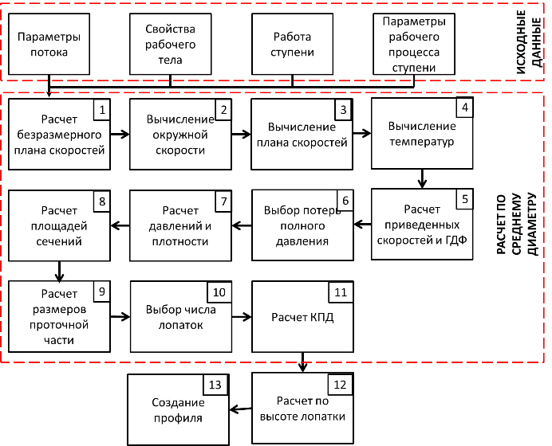
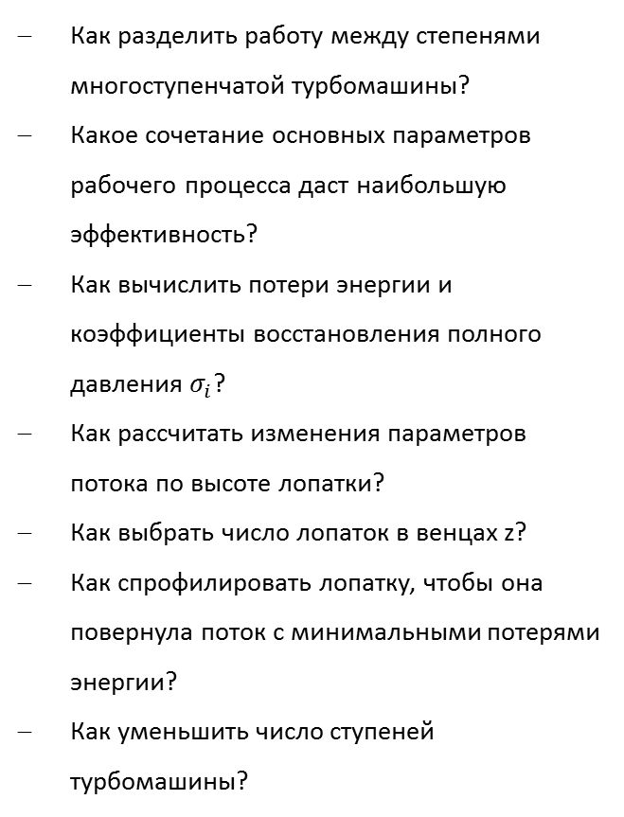
Ключевые вопросы проектирования турбин
Как разделить работу между степенями многоступенчатой турбомашины?
Какое сочетание основных параметров рабочего процесса даст наибольшую эффективность?
Как вычислить потери энергии и коэффициенты восстановления полного давления $σ_{i}$?
Как рассчитать изменения параметров потока по высоте лопатки?
Как выбрать число лопаток в венцах z?
Как спрофилировать лопатку, чтобы она повернула поток с минимальными потерями энергии?
Как уменьшить число ступеней турбомашины?
2

Slide 3






Оптимальные параметры рабочего процесса турбины
Баланс энергии в ступени турбины
0
0
$$L_{тs}=L_{т}+∆L_{са}+∆L_{рк}+\frac{c_{2}^{2}}{2}+∆L_{ут}+{∆L}_{д}$$
$$1=\frac{L_{т}}{L_{тs}}+ζ_{са}+ζ_{рк}+ζ_{вых}$$
$$η_{т}=1−ζ_{са}−ζ_{рк}−ζ_{вых}$$
Коэффициенты потерь
Потери в сопловом аппарате
Потери в рабочем колесе
Потери с выходной скоростью
Потери в сопловом аппарате зависят от скорости с₁ и поворота потока Δα
Потери в рабочем колесе зависят от скорости w₂ и поворота потока Δβ
Потери с выходной скоростью зависят от скорости с₂
Как изменится рабочий процесс в осевой турбине при изменении основных параметров (L/u², c_{a}/u, ρ_{ст} )?
3
Notes:
As noted earlier, the most important task of turbine stage design is to determine the velocity diagram.
Knowing velocity diagram allows determining shape of the blades, to calculate flow parameters in all control sections, dimensions of meridian section and to evaluate efficiency.
It was shown in Section 2.11 that velocity diagram is determined by three dimensionless parameters (, , ) for the stage with constant mean diameter (; ) and constant axial velocity ().
Let us consider which values of head coefficient, flow coefficient and degree of reaction should be selected to obtain high efficiency of the turbine stage.
Let us consider energy balance in turbine stage for this analysis:
It follows from this that work of gas expansion in turbine is used for creation of useful mechanical work and overcoming losses in blade rows NB and RW , as well as it for residual velocity losses.
Dividing both parts of the equation by isentropic work, we obtain:
Ratio of useful mechanical work or turbine to the work of expansion is efficiency. Then, relationship between power efficiency of stage and loss coefficients can be written as following:
The last dependence allows to analyze the effect of main parameters of turbine operation on its efficiency.
To do this, it is necessary to realize which affects the loss coefficients.
Losses in NB are determined by the level of velocity с₁ in it (it determinate the value of friction losses) and by the flow deflection angle Δα (it determinate the secondary losses).
Increase in the level of velocities and Δα leads to an increase of energy losses in the NB.
Losses in RW are determined by the level of velocity in relative motion and , as well as by the flow deflection angle Δβ. Growth in velocities and Δβ leads to an increase of energy losses in the RW.
Residual velocity losses are kinetic energy of the flow exiting turbine.
Their value is determined by the absolute velocity at the exit of RW . Residual velocity losses will increase with the growth in this velocity.

Slide 4
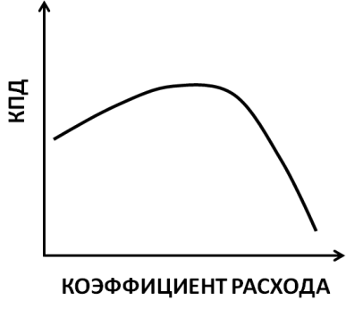
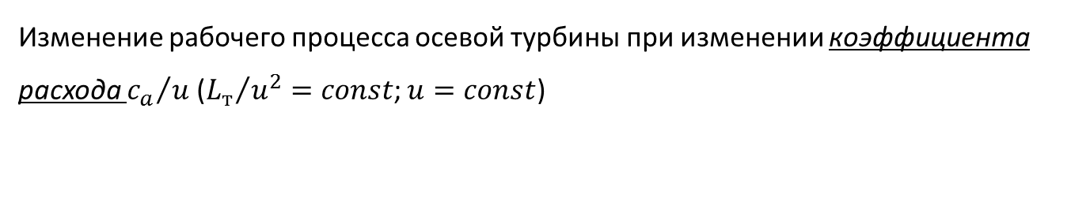


Оптимальные параметры рабочего процесса турбины
Изменение рабочего процесса осевой турбины при изменении коэффициента расхода ${c_{a}}/u$ (${L_{т}}/{u^{2}}=const$; $u=const$)
${c_{a}}/u$ ↑
${c_{a}}/u$ ↓
ΔW_{u}=ΔС_{u}
ΔW_{u}=ΔС_{u}
С₁
W₂
W₂
С₁
С_{a}
W₁
С₂
С_{a}
С₂
Δβ
W₁
Δβ
β₁
α₁
α₂
β₁
α₁
α₂
β₂
β₂
U₁= U₂
U₁= U₂
Исходный план
Измененный план
С увеличением коэффициента расхода:
Расчет уровень скоростей в венцах
Снижается поворот потока
4
Notes:
Let us consider arbitrary turbine with constant mean diameter () and constant axial velocities ().
Its velocity diagram is shown in Figure 5.3.1.
We consider how its operation will change with variation in flow coefficient with constant head coefficient .
To simplify the analysis it is assumed that circumferential velocity value does not change.
I.e. changing in flow coefficient occurs only by varying the axial velocity c_{a}.
Comparison of the velocity diagrams with increased and decreased values of flow coefficient and with the initial diagram is shown in Figures 5.3.2 and 5.3.3.
From the analysis of velocity diagrams, it is clear that the decrease in flow coefficient leads to a decrease in the level of velocities in the NB, which will reduce the losses there.
Level of velocities w in RW will be decreased as well, but there is a significant increase in flow deflection angle, which leads to the increase of losses in RW.
Outlet velocity decreases with the drop in flow coefficient, which will reduce residual velocity losses .
The opposite situation takes place with the increase in.
Thus, two opposite factors affect the loss value and turbine efficiency with change in coefficient.
Losses in NB and residual velocity losses increase with growth of flow coefficient, but losses in RW decrease.
Because of this, dependence of turbine efficiency on has maximum.

Slide 5
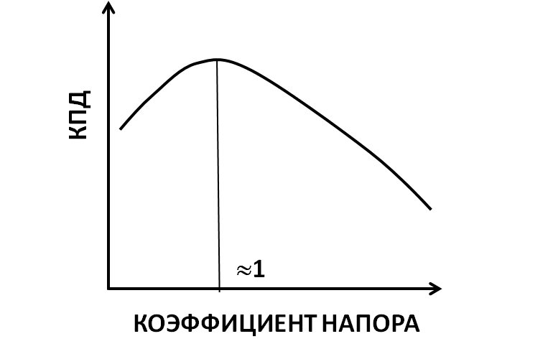
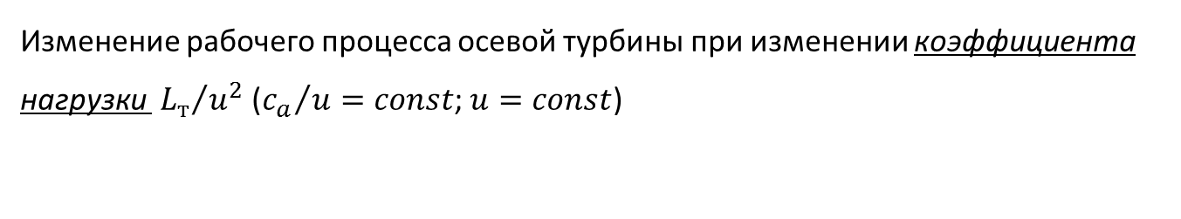
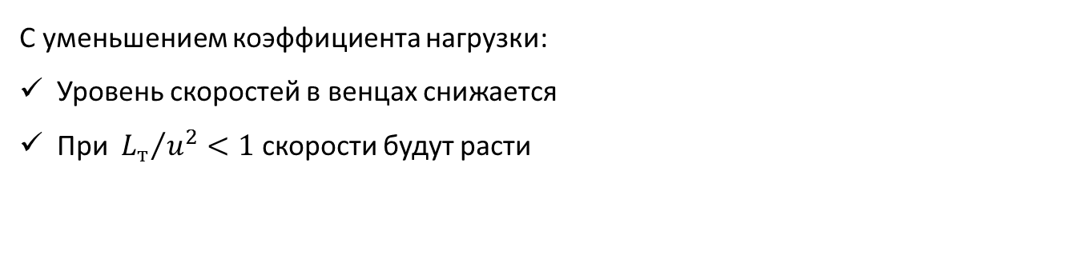


Оптимальные параметры рабочего процесса турбины
Изменение рабочего процесса осевой турбины при изменении коэффициента нагрузки ${{ L}_{т}}/{u^{2}}$ (${c_{a}}/u=const$; $u=const$)
${L_{т}}/{u^{2}}$↑
${L_{т}}/{u^{2}}$↓
ΔW_{u}=ΔС_{u}
ΔW_{u}=ΔС_{u}
С₁
W₂
С₁
С₁
W₂
W₁
W₂
С_{a}
W₁
С_{a}
W₁
С₂
С₂
С₂
Δβ
Δβ
β₁
α₁
α₂
β₁
α₁
α₂
β₂
β₂
U₁= U₂
U₁= U₂
Исходный план
Измененный план
С уменьшением коэффициента нагрузки:
Уровень скоростей в венцах снижается
При ${{ L}_{т}}/{u^{2}}<1$ скорости будут расти
5
Notes:
Let us consider how turbine stage operation will change with variation of head coefficient with constant flow coefficient .
To simplify the analysis it is assumed that circumferential velocity value does not change.
I.e. changing in head coefficient occurs only by varying the difference in swirls .
Comparison of the velocity diagrams with increased and decreased values of head coefficient and with the initial diagram is shown in Figures 5.3.5 and 5.3.6.
From the analysis of velocity diagrams, it is clear that the increase in head coefficient leads to an increase in the level of velocities in all elements of turbine.
Moreover, deflection flow angle increase both in NB and RW. All these factors clearly increase losses in the turbine and reduce its efficiency (Figure 5.3.7).
The opposite situation takes place with the decrease in head coefficient . Velocity level and flow deflection angles Δβ decrease with the drop in , which is the factor increasing turbine efficiency.
However, when become less than circumferential velocity u, the tendency will be changed.
Further decrease of head coefficient leads to the increase in residual velocity losses.
The level of velocities in RW will be increased and convergence degree will be decreased there, which leads to the growth in losses in RW.
Thus, dependence of turbine efficiency on head coefficient has maximum which occurs at (Figure 5.3.7).

Slide 6
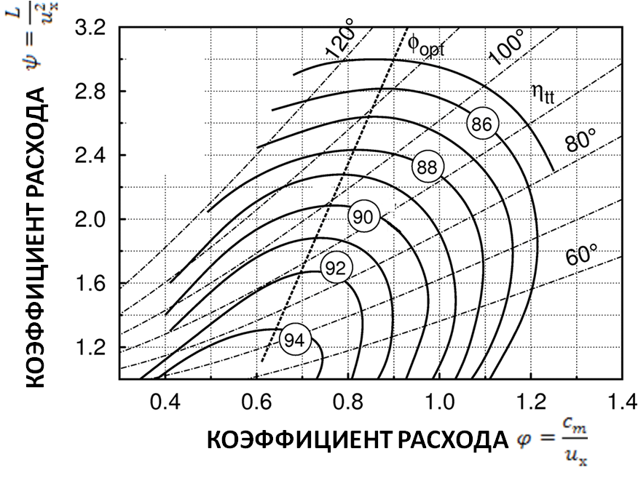



Оптимальные параметры рабочего процесса турбины
Стартовые точки
$\frac{L_{cт}^{∗}}{u^{2}}=2$, $\frac{c_{a}}{u}=0,6$
+
$\frac{L_{cт}^{∗}}{u^{2}}=1,7$, $\frac{c_{a}}{u}=0,37$
Линия оптимальных решений
$$\frac{L_{cт}^{∗}}{u^{2}}=0,65\frac{c_{a}}{u}−2,9$$
Диаграмма Смита
Диаграмма Смита получена экспериментально в 1967 на основании анализа данных 70 турбин
Значение КПД на диаграмме завышены на 1…2%, из-за не учета потерь в радиальном зазоре
Диаграмма Смита широко применяется при проектировании турбин
6
Notes:
If we construct the set of dependencies at different values of head coefficient, and a set of dependencies for different values of flow coefficient, combine them on the same graph, and connect the dots with the same efficiency, we will obtain a picture, known as Smith chart.
It is named after the English engineer Smith, who experimentally received it in 1967.
Smith reviewed the results of experimental investigations of 70 axial turbines of various types and application.
Smith put the results on the chat and found that lines of constant efficiency on the diagram form divergent concentric closed figures that are close to the oval form, clearly indicating the area of high efficiency.
Smith proposed to use obtained chart for selection of the parameters that define turbine operation at preliminary design.
Since the leakages in radial gap were not considered by Smith in the construction of chart, the level of efficiency that is displayed at diagram is by 1...2% more than real.
However, experience of diagram usage has shown that its application allows achieving good results even in the design of turbines parameters
The best turbine efficiency is observed at values of flow coefficient tending to 0.6...0.7 and head coefficient tending to 1.
The head coefficient can be reduced by increasing the circumferential velocity which will lead to the increase of the tensile stress in the rotor parts.
Decrease of flow coefficient due to the reduction of the axial component of the velocity leads to an increase in the blade height and growth of stresses in blades and disk.
Thus, the choice of parameters from the Smith chart is closely related to the strength of turbines and cannot be performed.

Slide 7
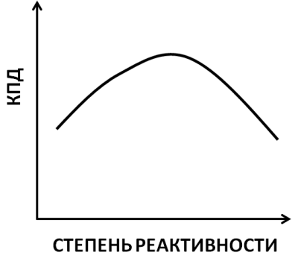
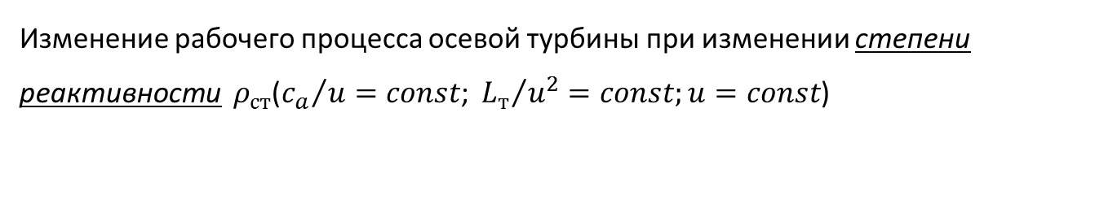


Оптимальные параметры рабочего процесса турбины
Изменение рабочего процесса осевой турбины при изменении степени реактивности $ρ_{ст}$(${c_{a}}/u=const\text{; }{L_{т}}/{u^{2}}=const;u=const$)
$ρ_{ст}$↑
$$ρ_{ст}=1+\frac{c_{2u}}{u}−\frac{∆c_{u}}{2∙u}=1+\frac{c_{2u}}{u}−\frac{1}{2}\frac{L}{u^{2}}$$
ΔW_{u}=ΔС_{u}
Исходный план
Измененный план
С₁
W₂
С₂
С_{a}
W₁
Δβ
β₁
α₁
α₂
β₂
U₁= U₂
С увеличением степени реактивности:
Уровень скоростей и потерь в СА снижается
Потери в РК и с выходной скоростью растут
7
Notes:
Let us consider how turbine operation changes with variation of degree of reaction .
To do this, we consider how velocity diagram of turbine changes with an increase of degree of reaction relatively to some initial value, shown in Figure 5.3.1 with constant values of head coefficient and flow coefficient .
With the increase of degree of reaction, expansion of working fluid in NB decreases, which leads to the drop of level of velocity at its outlet.
AT the same time, expansion in RW rises, which increases flow acceleration in relative motion and flow deflection angle Δβ in it.
As can be seen from Figure 5.3.9., increase in increased degree of reaction decreases level of velocities and flow deflection in NB, which leads to the reduction of losses in it .
Relative velocities in RW increase, which leads to the rise of losses in RW at slight change in flow deflection angle.
Flow acceleration in relative motion at turbine outlet causes growth of absolute velocity at turbine outlet , which increases residual velocity losses .
Thus, two opposite factors affect loss value in turbine stage and its efficiency with increase in degree of reaction .
On the one hand, decrease of losses in NB occurs, on the other hand, losses in RW and residual velocity losses increases because of the growth in the velocity level.
Thus, dependence at constant values of head and flow coefficients has maximum (Figure 5.3.9).
In practice, the value of degree of reaction is selected from the range of 0.25…0.5 in the designing process of turbines of aviation GTE.

Slide 8
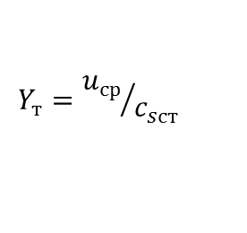
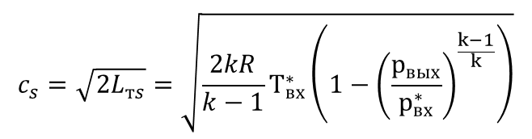
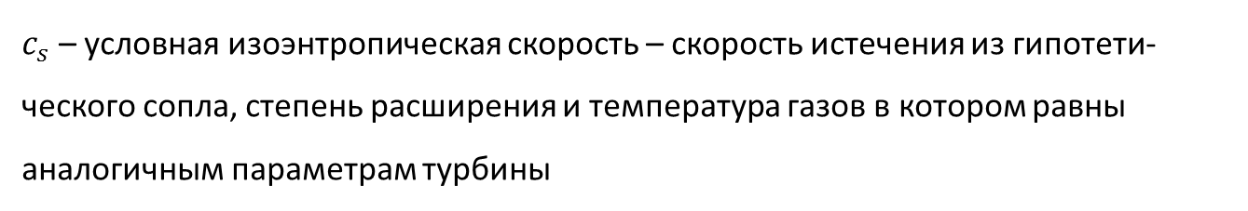
Параметр нагруженности турбины
Параметр нагруженности турбины
$$Y_{т}={u_{ср}}/{c_{sст}}$$
$c_{s}$ – условная изоэнтропическая скорость – скорость истечения из гипо­тети­ческого сопла, степень расширения и температура газов в котором равны аналогичным пара­метрам турбины
$$c_{s}=\sqrt{2L_{тs}}=\sqrt{\frac{2kR}{k−1}Т_{вх}^{∗}\left(1−{\left(\frac{р_{вых}}{р_{вх}^{∗}}\right)}^{\frac{k−1}{k}}\right)}$$
  Параметр нагруженности является комплексным параметром характеризующим кинематику потока и режим работы турбины. Он применяется в качестве универсального режимного параметра.
8
Notes:
In Russian and several foreign firms, an approach somewhat different from that described above is used to select the optimal velocity diagram.
In another approach, the stage loading parameter is used to describe the working process of turbine:
where $c_{s}$ – conditional isentropic velocity is the flowing velocity from the hypothetical nozzle, the expansion ratio and gas temperature in which are equal to those of the turbine:
On the one hand, $Y_{т}$ characterizes the kinematics of the flow in the stage.
On the other hand, the loading parameter $Y_{т}={u_{mid}}/{c_{s st}}$ uniquely determines the whole complex of dimensional parameters (p₀*, p₂, T₀* and n),characterizing the stage operation mode.
Therefore, it is often used as a universal mode parameter when displaying characteristics of turbines (or turbine stages).
In the absence of loss, the range of variation of the loading parameter $Y_{т}$ = 0...1. At $Y_{т}=0$, the turbine is extremely loaded and does not rotate, although the gas expansion in it occurs.
Reduction of the load causes an increase in the rotational speed and an increase in $Y_{т}$.
However, it is impossible to achieve$Y_{т}$ = 1.0 in the case of a real working fluid, since all types of losses in the turbine must be absent for this.

Slide 9

Параметр нагруженности турбины
$$η_{т}=1−ζ_{са}−ζ_{рк}−ζ_{вых}$$
Коэффициенты потерь
Потери в сопловом аппарате
Потери в рабочем колесе
Потери с выходной скоростью
Потери в сопловом аппарате зависят от скорости с₁
Потери с выходной скоростью зависят от скорости с₂
Потери в рабочем колесе зависят от скорости w₂ (w₁)
Чему равен КПД турбины при $Y_{т}$=0?
При $Y_{т}$=0 КПД турбины равен 0, т.к. турбина не производит полезной работы
Как изменится план скоростей ступени турбины при увеличении $Y_{т}$
$(L=const;ρ_{ст}=const)$?
9
Notes:
The loading parameter $Y_{т}={u_{mid}}/{c_{s st}}$ determines the stage efficiency. Let us prove this. To do this, we start from equation 7.1.3.
Using the above relationships, it is possible to analyze the change in the energy loss coefficients, and, consequently, $η_{т}$ as the $Y_{т}$ and $ρ_{st}$ change. The analysis itself is advisable to carry out not by the parameter $Y_{т}$, but by the value ${u_{1}}/{c_{1}}$, which is related to $Y_{т}$ by the following relation:
Figure 7.1.11 shows a diagram of the change in the energy loss components with increasing ${u_{1}}/{c_{1}}$ at $ρ_{st}=const$.
The horizontal line with an ordinate of 1.0 corresponds (in relative units) to the available heat drop. The quantity $ξ_{nb}$ does not depend on ${u_{1}}/{c_{1}}$ [1]. Therefore, the same relative loss value is subtracted from the horizontal line with an ordinate of 1.0 in Figure 7.1.11 for different values of ${u_{1}}/{c_{1}}$.
The dependence of $ξ_{rw}$ from ${u_{1}}/{c_{1}}$ at $ρ_{st}=const$ is determined by changing $\frac{w_{2}}{c_{1}}$. To establish the connection ${u_{1}}/{c_{1}}$ with the values $\frac{w_{2}}{c_{1}}$ and $\frac{с_{2}}{c_{1}}$, we consider the velocity diagrams of stages having the same values and at different (see Figure 7.1.12)/ The velocity diagram is in Figure 7.1.12, a) corresponds to the small value ${u_{1}}/{c_{1}}$. The value of$w_{1}$ in this case is close to $c_{1}$. Since the value of $w_{2}$ is determined from the expression:

Slide 10
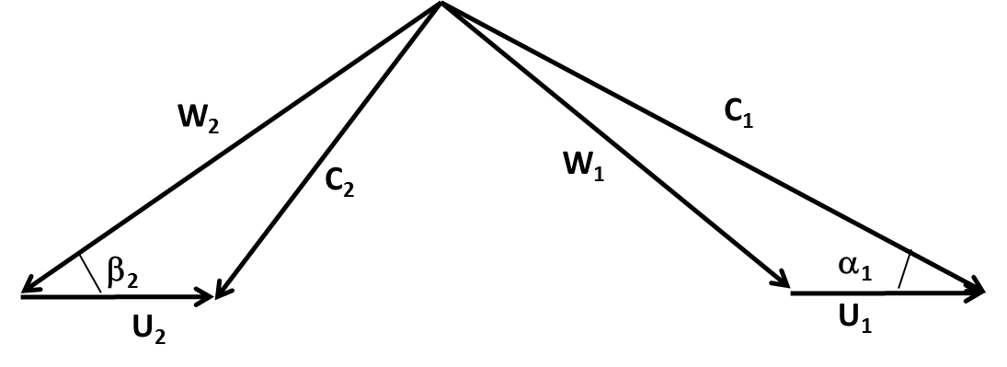
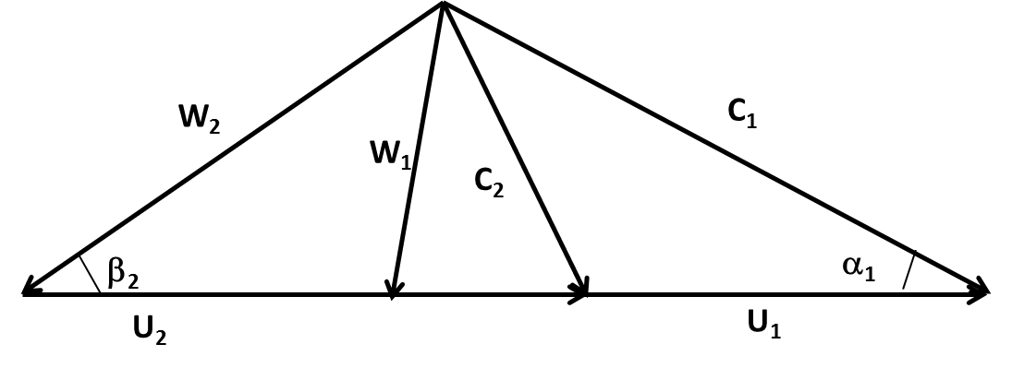
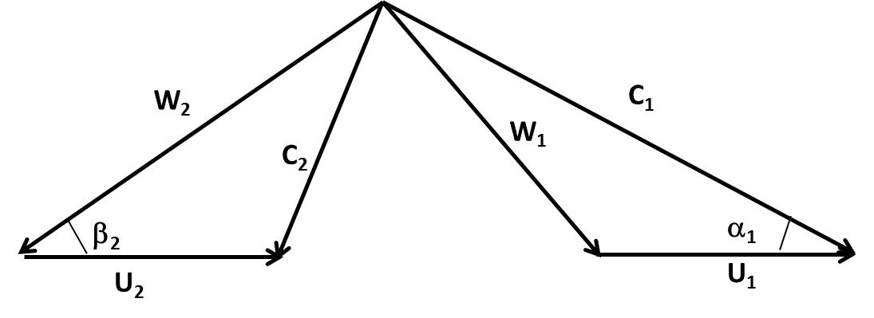
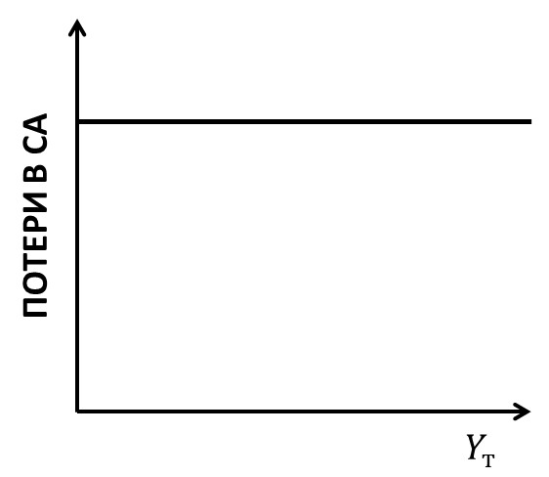
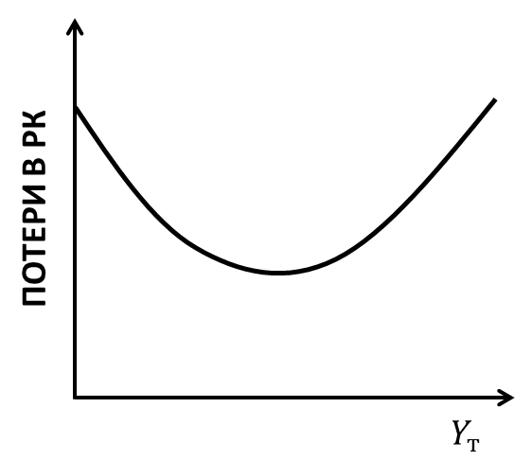
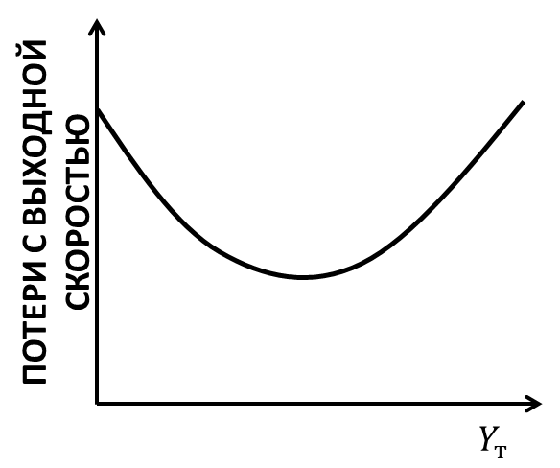
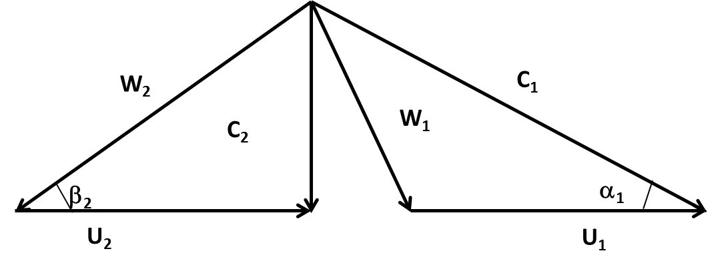
Параметр нагруженности турбины
$$Y_{т1}$$
$Y_{т4}>$ $Y_{т3}$
$Y_{т2}>$ $Y_{т1}$
Как меняются потери в СА, РК и с выходной скоростью
$Y_{т3}>$ $Y_{т2}$
10

Slide 11









Параметр нагруженности турбины
Изменение основных потерь ступени турбины
Изменение основных потерь турбины
$$η_{т}=1−ζ_{са}−ζ_{рк}−ζ_{вых}$$
100%
$$ζ_{са}$$
$$η_{т}=1−ζ_{са}$$
$$ζ_{рк}$$
$$η_{т}=1−ζ_{са}−ζ_{рк}$$
КПД
$$ζ_{вых}$$
$$η_{т}$$
$$Y_{тopt}$$
$$Y_{т}$$
Почему при больших $Y_{т}$ КПД равен 0?
11

Slide 12
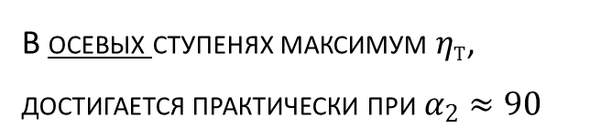


Параметр нагруженности турбины
$$η_{т}$$
КПД
$$Y_{т}$$
В осевых ступенях макси­мум $η_{т}$, достигается практически при $α_{2}≈90$
12
Notes:
At $u_{1}=1$, the work on the turbine shaft is zero, i.e. ${ξ_{nb}+ξ}_{rw}+ξ_{res}=1$ and the turbine efficiency is zero $η_{т}=0$, since no useful work is performed (the turbine does not rotate).
Thus, the curve $η_{т}=f\left({u_{1}}/{c_{1}}\right)$ outgoing from the point $η_{т}=0$ at ${u_{1}}/{c_{1}}=0$ and reaches a maximum at the optimal parameter ${\left({u_{1}}/{c_{1}}\right)}_{opt}$, the value of which corresponds to the exit of the gas flow from the stage at an angle $α_{2}$, several times exceeding 90°.
Moreover, in the axial stages, the maximum $η_{т}$ is reached, practically at $α_{2}≈90°$. In the centripetal stages, ${\left({u_{1}}/{c_{1}}\right)}_{opt}$ corresponds to $α_{2}>90°$ and cases are possible when $η_{тmax}$ is reached at $α_{2}=120…140°$.
Optimum in terms of achieving maximum efficiency, the loading parameter $Y_{т}={u_{mid}}/{c_{s st}}$ for axial turbines is 0.5...0.6.
The value of the loading parameter in the domestic practice of turbine design is one of the most important key parameters that determine its working process.

Slide 13
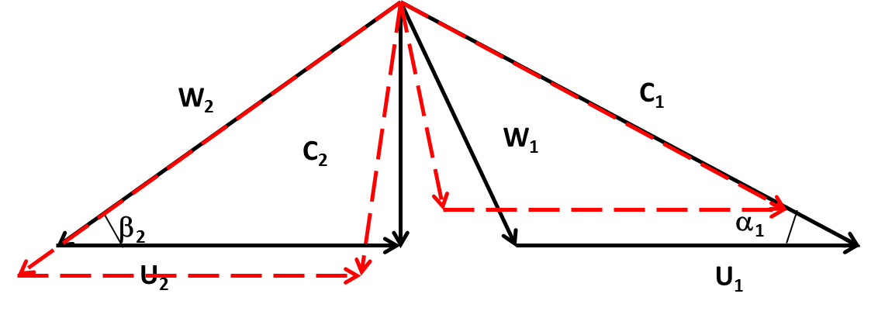
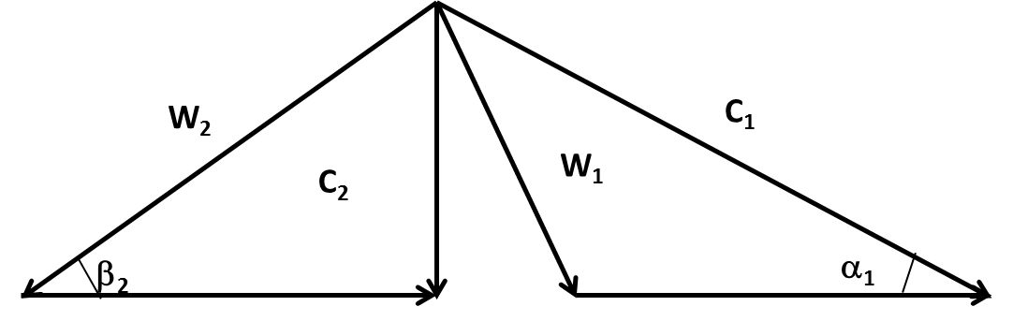

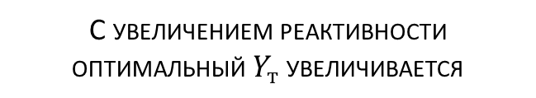
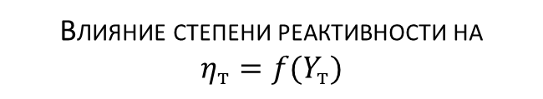
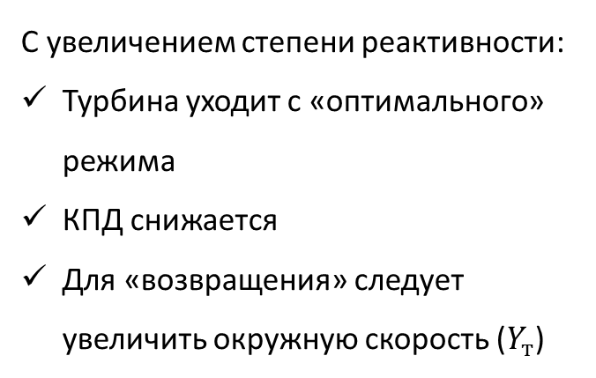





Параметр нагруженности турбины
Влияние степени реактивности на
$$η_{т}=f(Y_{т})$$
$$ρ_{ст2}>ρ_{ст1}$$
$ρ_{ст}$↑
$$ρ_{ст1}$$
КПД
Исходный план
$$Y_{тopt2}$$
Измененный план
$$Y_{тopt1}$$
С увеличением степени реактивности:
Турбина уходит с «оптимального» режима
КПД снижается
Для «возвращения» следует увеличить окружную скорость ($Y_{т}$)
$$Y_{т}$$
С увеличением реактивности оптимальный $Y_{т}$ увеличивается
13
Notes:
Let us estimate the influence of the value of the real reaction $ρ_{st}$ on the efficiency of the turbine $η_{т}.$
To do this, we first consider the cascades of the stage NB and RW with a small reaction $ρ_{st1}≈0.2$.
The velocity diagram of this stage, corresponding to the optimal loading parameter ${u_{1}}/{c_{1}}={\left({u_{1}}/{c_{1}}\right)}_{opt}$, is shown in Figure 7.1.13 by solid lines.
From this figure, it follows that the velocity $w_{2}$slightly exceeds $w_{1}$ and the value of $α_{2}$, as noted above, at ${\left({u_{1}}/{c_{1}}\right)}_{opt}$ is slightly higher than 90°.
With increase in reaction $ρ_{st2}>ρ_{st1}$, the velocity $w_{2}$ (dashed lines in Figure 7.1.13) becomes much larger than $w_{1}$ and higher velocity $u_{2}$ is required to achieve an angle $α_{2}$, providing $η_{тmax}$, and therefore a larger value of parameter ${u_{1}}/{c_{1}}$.
Thus, the value ${\left({u_{1}}/{c_{1}}\right)}_{opt}$ increases with increasing $ρ_{st}$.
The type of dependencies $η_{т}=f\left({u_{1}}/{c_{1}}\right)$for various values of $ρ_{st}$ for full-scale turbine stages is shown in Figure 7.1.14.
The use of stages with an increased degree of reaction allows a slight increase in their efficiency.
This is explained by the fact that the growth of $ρ_{st}$ increases the degree of confusion of gas flow in the RW cascade.
The latter circumstance leads to a decrease in losses in the RW and a decrease in $ζ_{rw}$. Figure 7.1.14 shows an approximate character of the dependence (dotted line) of the efficiency of the stage from the degree of reaction (for the values of ${u_{1}}/{c_{1}}$ optimal for $η_{т}$).
However, an increase in $ρ_{st}$ should be accompanied by an increase in the circumferential velocity, which leads to an increase in the level of stresses acting in the disk and the RW blades.
In relatively small-sized stages, an increase in $ρ_{st}$ is accompanied by a significant increase in losses due to the leakage of the working fluid through the radial gap.

Slide 14
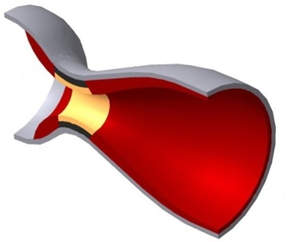
Особенности процесса в турбинной решетке
На что похож межлопаточный канал турбины?
Межлопаточный канал турбины – сопло
Это изогнутое сопло Лаваля с обрезанной выходной частью (с косым срезом)
Косой срез
Сопло Лаваля
Особенности течения в сопле с косым срезом:
Канал «сопла» криволинеен
Следы лопаток оказывают влияние на процесс истечения
Турбинная решетка работает в широком диапазоне параметров
Можно получить сверхзвуковую скорость с малыми потерями
14
Notes:
Flow acceleration occurs in turbine blade rows.
In fact, its blade passages are nozzles.
However, flow in the blade passages has a number of important features unlike the commonly used conical nozzles or Laval nozzle:
blade passage is curvilinear, which is caused by the necessity of flow turning;
blades have a finite thickness and their wakes have an effect on the exhausting process;
geometric parameters of cascade of turbine profiles can vary over a wide range;
geometry of exit part of blade passage is designed as wedge cut.
Presence of wedge cut gives the turbine cascade some unique features that are not found in conventional nozzles.
It is possible to obtain supersonic flow velocity at the outlet in wedge cut.
This is due to the fact that if the pressure drop in the cascade is more than critical, then expansion will not stop in the throat and will continue in wedge cut.
Wherein, blade with wedge cut allows obtaining subsonic, sonic and supersonic velocities with rather high efficiency, whereas the Laval nozzle has a good efficiency only at the design mode.
Another important feature of the cascade with wedge cut is that the outlet flow angle in it varies with the pressure drop variation that must be considered during design process.

Slide 15
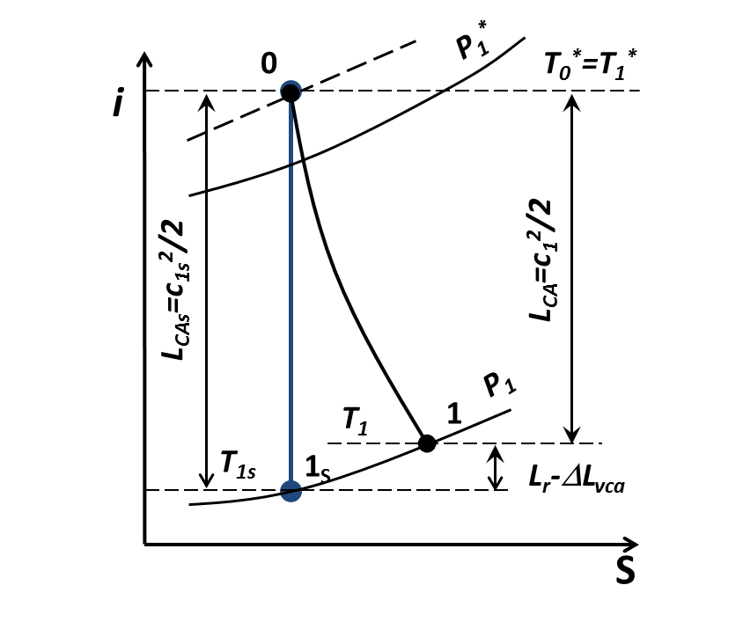
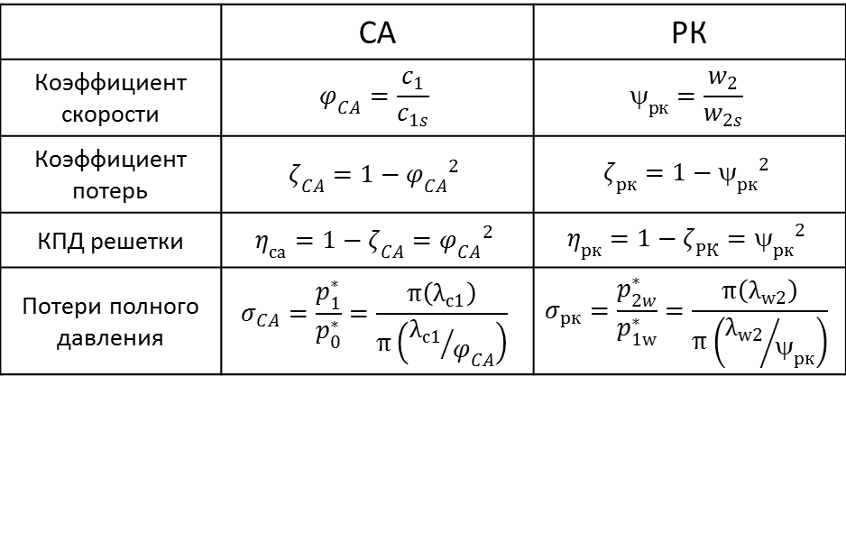
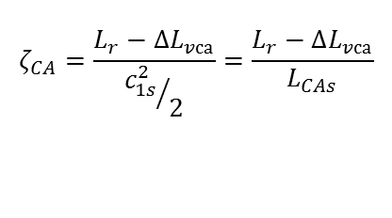


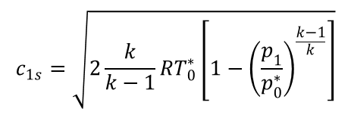
Потери энергии в лопаточном венце турбины
I-S диаграмма процесса расширения в сопле
Идеальная скорость истечения из сопла
Реальная скорость истечения из сопла
$$c_{1s}=\sqrt{2\frac{k}{k−1}RT_{0}^{∗}\left[1−{\left(\frac{p_{1}}{p_{0}^{∗}}\right)}^{\frac{k−1}{k}}\right]}$$
$$c_{1}=c_{1s}φ_{CA}$$
Коэффициенты потерь турбинных решеток
 | СА | РК
Коэффициент скорости | $$φ_{CA}=\frac{c_{1}}{c_{1s}}$$ | $$_{рк}=\frac{w_{2}}{w_{2s}}$$
Коэффициент потерь | $$ζ_{CA}=1−{φ_{CA}}^{2}$$ | $$ζ_{рк}=1−{_{рк}}^{2}$$
КПД решетки | $$η_{са}=1−ζ_{CA}={φ_{CA}}^{2}$$ | $$η_{рк}=1−ζ_{РК}={_{рк}}^{2}$$
Потери полного давления | $$σ_{CA}=\frac{p_{1}^{∗}}{p_{0}^{∗}}=\frac{π\left(λ_{c1}\right)}{π\left({λ_{c1}}/{φ_{CA}}\right)}$$ | $$σ_{рк}=\frac{p_{2w}^{∗}}{p_{1w}^{∗}}=\frac{π\left(λ_{w2}\right)}{π\left({λ_{w2}}/{ψ_{рк}}\right)}$$
Потери энергии в сопле
$$L_{r}−∆L_{vса}=\frac{c_{1s}^{2}}{2}−\frac{c_{1}^{2}}{2}=L_{CAs}\left(1−φ_{CA}^{2}\right)$$
Коэффициент потерь
$$ζ_{CA}=\frac{L_{r}−∆L_{vса}}{{c_{1s}^{2}}/2}=\frac{L_{r}−∆L_{vса}}{L_{CAs}}$$
Расчет коэффициентов потерь осуществляется с помощью моделей потерь
15
Notes:
Let us consider the exhausting process from turbine cascade on the example of NB.
To do this we draw expansion process in i-s diagram
According to the energy equation, potential energy of compressed and heated gas coverts in NB into kinetic energy, i.e. , from where it follows that ideal velocity of gas exhausting from NB is equal:
The value of can be calculated by the known thermodynamic parameters of the stage:
Real velocity c₁ is lower than isentropic, because of presence of energy losses Usually, in calculations velocity c₁ is found from the formula :
The value of for modern turbines is usually in the range of 0.96...0.98 .
Velocity can be calculated also by means of coefficient of energy losses , which is usually calculated with the formula:
It is interesting to note that the velocity coefficient in the RW, in spite of the complete physical analogy with the NB velocity coefficient, is traditionally denoted by other symbols.
Knowing the value of loss coefficient ζ, it is possible to find total pressure losses σ and velocity coefficient velocity coefficient and vice versa.

Slide 16




Расчет потерь в венце турбины
Модель потерь – комплекс эмпирических формул для вычисления потерь энергии
Пример – Модель потерь ЦИАМ (Россия) - 1975
Интегральные потери
$$ζ_{}=ζ_{тр}^{0}+ ζ_{кр}+ζ_{вт}+ζ_{Re}{+Δη}_{λ}$$
Профильные потери
Кромочные потери
$$ζ_{тр}^{0}=0,02185\left(0,01065х_{1}^{2}−2,295х_{1}+160,5\right)∙(0,1055у_{1}^{2}−0,3427у_{1}+0,295)$$
$$ζ_{кр}=0,4\frac{r_{2}}{t_{РК}∙sinβ_{2}}$$
Вторичные потери
Поправка по числу Рейнольдса
$$ζ_{вт}=2\left(ζ_{тр}^{0}+ ζ_{кр}+{Δζ}_{Re}{+Δζ}_{λ}\right)∙\frac{t_{РК}sinβ_{2}}{h_{2л}}$$
$${Δζ}_{Re}=\frac{2100}{Re}−0,0021$$
Поправка по скорости потока
$${Δζ}_{λ}=\left(3,61х^{3}−7,22х^{2}+3,87х−0,26\right)∙(ζ_{тр}^{0}+ ζ_{кр}+{Δζ}_{Re})$$
16
Notes:
The value of loss coefficient ζ is calculated using loss models.
This is the complexes of empirical formulas obtained on the basis of analysis of experimental data describing the change of the various components of energy losses in blade row.
Currently, more than ten complex models are known, allowing the calculation of the losses in axial turbines, as well as dozens of equations that allow calculating of the individual loss components.
These models and loss equations have been obtained over the last 70 years by different researchers in different countries.
Below, as an illustration, model for the loss calculation (for example, losses in the RW), developed by the Central Institute of Aviation Motors (CIAM) is shown.

Slide 17
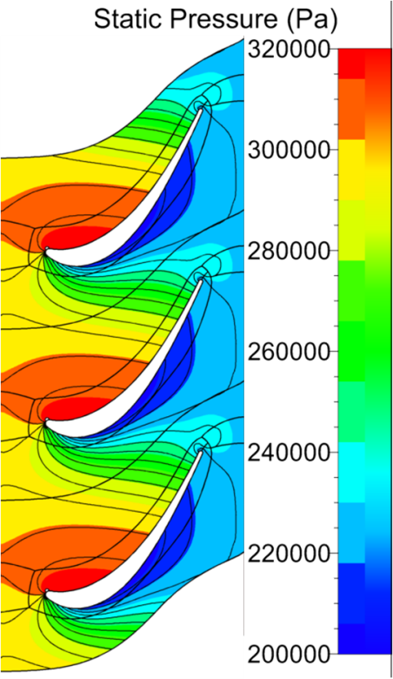
Выбор числа лопаток турбины
Поле статических давлений в межлопаточном канале
На корытце давление повышено
На спинке давление понижено
Причина возникновения разности давлений на лопатке – поворот потока и крыловидная форма лопатки
Из-за разницы давлений на лопатке возникает сила P_{u}
Сила P_{u} создает крутящий момент на валу и работу
Что определяет P_{u} и работу?
Как увеличить работу турбины?
p_{u}
17
Notes:
Static pressure p and other parameters change in blade passage of the turbine not only in the direction of movement of the working fluid, but also in circumferential direction.
Field of pressure distribution in the blade passage is shown in Figure 5.5.1.
As can be seen from the figure, the pressure on the blade pressure side is greater than pressure on the suction side.
This is due to several factors.
On the one hand, blade has a wing profile, while flowing which the back discharge is formed at the suction side.
On the other hand, the flow is pressed by centrifugal forces to the pressure side and is pushed away from the suction side while flow turning in the blade passage.
The pressure difference on the blade surface leads to unbalanced force P directed toward the suction side.
Circumferential component of this force P_{u} forced the turbine to rotate around the axis.
Obviously, the higher the circumferential component of the lift force is, with all other conditions being equal, the greater the torque and power will be created by the turbine.

Slide 18
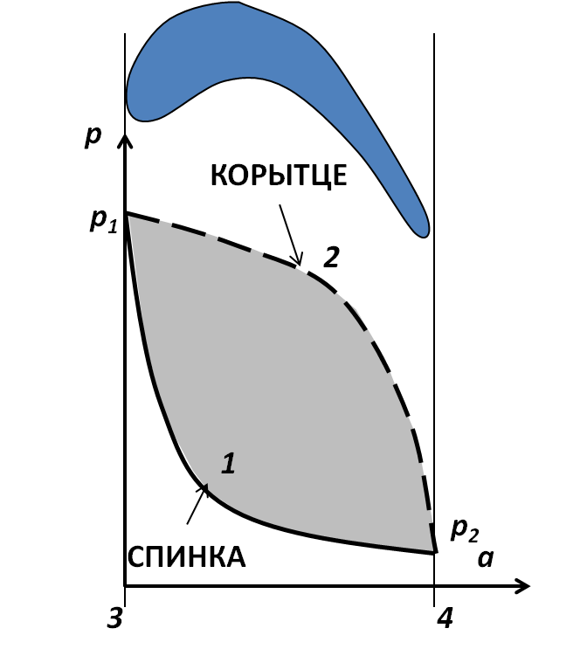
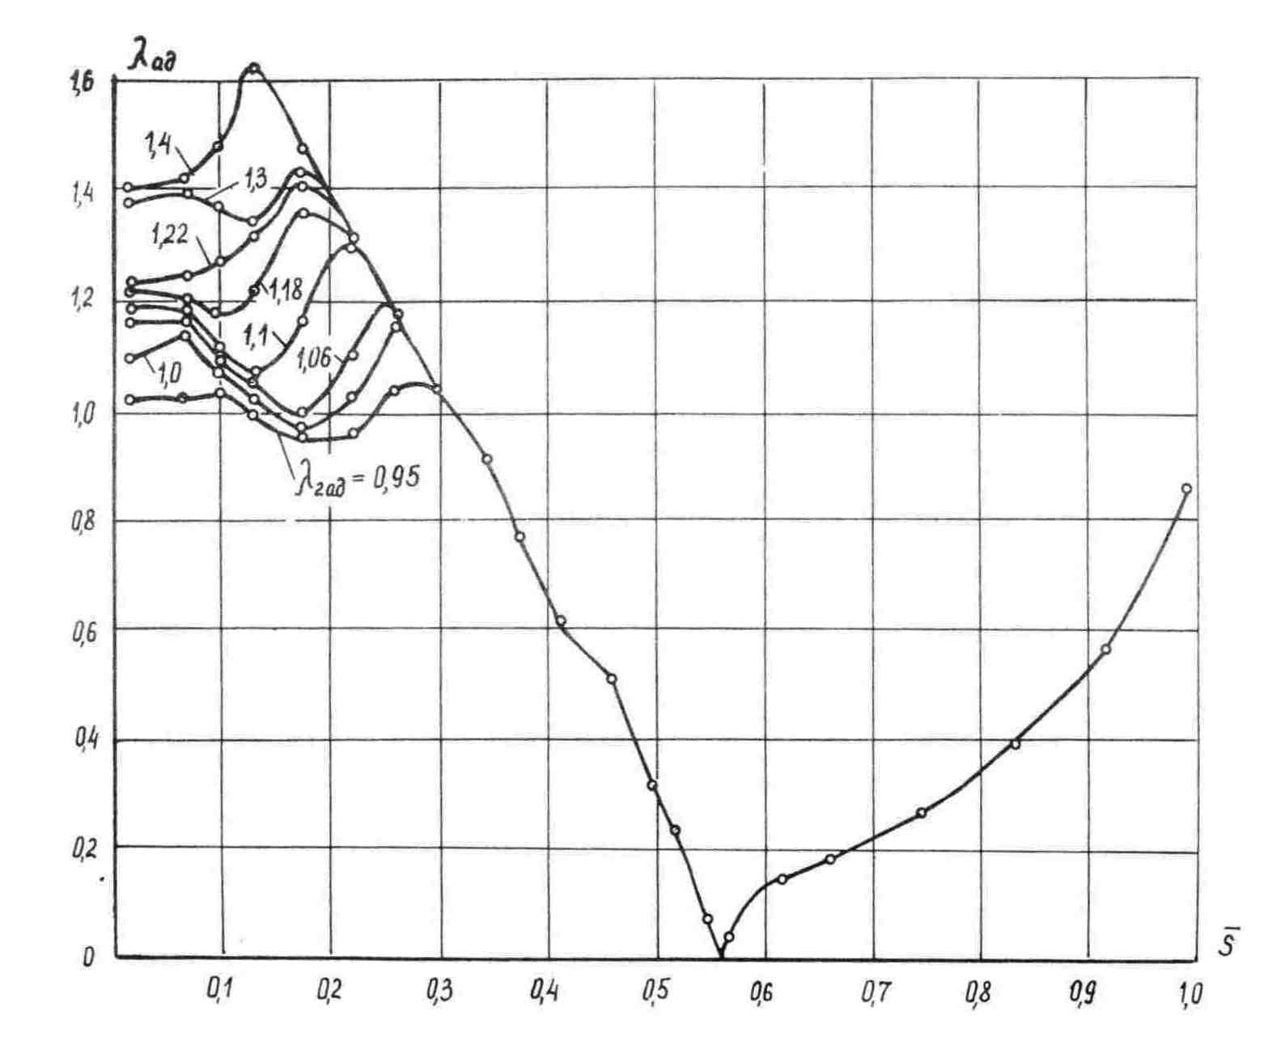
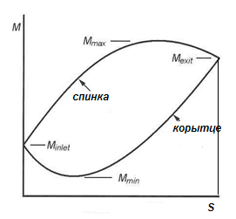
Выбор числа лопаток турбины
Диаграмма изменения давления по профилю лопатки
Диаграмма изменения скорости по профилю
Вариант 1
Вариант 2
Направление обхода построения развертки
Площадь замкнутой фигуры пропорциональна окружной силе P_{u}
и работе
Площадь замкнутой фигуры пропорциональна окружной силе P_{u}
и работе
0
18
Notes:
Figure 5.5.2 shows the load diagram of the pressure distribution along the axial chord along the suction side and pressure side of axial turbine blade.
This chart allows calculating the force at the profile as the sum of forces acting from the pressure on suction and pressure sides.
The resultant circumferential force P_{u} acting on pressure side is square to the area of the figure under the pressure curve (p₁-2-p₂-4-3).
In practice, the load diagram is often constructed as the dependence of the conditional specific velocity λ (in Russian practice) or of Mach number М (in international practice) on the profile surface from the axial chord or along the perimeter.
Since flow in RW is isoenergetic, velocity changing is opposite to pressure changing, and previous conclusions are valid for the charts constructed by the velocity.
I.e. area of the figure between curves of velocity changing on suction side and pressure side in Figure 5.5.4 is also a measure of the load of profile.
The larger the area, the greater pressure difference between suction and pressure sides occurs, and the greater the circumferential force P_{u} and torque М_{ru} can be obtained with this profile.
Increase in torque allows obtaining large turbine work L_{t}, or reducing the number of its blades z.

Slide 19


Выбор числа лопаток турбины
Как увеличить площадь диаграммы?
Вариант 1
Вариант 2
Быстро ускориться на спинке и держать скорость
Ускориться на корытце у выхода
Допустить диффузорные участки на корытце на входе и на выходе на спинке
Диаграмма - прямоугольник
Резкие ускорения – большие потери
Степень диффузорности нужно контролировать
Фактор диффузорности не более 0,2
Спинка требует большего внимания
Факторы диффузорности
$$D_{cп}=\frac{M_{max}−M_{вых}}{M_{max}}$$
$$D_{кар}=\frac{M_{вх}−M_{мин}}{M_{вх}}$$
Для получения большой работы в межлопаточном канале турбины должны быть диффузорные участки!!!
19
Notes:
Analyzing load charts, it can be concluded that it is necessary to accelerate the flow on the suction side to the maximum value as fast as possible, and on the pressure side as late as possible in order to obtain increased load on the profile.
Implementation of this is complicated by the fact that there are large gradients of pressure that might lead to additional losses during this process. Therefore, this option is, in practice, is rarely applicable.
It is possible to solve the problem of increase in circumferential force P_{u} by using divergent sections on the profile (on the pressure side near the leading edge and on the suction side in the wedge cut).
However, since the divergent flow tends to the separations, excessive deceleration on the pressure and suction sides can lead to separation of the boundary layer, which significantly increases the losses.
Divergence degree of indicated sections is estimated by means of divergence coefficient
Selection of the limit value of divergence coefficient is mainly determined by the experience of design company, however, generally it does not exceed 0.2.
Investigation of the structure and nature of the flow using CFD methods allows assuming an increase of this magnitude by the results of research in each case.
However, it is too early to talk about refusing to use the divergence coefficient, as CFD has not reached such level of development to predict flow separation with great accuracy.
The process of gas exhaust on the suction side is more important to ensure the gas dynamic efficiency of profile.
If the flow detaches from the suction side because of excessive divergence, the separation cannot be localized before the exit of the row due to the convex shape of suction side and the small distance to the exit.
As the result, the losses will be significant, and flow angle at the outlet will be greater than it is required (the flow is insufficient turned) and turbine work will be less than the calculated value.
In addition, the separation will adversely affect the operation of subsequent stage.
Separation of the boundary layer on the pressure side near the leading edge will have time to be localized, and the negative impact will be less.

Slide 20
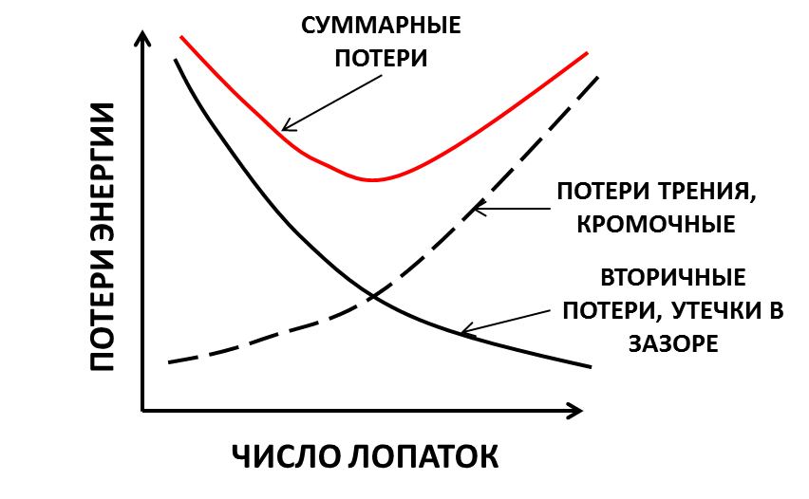
Выбор числа лопаток турбины
Как выбрать число лопаток турбины при заданной удельной работе?
Много лопаток |  | Мало лопаток
Достоинства | Недостатки | Достоинства | Недостатки
Малые вторичные потери | Большая масса и стоимость | Малая масса и стоимость | Большие вторичные потери
Малые потери в радиальном зазоре | Большие потери трения | Малые потери трения | Большие потери в радиальном зазоре
Малое отставание потока | Большие кромочные потери | Малые кромочные потери | Потери из-за диффузорности
Имеется оптимальное число лопаток !!!
20
Notes:
Design of the blades with the maximum possible load is not optimal solution.
Because obtaining large load is achieved through the large flow deflection angles (causing increased secondary losses and leakages in radial gap) and local divergent areas, which can lead to increased losses.
On the other hand, reduction of gas-dynamic load on the blade while maintaining stage work L_{t} is also not a good solution, because this will lead to increased edge and friction losses (due to increase of friction area and number of trailing edge vortexes) in addition to increasing weight and cost of turbine.
Thus, there is an optimum load on the profile at which the level of total losses will be minimal (Figure 5.5.5).

Slide 21
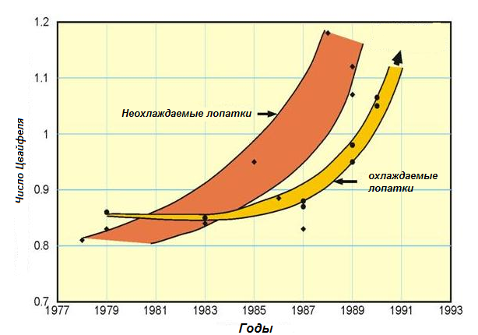
Выбор числа лопаток турбины
Как рассчитать оптимальное число лопаток турбины при заданной работе?
Число Цвайфеля (1945) - отношение удельной окружной силы, действующей на лопатку к идеальной силе. Под идеальной силой понимается окружная сила, возникшая бы на лопатке, если бы на всем протяжении спинки установилось бы давление равное выходному, а на всем корытце давление равное входному
$$C_{L}=\frac{ρс_{а}\left(c_{2u}+c_{1u}\right)}{\frac{1}{2}ρSc_{2}^{2}}=\frac{2t}{S}\sin^{2}β_{2}×\left(ctgβ_{2}+ctgβ_{1}\right)$$
Как выбрать число Цвайфеля?
Оценка Цвайфеля | 0,75…0,85
Современное проектирование | 0,9
Достигнутые значения | 1,2…1,6
21
Notes:
In world practice, load on the profile is usually estimated using the Zweifel parameter (1945).
It is the ratio of specific circumferential force acting on the blade to the ideal circumferential force. Circumferential force on the blade that would arise if the pressure equal to the outlet pressure would occur all over the suction side, and the pressure equal to the inlet would occur all over the pressure side is meant as deal [43].
Zweifel parameter is used to evaluate and further the number of blades z.
Thus, the selection of blade number is interconnected with blade aerodynamic load. The larger the number of blades, the less gas dynamic load on profile is required.
Selection of blade number is a complex problem. It is associated not only with gas dynamics, but also with the strength, technology and design (setting in the disc and shroud platform) aspects.
Zweifel parameter allows finding the optimal number of blades in terms of aerodynamics.
Based on the test results of the various stages, Zweifel believed that the optimum value of parameter is in the range of 0.75...0.85.

Slide 22
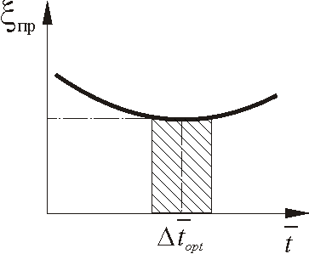
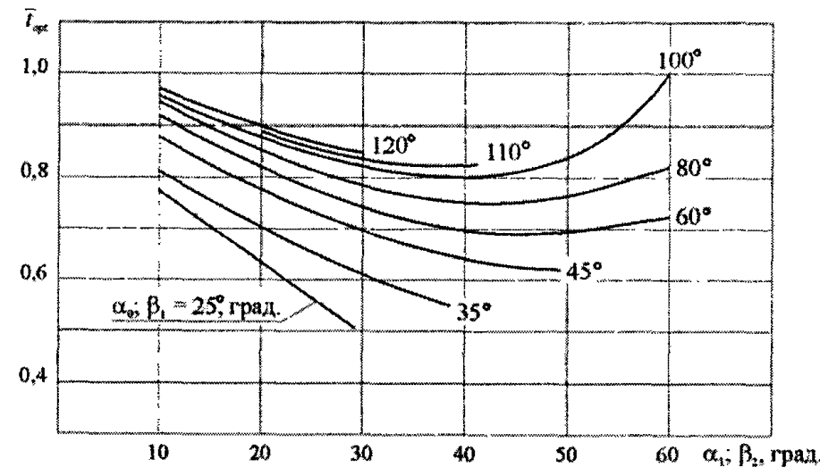


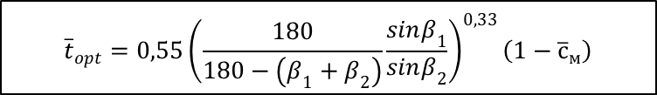
Выбор числа лопаток турбины
Альтернативный подход к оценке числа лопаток - относительный шаг:
$$\overline{t}=\frac{t}{b}$$
Малый относительный шаг
Большой относительный шаг
Большое число лопаток: масса, стоимость
Большая поверхность трения – увеличенные потери трения
Большое число кромок – увеличенные кромочные потери
Большой поворот потока
Повышенные вторичные потери и утечки в зазорах
Вероятность «прострела» потока
Оптимальный относительный шаг 0,6…0,8
$${\overline{t}}_{opt}=0,55{\left(\frac{180}{180−\left(β_{1}+β_{2}\right)}\frac{sinβ_{1}}{sinβ_{2}}\right)}^{0,33}\left(1−{\overline{с}}_{м}\right)$$
${\overline{t}}_{opt}=\left(1+d{\overline{t}}_{opt}\right)K_{KP}{\overline{t}}_{opt_0}$
Формула Дышлевского
Формула Мамаева и Клебанова
22
Notes:
1. The value of relative pitch is used in Russian practice for estimation of blade number z of axial turbine:
2. The same factors influence variation of relative pitch as the Zweifel parameter.
3. The number of blades in high at low value of , friction area and number of trailing edge vortexes are significant.
4. The load on profile increases with the growth of (at Lt=const), which leads to the local flow separation in the area of local divergence, growth of secondary losses and growth of leakage in radial gap.
5. Because of indicated reasons, there is an optimal value of relative pitch in terms of minimization of losses (Figure 5.5.7). In particular, modern axial turbines of GTE have for NB cascades and for RW cascades.
6. The value of depends on the fluid deflection angle Δβ in cascade, on degree of convergence K, relative profile thickness and on the other parameters.
7. As can be seen, relative pitch and the Zweifel parameter are similar values, and their change is determined by the same factors.
8 However, the use of the Zweifel parameter seems more preferable, because it is associated with a peripheral force P_{u}, generating torque (in other words with the physics of the process), and is largely a statistical parameter.

Slide 23
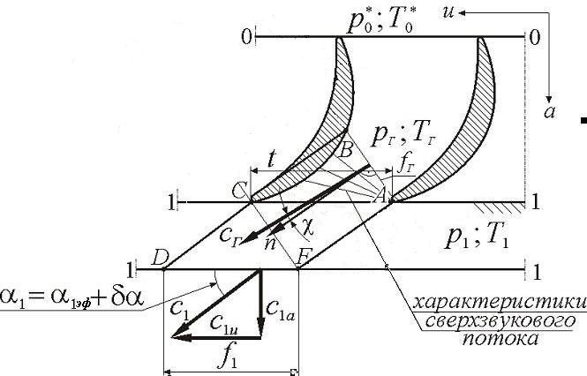
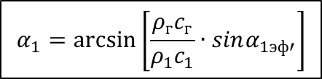

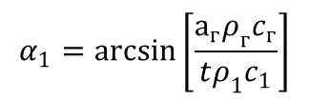

Угол выхода потока из турбинной решетки
В решётках с косым срезом, угол выхода потока α₁(β₂) существенно меняется при изменении режима работы
Величина угла α₁(β₂) влияет на работу турбины
Рассматривается течение на выходе из турбинной решётки
Уравнение неразрывности AB и DF
$$а_{г}drρ_{г}c_{г}cosχ=t∙drρ_{1}c_{1}sinα_{1}$$
$$α_{1}=\arcsin\left[\frac{а_{г}ρ_{г}c_{г}}{tρ_{1}c_{1}}\right]$$
Эффективный угол решетки
$$α_{1эф}=\arcsin\left[\frac{a_{г}}{t}\right]$$
Схема течения
$$α_{1}=\arcsin\left[\frac{ρ_{г}c_{г}}{ρ_{1}c_{1}}∙sinα_{1эф′}\right]$$
Зависит от режима течения
const
23
Notes:
As noted in Section 5.4, because of the presence of wedge cut, outlet flow angle of blade row α₁(β₂) will vary with change of the pressure drop.
This makes difficult the selection of outlet flow angle of cascade, because its wrong choice will lead to a shortfall in stage work.
Let us consider what determines outlet flow angle of cascade α₁(β₂).
Consideration will be conducted on the example of the nozzle vane cascade. These conclusions are fully applicable to the rotor wheels.
To determine the nature of the change in the outlet flow angle α₁ depending on the pressure drop, let us consider the flow of gas at the area ABC of wedge cut and ACDF (Figure 5.6.2).
This ratio shows that the direction of gas flow behind the cascade depends on the main geometric ratio of wedge cut a_{th}/t and the relationship of flux density , characterizing the mode of gas flow. The value is called effective angle of NB cascade α_{1 eff}:
Angle α_{1 eff} is approximately equal to the blade angle α_{1b}.
Obviously, the value of α₁ is increases with the growth of α_{1 eff} (α_{1 b})
Let us consider how the expansion mode (subcritical, supercritical, critical) affects the value of outlet flow angle of cascade.

Slide 24
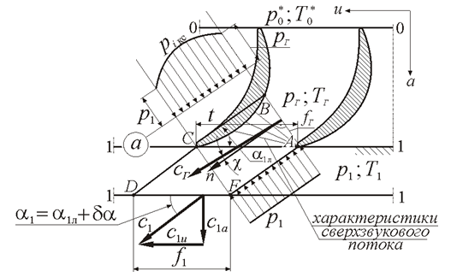
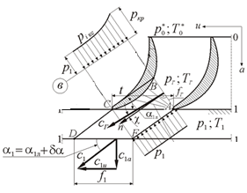
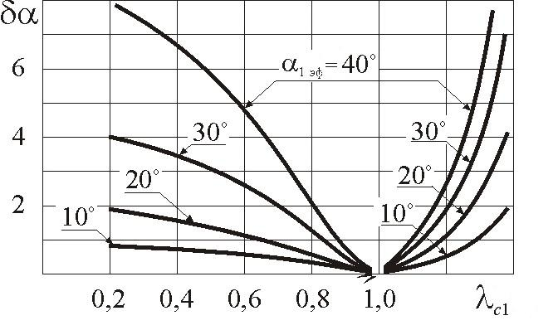
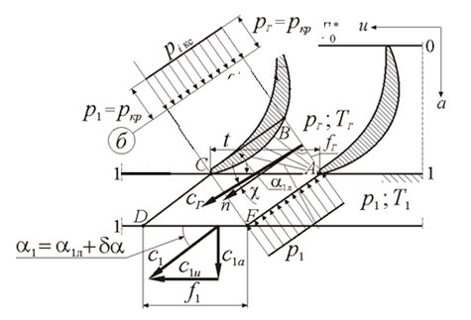



Угол выхода потока из турбинной решетки
Влияние режима течения
1. Дозвуковое течение λ<1
3. Сверхзвуковое течение λ>1
$$\frac{ρ_{г}c_{г}}{ρ_{1}c_{1}}>1$$
α₁ =α_{1 эф} + δα
$$\frac{ρ_{г}c_{г}}{ρ_{1}c_{1}}>1$$
α₁ =α_{1 эф} + δα
2. Звуковое течение λ=1
$$\frac{ρ_{г}c_{г}}{ρ_{1}c_{1}}=1$$
Диаграмма для угла отставания
24
Notes:
1. Pressure drop in NB is subcritical.
In this case, the entire flow is subsonic, absolute velocity is less than critical at any point of the flow (). Consequently, the flow velocity increases and will be the largest in the throat of duct when gas flows from the section 0-0 to section Th-Th. Further, flow velocity decreases, because cross-sectional area of the jet increases. Flow velocity changes more intensively than its density at the values of specific velocity . Consequently, the change in flux density will be determined by the change of velocity. As velocity is maximum in the section Th-Th, then , consequently, . The difference in the intensity of change of velocity and density of the gas increases with the decrease of pressure drop p₀*/p₁ and specific velocity λ_{th}, which leads to the increase in angle α₁. The last is represented as the sum:
5.6.11
where δα - flow deviation angle in wedge cut.
2. Pressure drop in NB will be approximately critical. In this case, near the section Th-Th. The intensity of change of density and velocity is approximately equal for such modes. For this reason , consequently,
3. Pressure drop in NB is supercritical. In this case, velocity from the section 0-0 and Th-Th and in the throat of blade passage is . Since pressure drop further remains very large, jet cross-sectional area increases, the flow velocity increases and becomes supersonic. In the region of supersonic flows, flux density varies intensely than velocity, so change of the flux density is determined by the change in the gas density . It follows from this that GDF q(λ₁) decreases and angle α₁ and δα increase with the increase of p₀*/p₁, and, consequently, of supersonic specific velocity λ₁. Dependence of the flow deflection angle in wedge cut δα from specific velocity at the outlet of turbine cascade λ₁ is shown in Figure 5.6.3.

Slide 25
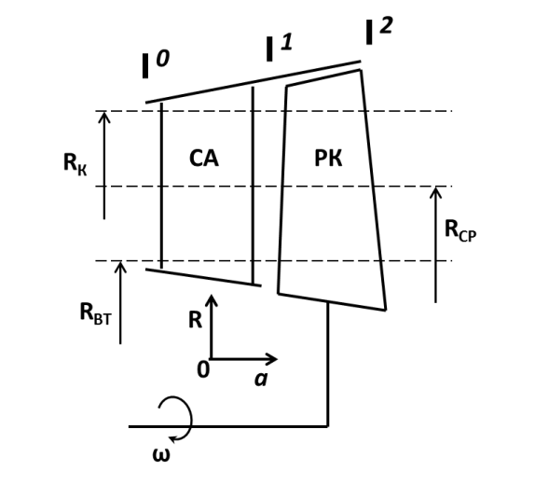
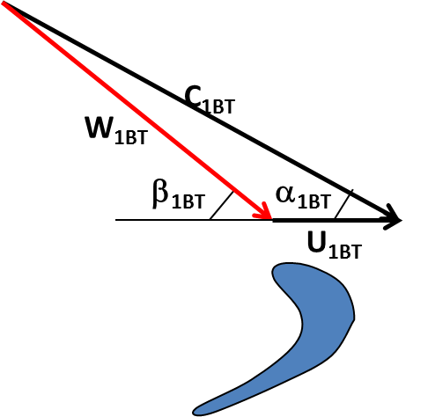
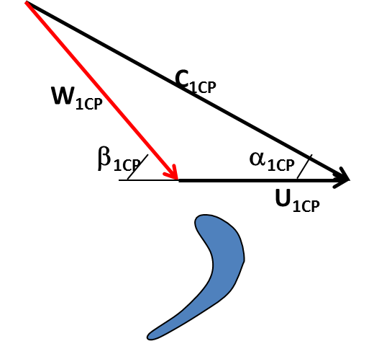


Работа ступеней турбины на разных радиусах
Рассматриваются треугольники скоростей на входе в РК в трех сечениях: периферийном среднем и втулочном
Допущение: абсолютная скорость на входе в РК – постоянна
От радиуса зависит окружная скорость: u=ω⋅r
Втулочное сечение
Среднее сечение
Периферийное сечение
Форма лопатки
По высоте лопатки изменяется угол входа в относительном движении β₁
25
Notes:
1. Pressure drop in NB is subcritical.
In this case, the entire flow is subsonic, absolute velocity is less than critical at any point of the flow (). Consequently, the flow velocity increases and will be the largest in the throat of duct when gas flows from the section 0-0 to section Th-Th. Further, flow velocity decreases, because cross-sectional area of the jet increases. Flow velocity changes more intensively than its density at the values of specific velocity . Consequently, the change in flux density will be determined by the change of velocity. As velocity is maximum in the section Th-Th, then , consequently, . The difference in the intensity of change of velocity and density of the gas increases with the decrease of pressure drop p₀*/p₁ and specific velocity λ_{th}, which leads to the increase in angle α₁. The last is represented as the sum:
5.6.11
where δα - flow deviation angle in wedge cut.
2. Pressure drop in NB will be approximately critical. In this case, near the section Th-Th. The intensity of change of density and velocity is approximately equal for such modes. For this reason , consequently,
3. Pressure drop in NB is supercritical. In this case, velocity from the section 0-0 and Th-Th and in the throat of blade passage is . Since pressure drop further remains very large, jet cross-sectional area increases, the flow velocity increases and becomes supersonic. In the region of supersonic flows, flux density varies intensely than velocity, so change of the flux density is determined by the change in the gas density . It follows from this that GDF q(λ₁) decreases and angle α₁ and δα increase with the increase of p₀*/p₁, and, consequently, of supersonic specific velocity λ₁. Dependence of the flow deflection angle in wedge cut δα from specific velocity at the outlet of turbine cascade λ₁ is shown in Figure 5.6.3.

Slide 26


Работа ступеней турбины на разных радиусах
Как рассчитать изменение параметров по высоте канала?
В этом уравнении две переменных
Для решения необходимо второе уравнение
Обычно применяют уравнение c_{u}=f(r) - закон закрутки
Закон закрутки обычно представляется в виде: c_{u}r^{m}=const
если m=1 - c_{u}r=const – закон постоянства циркуляции
если m=-1 – c_{u}/r=const – закон твердого тела
если m=cos²α₁– α₁=const – закон постоянства угла в абсолютном движении
Как выбрать закон закрутки?
Лопатка должна иметь низкие потери и быть технологичной
26
Notes:
To determine the parameters along the blade height, calculation of radial distribution of the flow parameters is carried out on the basis of equations of three-dimensional model.
It is assumed that the stream lines are straight and their energy (total enthalpy i*) is constant.
Since this equation cannot determine the laws of variation of two variables in it c_{u} and c_{a}, one of them is selected arbitrarily.
The dependence is usually chosen as the law which is called law as swirl.
Selection of the law of swirl is based on various criteria, which include: the nature of change of parameters along the blade height in accordance with the design requirements; providing throughflow capacity of stage; efficiency of stage; technological quality of blades, etc. and technological quality of blades are defining criteria for modern turbines of GTE.
The figure 5.7.2 shows a section of airfoil of cooled turbine vane.
As can be seen from the figure, the cooled blades have developed internal cavities, comprising a large number of turns and cooling intensifiers.
Complex shape of the airfoil complicates the arrangement of all the necessary elements of the cooling system inside the cavities and leads to technological difficulties in casting the blades.
From this point of view, the most expedient law of swirl is , i.e. and . Indeed, the application of this law allows you to perform the nozzle rows with . The law can improve manufacturability of the nozzle row of the next stage.

Slide 27

Работа ступеней компрессора на разных радиусах
Закон постоянства циркуляции α₁=const
Изменение параметров по высоте лопатки при использовании закона α₁=const
Достоинства
Недостатки
Лопатки простой формы
Постоянная по высоте лопатки удельная работа
Возможность появления отрицательной реактивности на втулке
Большие скорости на периферии
Большие потери в радиальном зазоре
27
Notes:
Let us consider the change of the flow parameters along the stage radius under the law and .
Apparently, unfavorable flowing of curve takes place.
In particular, the risk of negative values of degree of reactivity () on the hub and increased values () on the periphery appears for relatively long blades (, resulting in the increased losses in radial gap and "early" flow separation in the hub section.
Dependence behaves similarly (Figure 5.7.3) that can cause supersonic flows in relative motion at the periphery for long blades.
At the same time, the virtual absence of the swirl of the NB blades and weak swirl of the RW blade airfoil are responsible for the preferential application of the law of swirl α = const in cooled stages.

Slide 28



Многоступенчатые турбины
Для получения высоких КПД коэффициент напора ${L_{т}}/{u^{2}}$ должен стремиться к 1
В случае больших работ турбины это требует недопустимых по критериям прочности окружных скоростей u
Получить работоспособную одноступенчатую турбину без потери КПД нельзя
Большую работу с высоким КПД следует получать в многоступенчатых турбинах
28
Notes:
As has been noted before, to achieve high turbine efficiency, it is necessary that the value of head coefficient tends to 1.
In case turbine should produce great work, this leads to the fact that circumferential velocity u will exceed the values which construction is able to withstand.
In such cases, the circumferential velocity must be reduced in order to ensure the turbine functionality, which increases head coefficient and leads to its efficiency decrease.
Thus, it is possible to obtain large turbine work (higher than 250...300 KJ/kg) [1] without the threat of loss of reliability only with low efficiency.
The large work is obtained in several successive stages in order to preserve efficiency at high level.

Slide 29


Многоступенчатые турбины
Достоинства
Коэффициенты напора в ступенях приближаются к оптимальным
Выходная скорость одной ступени полезно используется в другой
Нагрев газа из-за потерь позволяет увеличить получаемую работу в последующих ступенях (возврат тепла)
КПД многоступенчатой турбины больше КПД ступени
Недостатки
Сложность конструкции
Усложняется система охлаждения из-за большего числа охлаждаемых ступеней
Большие размеры
Большая масса
29
Notes:
The transition to the multistage turbine makes it possible to reduce the work of the individual stages, and to bring the value of head coefficient to the optimum for each of them, which will favorably affect their performance.
Other advantages of multistage turbines include the following:
kinetic energy of outlet velocity, which is the loss for the stage, can be converted into useful work in subsequent stages (except the last);
gas heating, occurring due to internal losses in the stage, increases the work of the subsequent stages.
The latter circumstance is the reason that the multistage turbine efficiency is greater than the average efficiency of stages, of which it is consist.
The main disadvantages of multistage turbine are as follows.
presence of several of stages complicates the design, increases the complexity of manufacturing and cost;
preservation of high temperature of the gas in several stages due to the "slow" response of heat drop. In the case of high-temperature turbines, latter circumstance complicates the cooling system, making to do cooled 2...3 stages.
However, despite these disadvantages, multistage turbines are widely used in GTE where the requirements of obtaining high η_{т}* come to the fore.
Поток направляется на следующий венец под конструктивным углом

Slide 30



Многоступенчатые турбины
Связь параметров многоступенчатой турбины с параметрами ступеней
Работа турбины:
$$L_{т}^{∗}=i_{г}^{∗}−i_{т}^{∗},=L_{cтI}^{∗}+…+L_{cтz}^{∗}=\sum_{i=1}^{z}{L_{cтi}^{∗}}$$
Степень расширения газа:
$$π_{т}^{∗}=\frac{p_{г}^{∗}}{p_{т}^{∗}}=π_{cтI}^{∗}π_{cтII}^{∗}…π_{cтz}^{∗}=\prod_{i=1}^{z}{π_{cтz}^{∗}}$$
Располагаемый теплоперепад:
$$\sum_{i=1}^{z}{{L_{стsi}}^{∗}}>{L_{тs}}^{∗}=i_{Г}^{∗}−{i_{т}}^{∗}$$
КПД многоступенчатой турбины
$$η_{т}^{∗}=\frac{\sum_{i=1}^{z}{{L_{стsi}}^{∗}η_{cтi}^{∗}}}{{L_{тs}}^{∗}}$$
P-v диаграмма многоступенчатого расширения
Связь КПД турбины с КПД ступени
КПД турбины больше
КПД ступени !!!
30
Notes:
Multi-stage turbine can be characterized with the same parameters as one stage, or similar items.
Let us consider these options and establish its connection with the parameters of separate stages.
Thermodynamic parameters are of particular interest
Expansion ratio in the turbine is determined either by the static pressure at the outlet , or by the total pressure (is more often used in thermodynamic
Thus, the expansion ratio of multistage turbine is a product of expansion ratios of stages, from which it is composed.
Work of on the turbine shaft in accordance with energy equation is equal to the sum of the work of stages (Figure 5.8.3):
Thus, work on the shaft of multistage turbine is a sum works of stages, from which it is composed.
This work as well as π_{т}*, is used in the thermodynamic calculations of GTE as the whole.
Available heat drop in the turbine is determined in the same way as in stage. It can be determined (see. Fig. 5.5) from expression
5.8.5
On the other hand, it is expedient to take into account the fact that the gas exiting the turbine rotor blades, has a velocity с_{т}; the kinetic energy of the gas may be effectively used in jet engine nozzle. Therefore, available heat drop can be considered as:
5.8.6
Available heat drop in the turbine as a whole is not equal to the sum of available heat drops in its stages. Due to the fact that the temperature (and enthalpy, respectively) of the gas at the inlet of each subsequent stage in the real process is higher than in the ideal (see. Fig. 5.5), available heat drop respectively increases in them. Indeed,
, since , then . From which it follows:
5.8.7
The difference
5.8.8
is called recovered heat. Then expression (5.8.8) can be written as follows:
5.8.9
or in more convenient form:
5.8.10
where - reheat factor. For turbines of modern GTE, α is 2...4% and depends on z_{т} and π_{т}* [1].
Connection of multistage turbine efficiency with efficiency of stages can be found using reheat factor α. We note first used effective (power) which is determined by the ratio L*_{т} / is most commonly that in the calculation of multistage turbines.
Consequently,η_{т}* is approximately (1+α) times higher than the average efficiency of stages because of heat recovery and depends (similar to α) on values π*_{т}, z_{т} and η*₀. The approximate view of dependence η_{т}* = f(η*_{st}, π*_{т}, z_{т}) is shown in Figure 5.8.4. Apparently, difference between π*_{т} and z_{т} increases with increasing π*_{т} and z_{т}. This is easily explained by the fact that with increasing π*_{т} and z_{т} reheat factor α increases and, consequently, η_{т}*compared to η*_{st}.

Slide 31
Многоступенчатые турбины
Распределение удельных работ между ступенями турбины
Число ступеней турбины | 1 | 2 | 3 | Z-1 | Z
Ступень
1 | 100%
2 | 60% | 40%
3 | 40% | 35% | 25%
>3 | L_{ст}≈L_{ст ср} | L_{ст}≈L_{ст ср} | L_{ст}≈L_{ст ср} | L_{ст}≈L_{ст ср} | L_{ст}=(0,8…0,9)L_{ст ср}
Мотивация
Быстрое снижение температуры на выходе
Обеспечение осевого выхода потока из турбины
31

Slide 32

БЛАГОДАРЮ
ЗА ВНИМАНИЕ
Батурин Олег Витальевич
443086 г. Самара, Московское шоссе 34, комн. 336-5 Tel: (846)267-45-94
oleg.v.baturin@gmail.com
10

